Slide 1

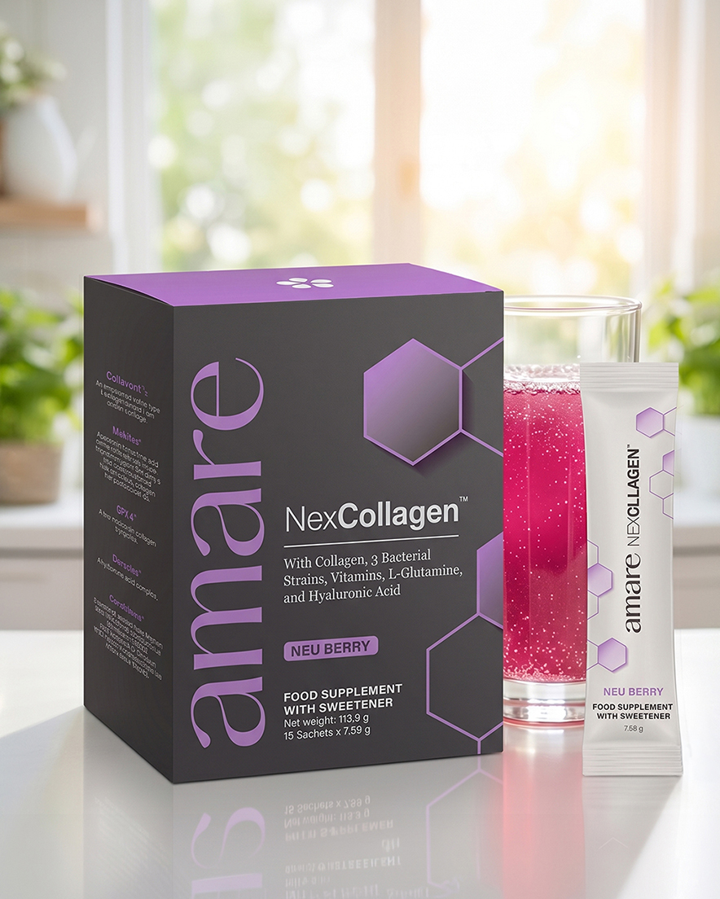


NexCollagen™
1
Copyright © 2026 Amare Global. All rights reserved.

Slide 2
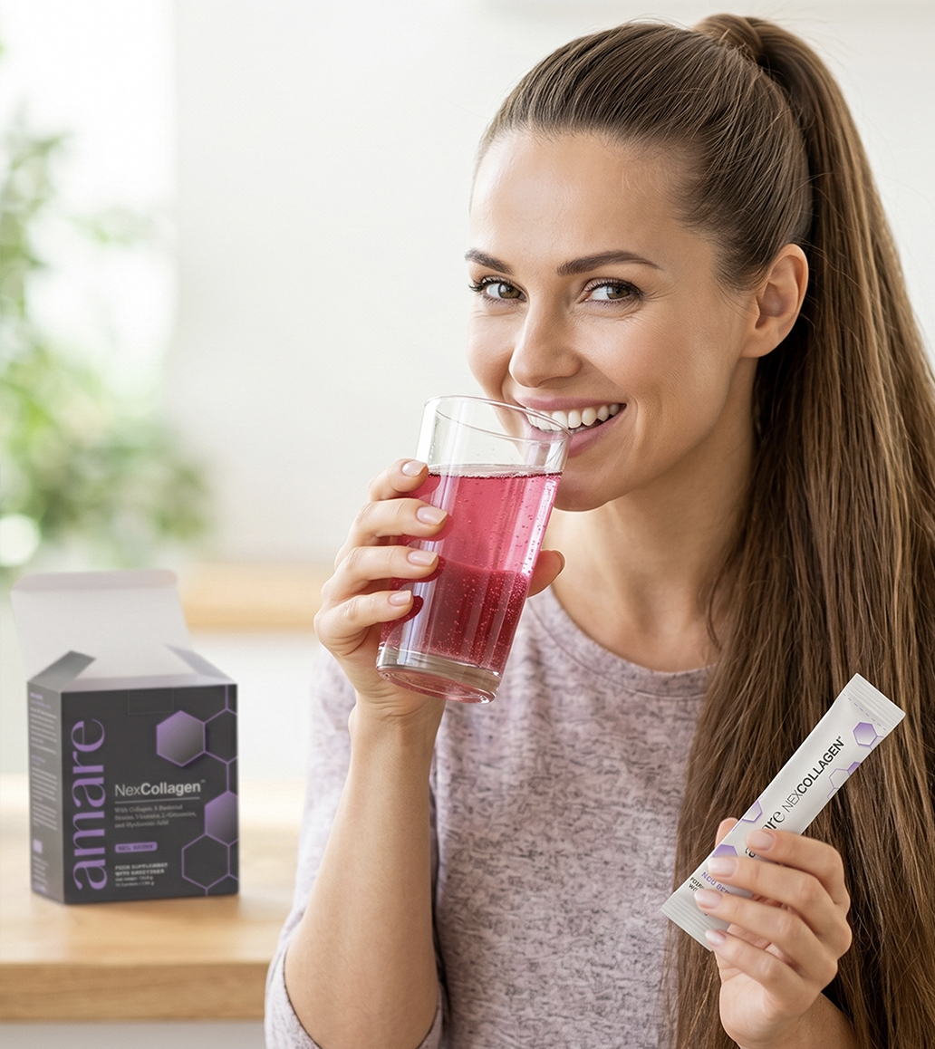
Amare NexCollagen™
What It Is?
A multi-ingredient formula containing collagen peptides, hyaluronic acid, live bacterial cultures, amino acids, and key vitamins as part of a balanced diet and healthy lifestyle.
The formula includes collagen peptide, Collavant® n2 native type II collagen, GPX-4™ collagen tripeptides, Mobilee® hyaluronic acid matrix, and Cerebiome® live bacterial cultures, alongside vitamin C, biotin, and vitamin B12.
Vitamin C contributes to normal collagen formation for the normal function of skin, bones, and cartilage. Biotin contributes to the maintenance of normal skin and hair. Vitamin B12 contributes to the reduction of tiredness and fatigue and to normal psychological function.*
*DISCLAIMER: Food supplements are not a substitute for a varied and balanced diet and a healthy lifestyle. Do not exceed the recommended daily dose. Keep out of the reach of young children. If you are pregnant, breastfeeding, taking prescribed medication, or have a medical condition, consult your doctor or pharmacist before use. The stated benefits of vitamin C, biotin, and vitamin B12 apply when the product is consumed as part of a balanced diet and provides these vitamins in amounts that contribute at least 15% of the nutrient reference value per serving.
2
Copyright © 2026 Amare Global. All rights reserved.

Slide 3
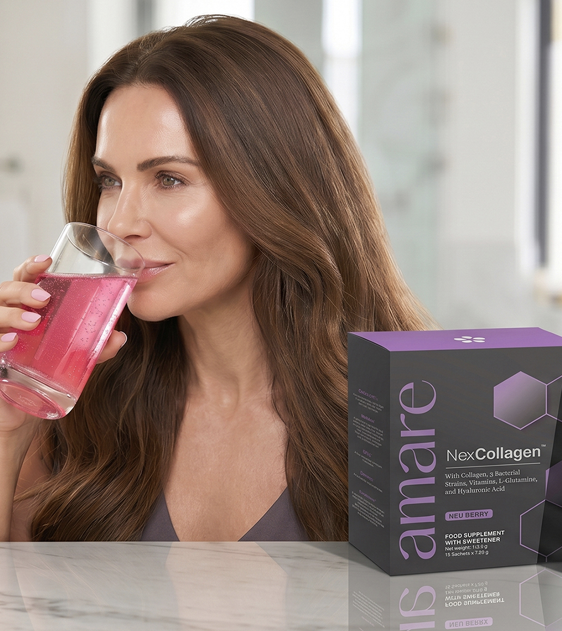

Amare NexCollagen™
Why You Need It?
Collagen is a structural protein naturally present throughout the body, including in skin, cartilage, bones, and connective tissues. It is one of the most abundant proteins in the human body and contributes to the structural composition of these tissues.
Maintaining a varied and balanced diet that provides adequate vitamin C, biotin, and vitamin B12 supports normal physiological processes including collagen formation, as well as the maintenance of normal skin and hair.
Amare NexCollagen is a food supplement providing collagen peptides alongside these key vitamins, formulated to complement a balanced diet and healthy lifestyle.
*DISCLAIMER: Food supplements are not a substitute for a varied and balanced diet and a healthy lifestyle. Do not exceed the recommended daily dose. Keep out of the reach of young children. If you are pregnant, breastfeeding, taking prescribed medication, or have a medical condition, consult your doctor or pharmacist before use. The stated benefits of vitamin C, biotin, and vitamin B12 apply when the product is consumed as part of a balanced diet and provides these vitamins in amounts that contribute at least 15% of the nutrient reference value per serving.
3
3
3
3
Copyright © 2026 Amare Global. All rights reserved.

Slide 4
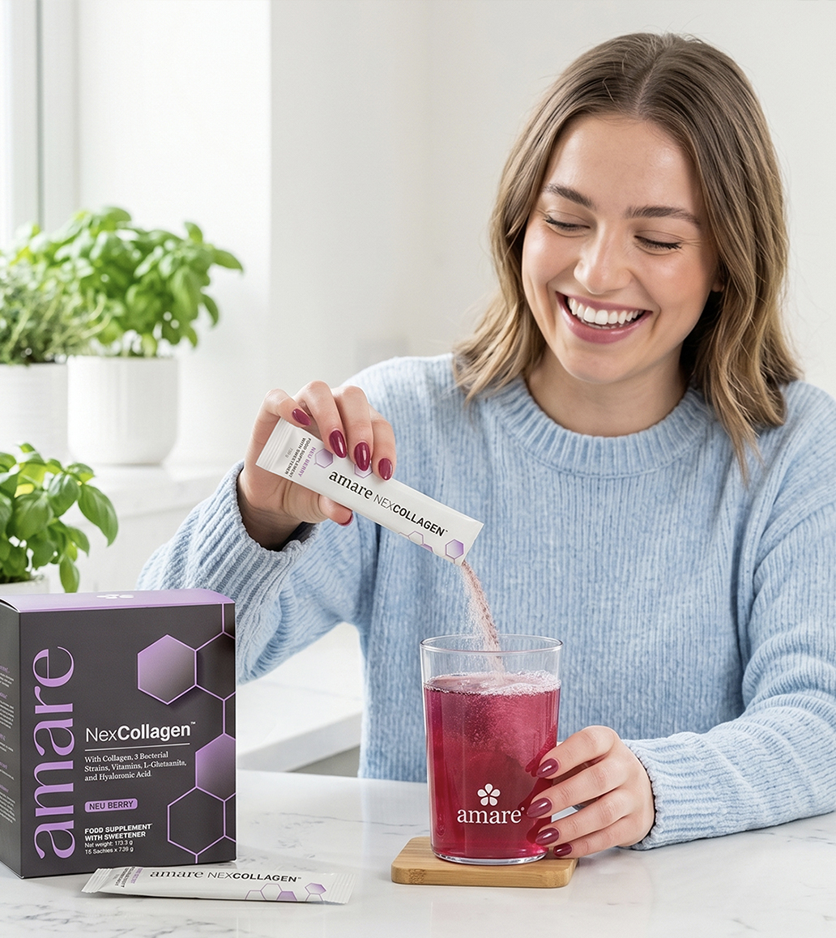
Amare NexCollagen™
How It Works?
Amare NexCollagen brings together five key ingredient groups in a single daily serving:
1. Collagen Peptide Complex
Collavant® n2 (native type II collagen), Collagen peptide, and GPX-4™ (collagen tripeptides) together provide the collagen peptide content of the formula.
2. Hyaluronic Acid Matrix
Mobilee® provides a source of hyaluronic acid, a substance naturally present in the body's connective tissues.
*DISCLAIMER: Food supplements are not a substitute for a varied and balanced diet and a healthy lifestyle. Do not exceed the recommended daily dose. Keep out of the reach of young children. If you are pregnant, breastfeeding, taking prescribed medication, or have a medical condition, consult your doctor or pharmacist before use. The stated benefits of vitamin C, biotin, and vitamin B12 apply when the product is consumed as part of a balanced diet and provides these vitamins in amounts that contribute at least 15% of the nutrient reference value per serving.
4
Copyright © 2026 Amare Global. All rights reserved.

Slide 5
Amare NexCollagen™
How It Works?
3. Live Bacterial Cultures
Cerebiome® contributes Lactobacillus helveticus R0052, Bifidobacterium longum R0175, and Lacticaseibacillus rhamnosus R0011 to the formula's ingredient composition.
4. Amino Acids
The formula includes L-glutamine and additional amino acids as part of its nutritional composition.
*DISCLAIMER: Food supplements are not a substitute for a varied and balanced diet and a healthy lifestyle. Do not exceed the recommended daily dose. Keep out of the reach of young children. If you are pregnant, breastfeeding, taking prescribed medication, or have a medical condition, consult your doctor or pharmacist before use. The stated benefits of vitamin C, biotin, and vitamin B12 apply when the product is consumed as part of a balanced diet and provides these vitamins in amounts that contribute at least 15% of the nutrient reference value per serving.
5
Copyright © 2026 Amare Global. All rights reserved.

Slide 6
Amare NexCollagen™
How It Works?
5. Key Vitamins
Vitamin C contributes to normal collagen formation for the normal function of skin, bones, and cartilage. Biotin contributes to the maintenance of normal skin and hair. Vitamin B12 contributes to the reduction of tiredness and fatigue and to normal psychological function.*
*DISCLAIMER: Food supplements are not a substitute for a varied and balanced diet and a healthy lifestyle. Do not exceed the recommended daily dose. Keep out of the reach of young children. If you are pregnant, breastfeeding, taking prescribed medication, or have a medical condition, consult your doctor or pharmacist before use. The stated benefits of vitamin C, biotin, and vitamin B12 apply when the product is consumed as part of a balanced diet and provides these vitamins in amounts that contribute at least 15% of the nutrient reference value per serving.
6
Copyright © 2026 Amare Global. All rights reserved.

Slide 7
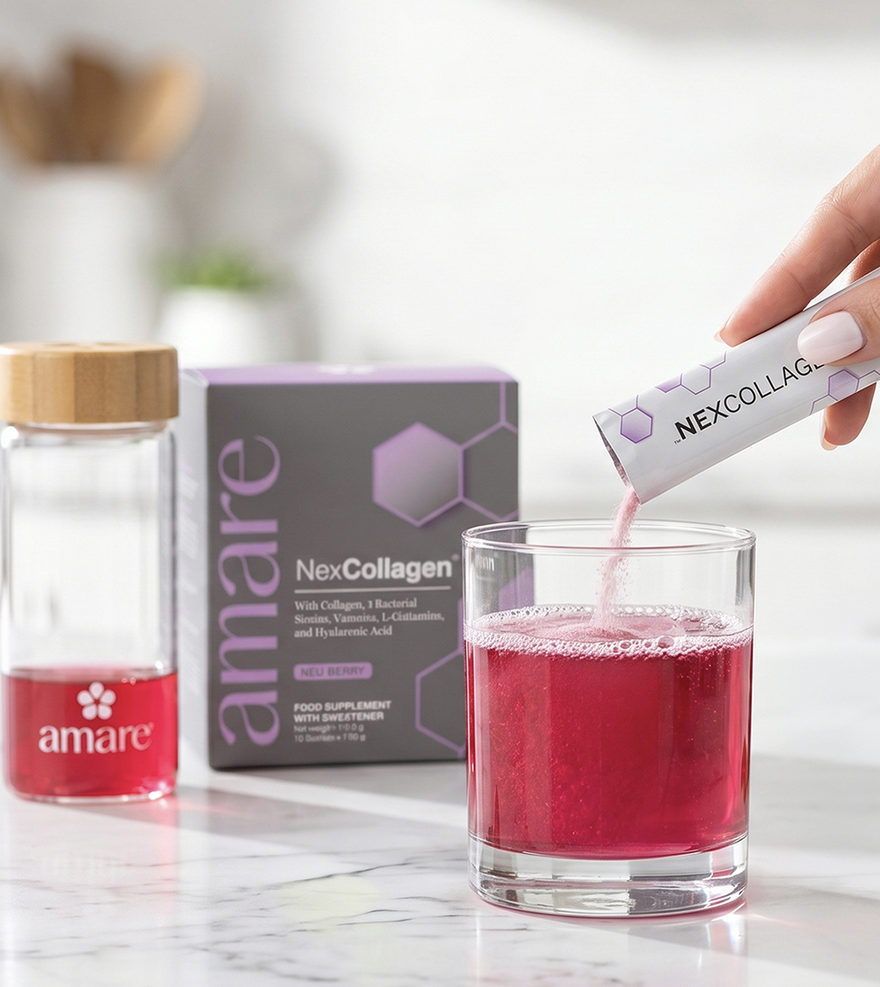
Amare NexCollagen™
How To Use?
Mix one stick pack into 240-350 ml water or beverage of choice. The amount of liquid used does not impact the product’s efficacy, so you can adjust the water level to achieve your preferred taste and concentration. Do not add to boiling or scalding temperatures. Store in a cool, dry place.
WARNINGS: Keep out of reach of children. This product is for 18+. Consult a physician if you are pregnant or nursing; have or had a medical condition; or are taking prescription drugs.
*DISCLAIMER: Food supplements are not a substitute for a varied and balanced diet and a healthy lifestyle. Do not exceed the recommended daily dose. Keep out of the reach of young children. If you are pregnant, breastfeeding, taking prescribed medication, or have a medical condition, consult your doctor or pharmacist before use. The stated benefits of vitamin C, biotin, and vitamin B12 apply when the product is consumed as part of a balanced diet and provides these vitamins in amounts that contribute at least 15% of the nutrient reference value per serving.
7
Copyright © 2026 Amare Global. All rights reserved.

Slide 8
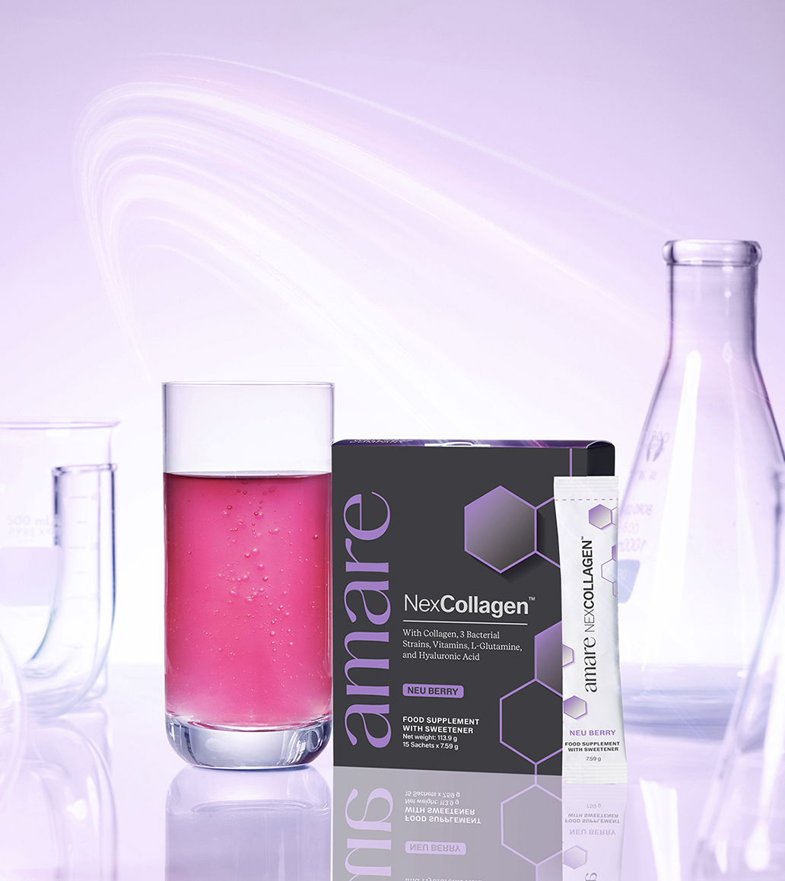
Amare NexCollagen™
The SCIENCE of NexCollagen™
Amare NexCollagen™ combines three sources of collagen peptides — providing Type I, Type II, and Type III collagen — with a hyaluronic acid matrix, live bacterial cultures, amino acids, and vitamins in a single daily formula.
The formula was developed by Amare's R&D team and includes Collavant® n2, Collagen peptides, GPX-4™, Mobilee®, and Cerebiome®, alongside L-glutamine, biotin, vitamin C, and vitamin B12.
Vitamin C contributes to normal collagen formation for the normal function of skin, bones, and cartilage. Biotin contributes to the maintenance of normal skin and hair. Vitamin B12 contributes to the reduction of tiredness and fatigue and to normal psychological function.*
*DISCLAIMER: Food supplements are not a substitute for a varied and balanced diet and a healthy lifestyle. Do not exceed the recommended daily dose. Keep out of the reach of young children. If you are pregnant, breastfeeding, taking prescribed medication, or have a medical condition, consult your doctor or pharmacist before use. The stated benefits of vitamin C, biotin, and vitamin B12 apply when the product is consumed as part of a balanced diet and provides these vitamins in amounts that contribute at least 15% of the nutrient reference value per serving.
8
Copyright © 2026 Amare Global. All rights reserved.

Slide 9
Amare NexCollagen™
The SCIENCE of NexCollagen™
The information provided on this page about specific named ingredients is derived from scientific studies conducted on those individual ingredients. These studies were not performed directly on Amare NexCollagen. Findings from ingredient studies should not be interpreted as direct evidence of the effects of this product.
*DISCLAIMER: Food supplements are not a substitute for a varied and balanced diet and a healthy lifestyle. Do not exceed the recommended daily dose. Keep out of the reach of young children. If you are pregnant, breastfeeding, taking prescribed medication, or have a medical condition, consult your doctor or pharmacist before use. The stated benefits of vitamin C, biotin, and vitamin B12 apply when the product is consumed as part of a balanced diet and provides these vitamins in amounts that contribute at least 15% of the nutrient reference value per serving.
9
Copyright © 2026 Amare Global. All rights reserved.

Slide 10
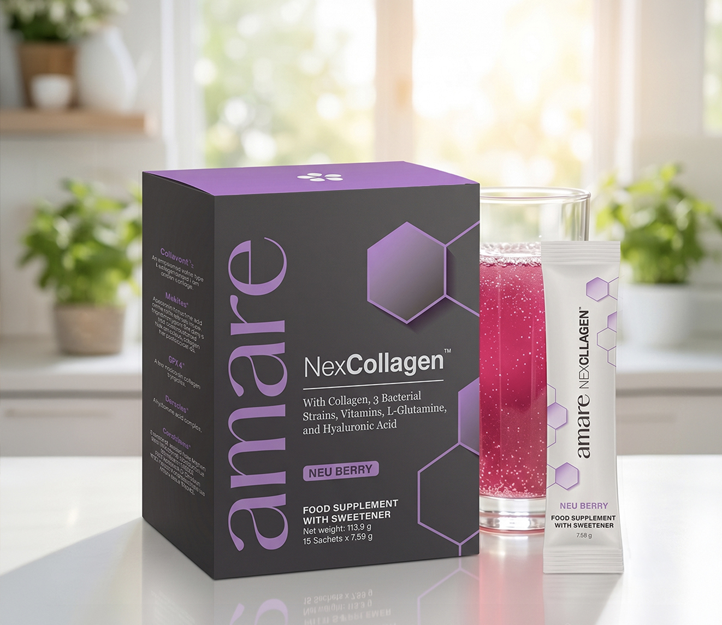

Amare NexCollagen™
Key Features

Slide 11

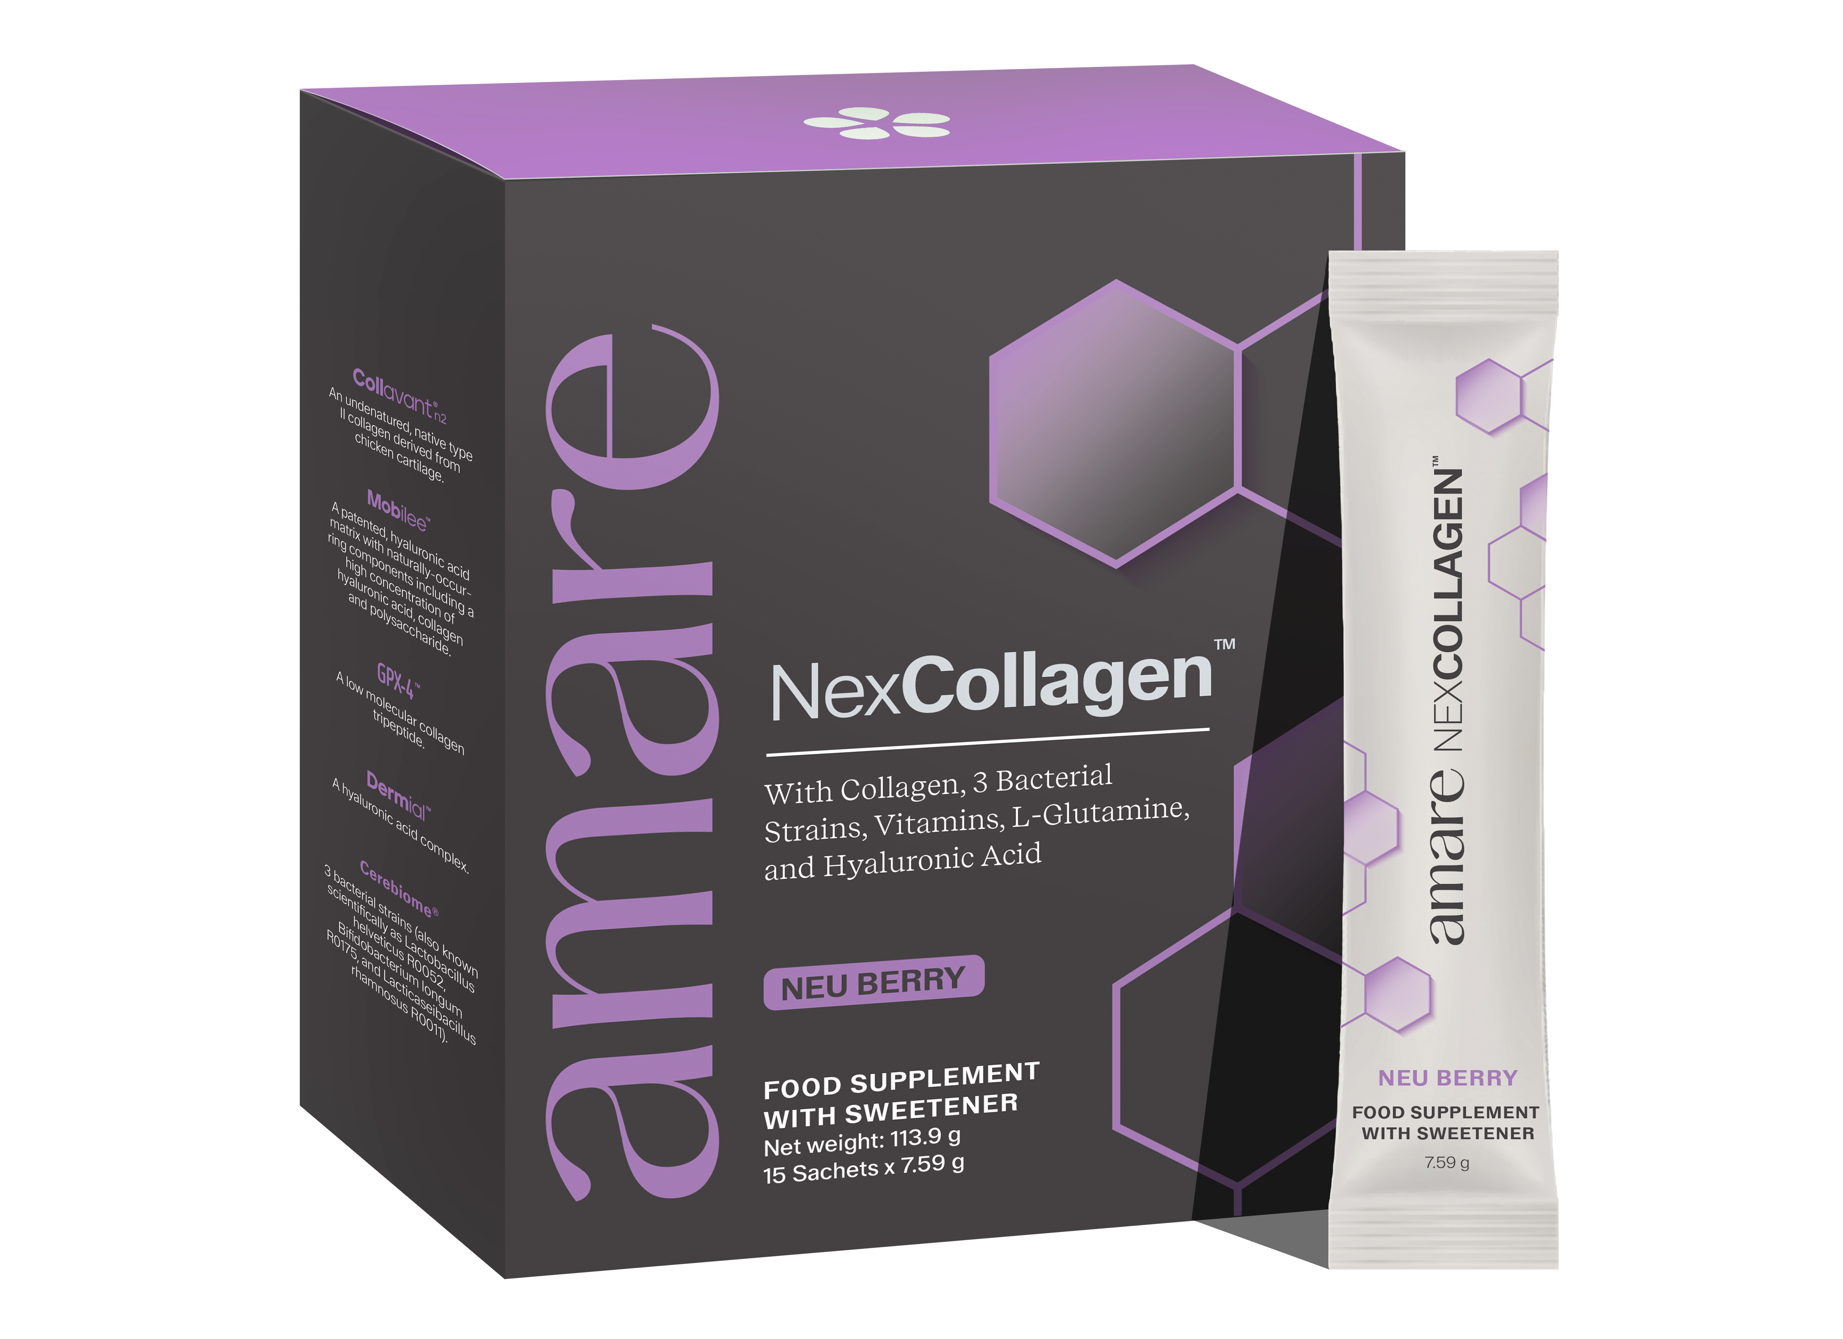



Amare NexCollagen™
Bones
Key Benefits
Vitamin C contributes to normal collagen formation for the normal function of bones.
Cartilage
Vitamin C contributes to normal collagen formation for the normal function of cartilage.
Immune System
Vitamin C and Vitamin B12 contribute to the normal function of the immune system.
Hair
*DISCLAIMER: Food supplements are not a substitute for a varied and balanced diet and a healthy lifestyle. Do not exceed the recommended daily dose. Keep out of the reach of young children. If you are pregnant, breastfeeding, taking prescribed medication, or have a medical condition, consult your doctor or pharmacist before use. The stated benefits of vitamin C, biotin, and vitamin B12 apply when the product is consumed as part of a balanced diet and provides these vitamins in amounts that contribute at least 15% of the nutrient reference value per serving.
Biotin contributes to the maintenance of normal hair.
11
Copyright © 2026 Amare Global. All rights reserved.

Slide 12


Amare NexCollagen™
Skin
Key Benefits
Vitamin C contributes to normal collagen formation for the normal function of skin.
Biotin contributes to the maintenance of normal skin
Brain
Vitamin C, Biotin and Vitamin B12 contribute to normal functioning of the nervous system.
*DISCLAIMER: Food supplements are not a substitute for a varied and balanced diet and a healthy lifestyle. Do not exceed the recommended daily dose. Keep out of the reach of young children. If you are pregnant, breastfeeding, taking prescribed medication, or have a medical condition, consult your doctor or pharmacist before use. The stated benefits of vitamin C, biotin, and vitamin B12 apply when the product is consumed as part of a balanced diet and provides these vitamins in amounts that contribute at least 15% of the nutrient reference value per serving.
12
Copyright © 2026 Amare Global. All rights reserved.

Slide 13
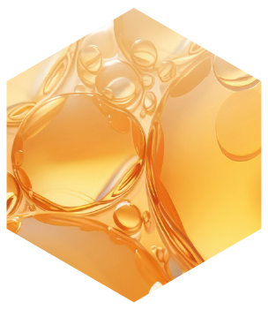
Amare NexCollagen™
Collavant® n2 (native type II collagen)
Key Ingredients
Collavant® n2 is an undenatured native type II collagen derived from chicken sternum, produced using a proprietary manufacturing process developed by BIOIBERICA, S.A.U.
Native type II collagen retains its natural triple-helix structure and is used as an ingredient in food supplement formulations.
Collavant® n2 is used in Amare formulations in combination with Mobilee®. Collavant® n2 is a registered trademark licensed by BIOIBERICA, S.A.U.
*DISCLAIMER: Food supplements are not a substitute for a varied and balanced diet and a healthy lifestyle. Do not exceed the recommended daily dose. Keep out of the reach of young children. If you are pregnant, breastfeeding, taking prescribed medication, or have a medical condition, consult your doctor or pharmacist before use. The stated benefits of vitamin C, biotin, and vitamin B12 apply when the product is consumed as part of a balanced diet and provides these vitamins in amounts that contribute at least 15% of the nutrient reference value per serving.
13
Copyright © 2026 Amare Global. All rights reserved.

Slide 14
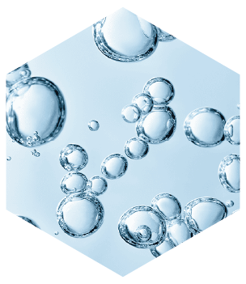
Amare NexCollagen™
Mobilee® (hyaluronic acid matrix)
Key Ingredients
Mobilee® is a patented hyaluronic acid matrix ingredient developed by BIOIBERICA, S.A.U. Hyaluronic acid is a substance naturally present in the body's connective tissues.
Mobilee® is used in Amare formulations in combination with Collavant® n2 as part of the formula's collagen and hyaluronic acid ingredient system.
Mobilee® is a registered trademark licensed by BIOIBERICA, S.A.U.
*DISCLAIMER: Food supplements are not a substitute for a varied and balanced diet and a healthy lifestyle. Do not exceed the recommended daily dose. Keep out of the reach of young children. If you are pregnant, breastfeeding, taking prescribed medication, or have a medical condition, consult your doctor or pharmacist before use. The stated benefits of vitamin C, biotin, and vitamin B12 apply when the product is consumed as part of a balanced diet and provides these vitamins in amounts that contribute at least 15% of the nutrient reference value per serving.
14
Copyright © 2026 Amare Global. All rights reserved.

Slide 15
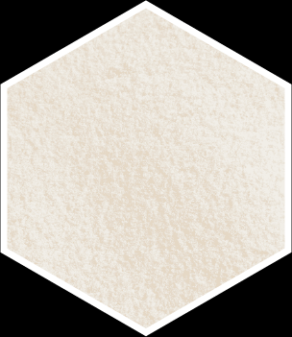
Amare NexCollagen™
GPX-4™ (collagen tripeptides)
Key Ingredients
GPX-4™ is a low molecular weight collagen tripeptide ingredient manufactured by Newtree Co. Ltd. Collagen tripeptides are a form of hydrolysed collagen characterised by their small molecular size.
GPX-4™ contributes to the collagen peptide profile of the Amare NexCollagen formula.
GPX-4™ is an exclusive ingredient in Amare formulations and is a licensed trademark of Newtree Co. Ltd.
*DISCLAIMER: Food supplements are not a substitute for a varied and balanced diet and a healthy lifestyle. Do not exceed the recommended daily dose. Keep out of the reach of young children. If you are pregnant, breastfeeding, taking prescribed medication, or have a medical condition, consult your doctor or pharmacist before use. The stated benefits of vitamin C, biotin, and vitamin B12 apply when the product is consumed as part of a balanced diet and provides these vitamins in amounts that contribute at least 15% of the nutrient reference value per serving.
15
Copyright © 2026 Amare Global. All rights reserved.

Slide 16
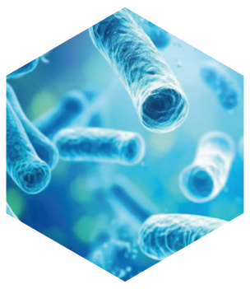
Amare NexCollagen™
Cerebiome® (live bacterial cultures)
Key Ingredients
Cerebiome® is a proprietary blend of live bacterial cultures developed by Danstar Ferment AG, comprising Lactobacillus helveticus R0052, Bifidobacterium longum R0175, and Lacticaseibacillus rhamnosus R0011.
These strains are included as part of the multi-ingredient composition of Amare NexCollagen.
Cerebiome® is a registered trademark of Danstar Ferment AG.
*DISCLAIMER: Food supplements are not a substitute for a varied and balanced diet and a healthy lifestyle. Do not exceed the recommended daily dose. Keep out of the reach of young children. If you are pregnant, breastfeeding, taking prescribed medication, or have a medical condition, consult your doctor or pharmacist before use. The stated benefits of vitamin C, biotin, and vitamin B12 apply when the product is consumed as part of a balanced diet and provides these vitamins in amounts that contribute at least 15% of the nutrient reference value per serving.
16
Copyright © 2026 Amare Global. All rights reserved.

Slide 17
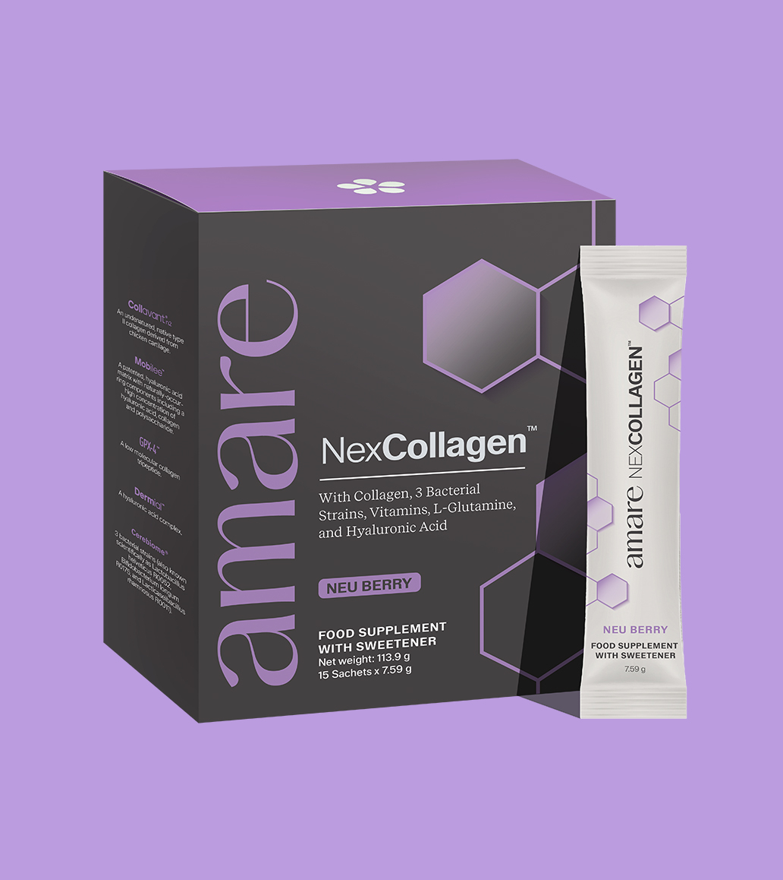
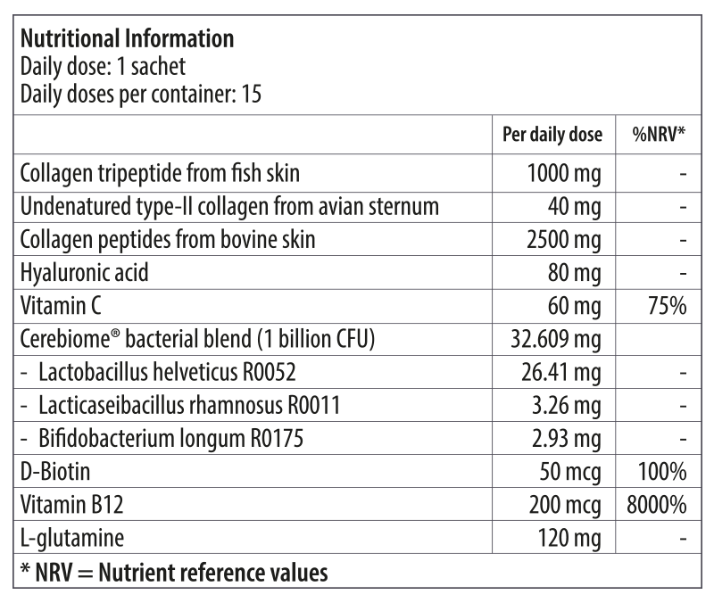
Amare NexCollagen™
Nutritional Information
17
17
17
Copyright © 2026 Amare Global. All rights reserved.

Slide 18
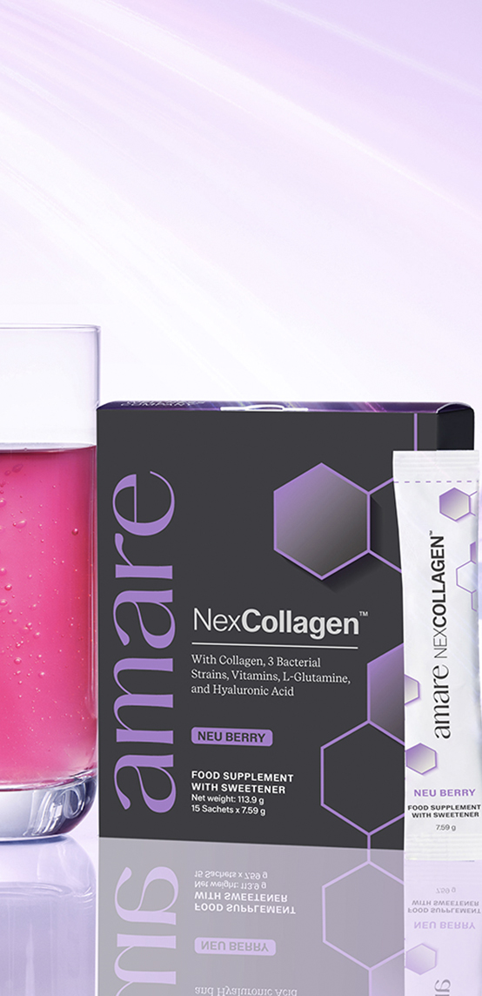
Amare NexCollagen™
Ingredients
Collagen peptides from bovine skin, collagen tripeptide from FISH skin, flavouring, acidity regulator: citric acid, flavouring, flavouring, flavouring, L-glutamine, red beetroot (Beta vulgaris L., root) powder for color, sweetener: steviol glycosides from Stevia, hyaluronic acid, vitamin C (L-ascorbic acid), mixed carrot (Daucus carota L., root) and blueberry (Vaccinium corymbosum L., fruit) powder for color, undenatured type-II collagen from avian sternum, Cerebiome® bacterial blend (Lactobacillus helveticus R0052, Bifidobacterium longum R0175, Lacticaseibacillus rhamnosus R0011) (SOY), vitamin B12 (methylcobalamin), Biotin (D-Biotin).
Collavant® n2, Dermial ®, and Mobilee ® are licensed trademarks licensed by BIOBERICA, S.A.U.
GPX-4™ is a licensed trademark of Newtree Co. LTD,
CereBiome® is a registered trademark of Danstar Ferment AG.
18
18
18
Copyright © 2026 Amare Global. All rights reserved.

Slide 19
You can reach out product brochure in your official language: NexCollagen™ EU Product Brochure
For More Please Check Out
www.amare.com

