Slide 1
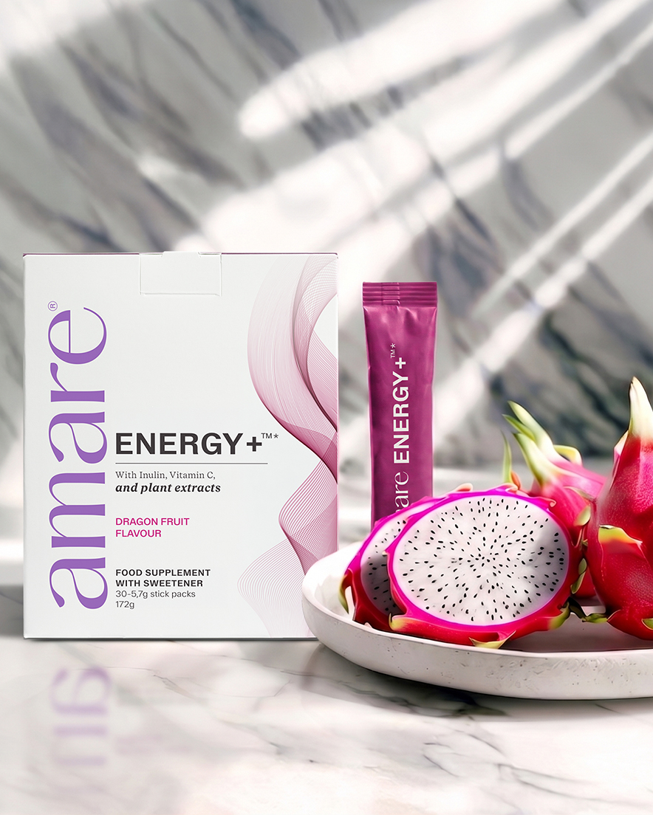


ENERGY+™
1
Copyright © 2026 Amare Global. All rights reserved.

Slide 2
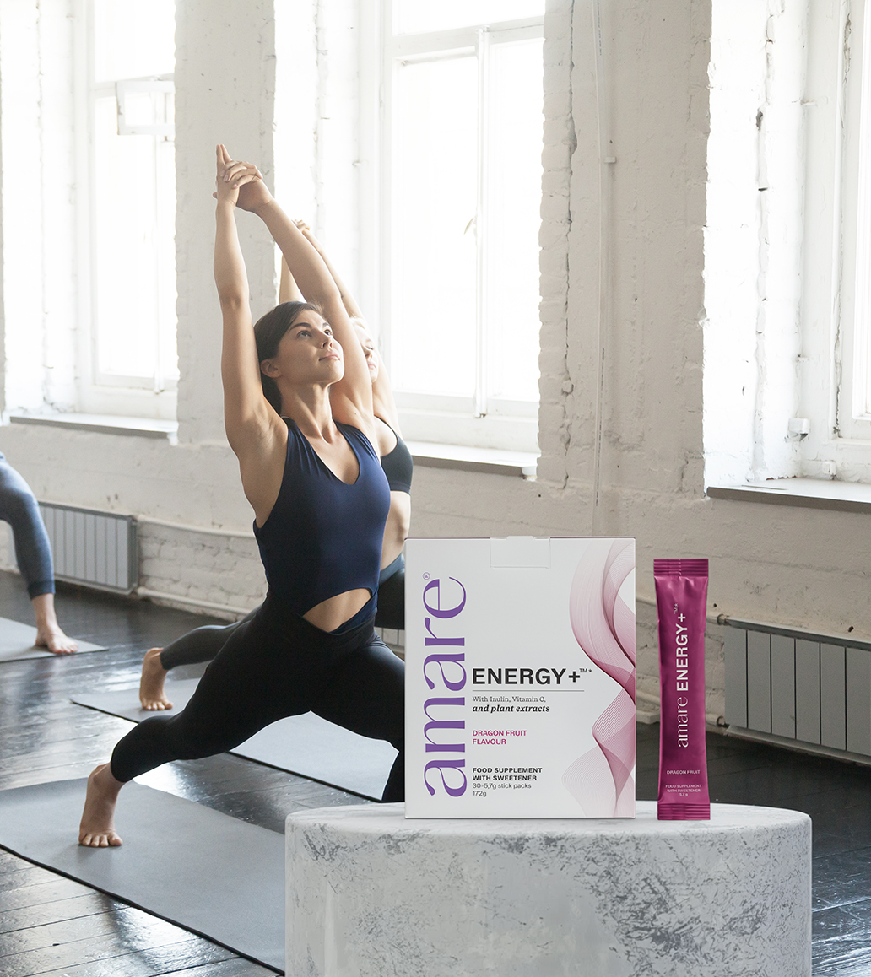
Amare ENERGY+™
What It Is?
Amare ENERGY+™ Dragon Fruit is a naturally inspired food supplement designed to support your daily vitality.
Formulated with inulin, a non-digestible fibre and L-glycine, an amino acid. It also contains vitamin C, which contributes to normal energy-yielding metabolism, the normal function of the immune systemto the protection of cells from oxidative stress.
Enriched with botanical extracts from apple, grape seed, maritime pine bark and pomegranate, the formula provides plant-derived polyphenols. These ingredients are complemented by the refreshing dragon fruit flavour, sweetened with steviol glycosides from stevia, and free from added sugar.
*DISCLAIMER: Amare products do not claim to diagnose, treat, cure, or prevent any disease or medical condition. Statements regarding vitamins and minerals are valid only when these nutrients are present in the supplement in amounts specified by relevant EU regulations. The provided information is based on scientific studies of individual ingredients contained within Amare products. These studies have not directly examined Amare products themselves; thus, no direct relationship should be inferred between these study findings and Amare products. Food supplements must not be used as a substitute for a varied and balanced diet and a healthy lifestyle. If you are pregnant, breastfeeding, taking any medications or under medical supervision, please consult a doctor or healthcare professional before use. Keep out of reach of young children. Do not exceed the recommended daily dose. Should not be consumed by children under 12 years of age. For adults only.
2
Copyright © 2026 Amare Global. All rights reserved.

Slide 3
Amare ENERGY+™
What It Is?
Crafted to fit modern wellness lifestyles, this supplement supports a balanced daily routine focused on vitality and well-being.
Amare ENERGY+™ Dragon Fruit is a food supplement that combines vitamin C, inulin, L-glycine and carefully selected plant extracts, presented in convenient, ready-to-mix sachets with a light dragon fruit flavour.
Sweetened with steviol glycosides from stevia, it contains no added sugars and offers a clean, fruity taste.
*DISCLAIMER: Amare products do not claim to diagnose, treat, cure, or prevent any disease or medical condition. Statements regarding vitamins and minerals are valid only when these nutrients are present in the supplement in amounts specified by relevant EU regulations. The provided information is based on scientific studies of individual ingredients contained within Amare products. These studies have not directly examined Amare products themselves; thus, no direct relationship should be inferred between these study findings and Amare products. Food supplements must not be used as a substitute for a varied and balanced diet and a healthy lifestyle. If you are pregnant, breastfeeding, taking any medications or under medical supervision, please consult a doctor or healthcare professional before use. Keep out of reach of young children. Do not exceed the recommended daily dose. Should not be consumed by children under 12 years of age. For adults only.
3
Copyright © 2026 Amare Global. All rights reserved.

Slide 4
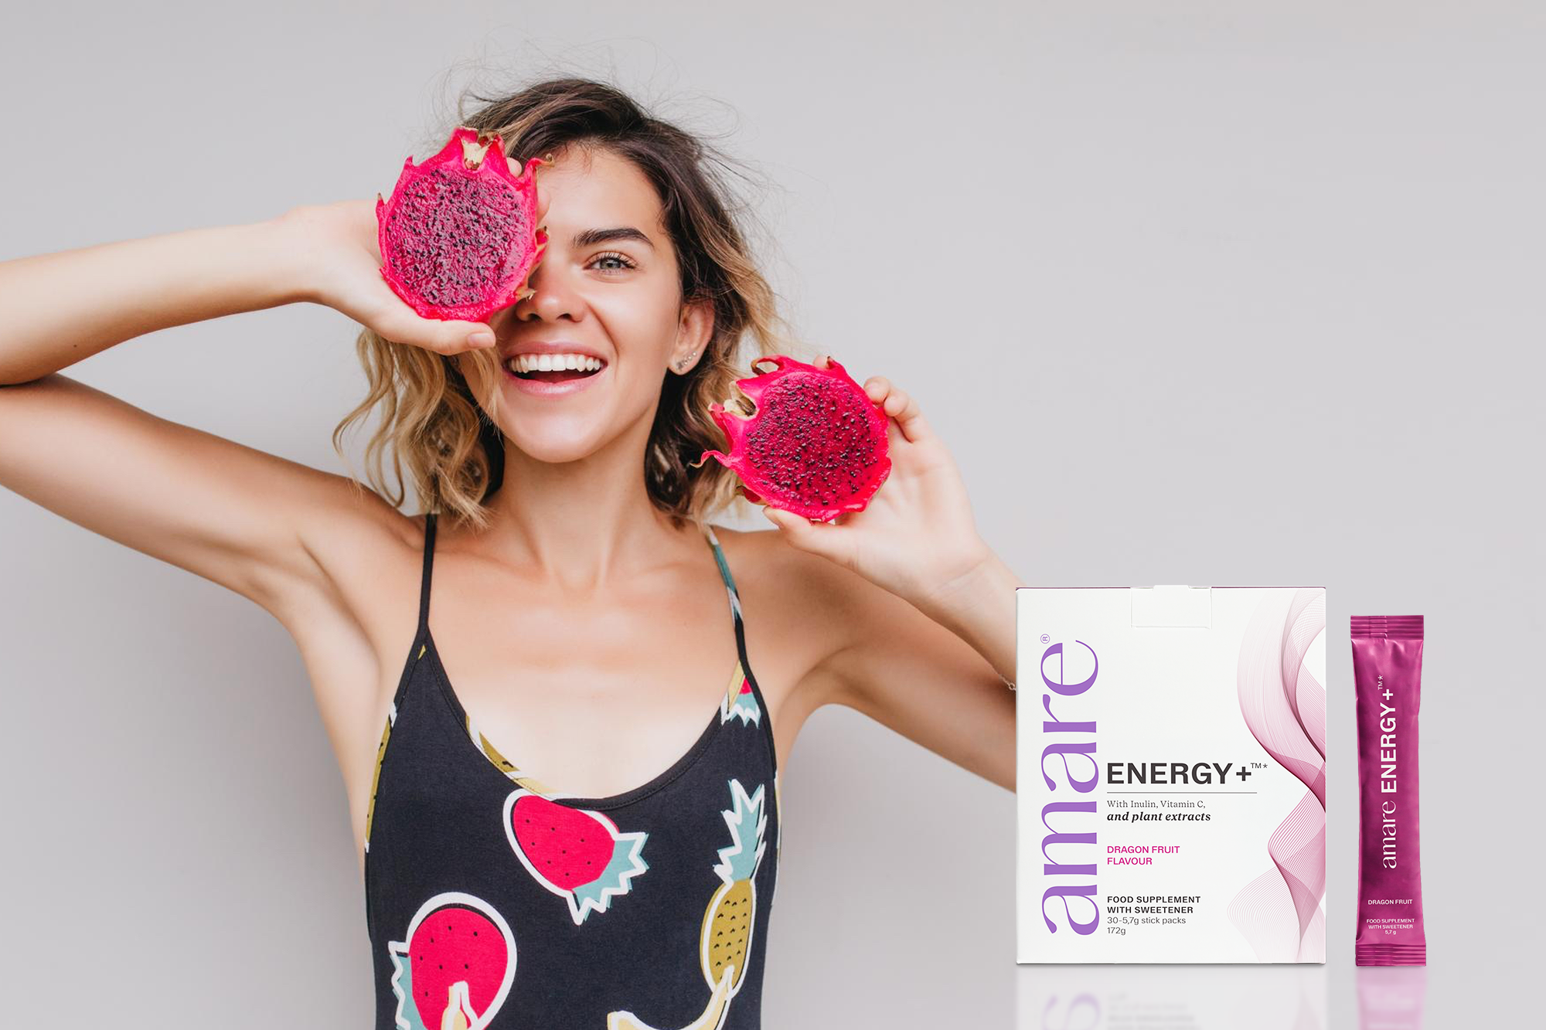
Amare ENERGY+™
How It Works?
Vitamin C contributes to:
• normal energy-yielding metabolism
• the normal function of the immune system
• the protection of cells from oxidative stress
• the reduction of tiredness and fatigue
Inulin is a non-digestible dietary fibre.
L-Glycine an amino acid.
Apple, grape seed, maritime pine bark and pomegranate extracts are naturally rich in plant-derived polyphenols, together with dragon fruit flavour.
*DISCLAIMER: Amare products do not claim to diagnose, treat, cure, or prevent any disease or medical condition. Statements regarding vitamins and minerals are valid only when these nutrients are present in the supplement in amounts specified by relevant EU regulations. The provided information is based on scientific studies of individual ingredients contained within Amare products. These studies have not directly examined Amare products themselves; thus, no direct relationship should be inferred between these study findings and Amare products. Food supplements must not be used as a substitute for a varied and balanced diet and a healthy lifestyle. If you are pregnant, breastfeeding, taking any medications or under medical supervision, please consult a doctor or healthcare professional before use. Keep out of reach of young children. Do not exceed the recommended daily dose. Should not be consumed by children under 12 years of age. For adults only.
4
Copyright © 2026 Amare Global. All rights reserved.

Slide 5
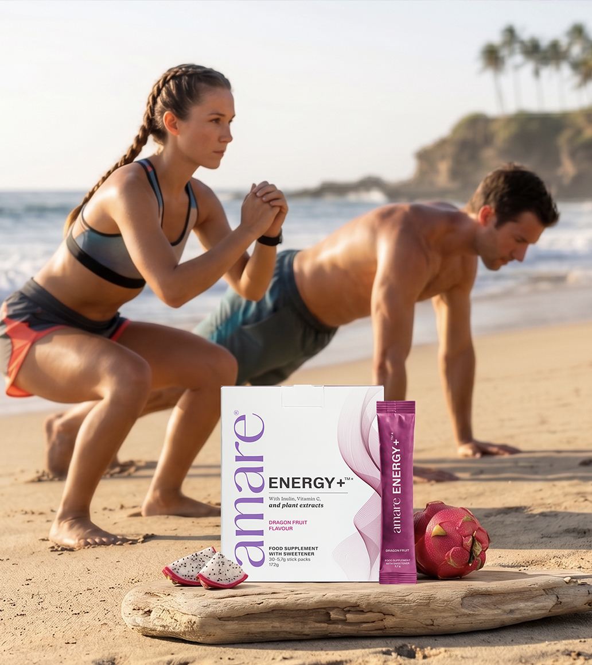

Amare ENERGY+™
Why You’ll Love It?
Experience a refreshing way to support your daily vitality with Amare ENERGY+™ Dragon Fruit — a delicious, sweetened supplement designed to fit modern wellness routines.
Each sachet delivers vitamin C which contributes to normal energy-yielding metabolism,the normal function of the immune system,and to the protection of cells from oxidative stress.
Each sachet also contains inulin, a plant-based fibre, and glycine, an amino acid.
*DISCLAIMER: Amare products do not claim to diagnose, treat, cure, or prevent any disease or medical condition. Statements regarding vitamins and minerals are valid only when these nutrients are present in the supplement in amounts specified by relevant EU regulations. The provided information is based on scientific studies of individual ingredients contained within Amare products. These studies have not directly examined Amare products themselves; thus, no direct relationship should be inferred between these study findings and Amare products. Food supplements must not be used as a substitute for a varied and balanced diet and a healthy lifestyle. If you are pregnant, breastfeeding, taking any medications or under medical supervision, please consult a doctor or healthcare professional before use. Keep out of reach of young children. Do not exceed the recommended daily dose. Should not be consumed by children under 12 years of age. For adults only.
5
5
5
5
Copyright © 2026 Amare Global. All rights reserved.

Slide 6
Amare ENERGY+™
Why You’ll Love It?
Enriched with botanical extracts from apple, grape seed, maritime pine bark and pomegranate — all naturally containing polyphenols.
*Vitamin C contributes to normal energy-yielding metabolism, the normal function of the immune system, and to the protection of cells from oxidative stress.
*DISCLAIMER: Amare products do not claim to diagnose, treat, cure, or prevent any disease or medical condition. Statements regarding vitamins and minerals are valid only when these nutrients are present in the supplement in amounts specified by relevant EU regulations. The provided information is based on scientific studies of individual ingredients contained within Amare products. These studies have not directly examined Amare products themselves; thus, no direct relationship should be inferred between these study findings and Amare products. Food supplements must not be used as a substitute for a varied and balanced diet and a healthy lifestyle. If you are pregnant, breastfeeding, taking any medications or under medical supervision, please consult a doctor or healthcare professional before use. Keep out of reach of young children. Do not exceed the recommended daily dose. Should not be consumed by children under 12 years of age. For adults only.
6
6
6
6
Copyright © 2026 Amare Global. All rights reserved.

Slide 7
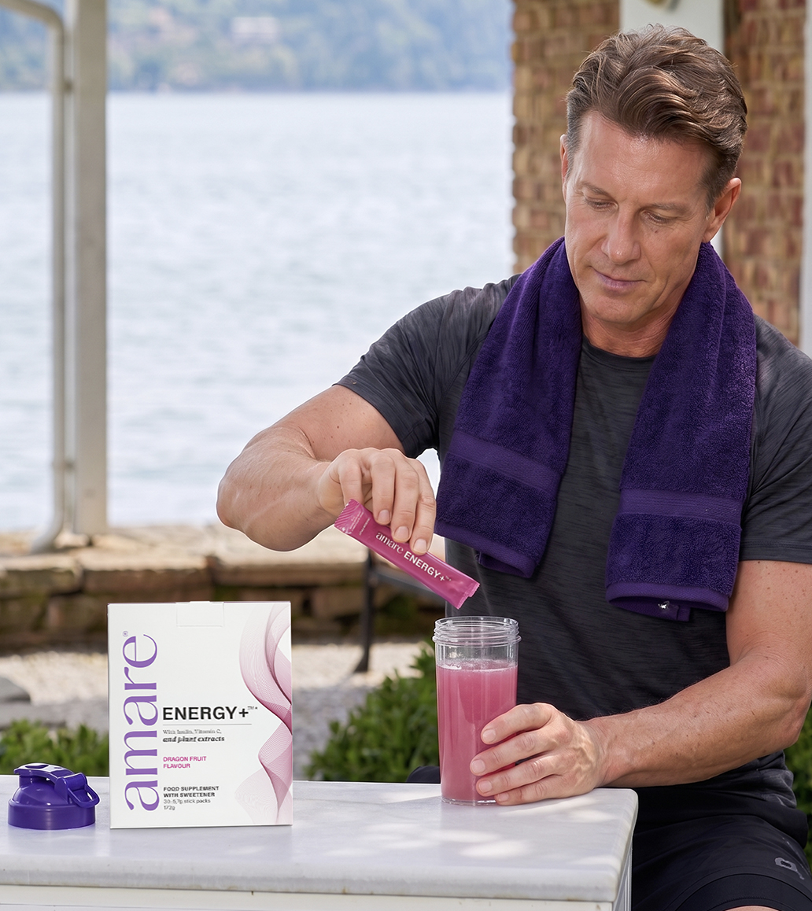
Amare ENERGY+™
How To Use?
Mix 1 sachet in 250 ml of water. Take once per day. Do not exceed the recommended daily dose. Store in a cool, dry place, away from light.
CAUTION: Do not exceed the recommended stated daily intake. Food supplements are not a substitute for a varied balanced diet and healthy lifestyle. The product is not suitable for use by children. If you are preganant, breastfeading, have a serious medical condition or are taking any prescription medications, please consult with your doctor before use.
*DISCLAIMER: Amare products do not claim to diagnose, treat, cure, or prevent any disease or medical condition. Statements regarding vitamins and minerals are valid only when these nutrients are present in the supplement in amounts specified by relevant EU regulations. The provided information is based on scientific studies of individual ingredients contained within Amare products. These studies have not directly examined Amare products themselves; thus, no direct relationship should be inferred between these study findings and Amare products. Food supplements must not be used as a substitute for a varied and balanced diet and a healthy lifestyle. If you are pregnant, breastfeeding, taking any medications or under medical supervision, please consult a doctor or healthcare professional before use. Keep out of reach of young children. Do not exceed the recommended daily dose. Should not be consumed by children under 12 years of age. For adults only.
7
Copyright © 2026 Amare Global. All rights reserved.

Slide 8
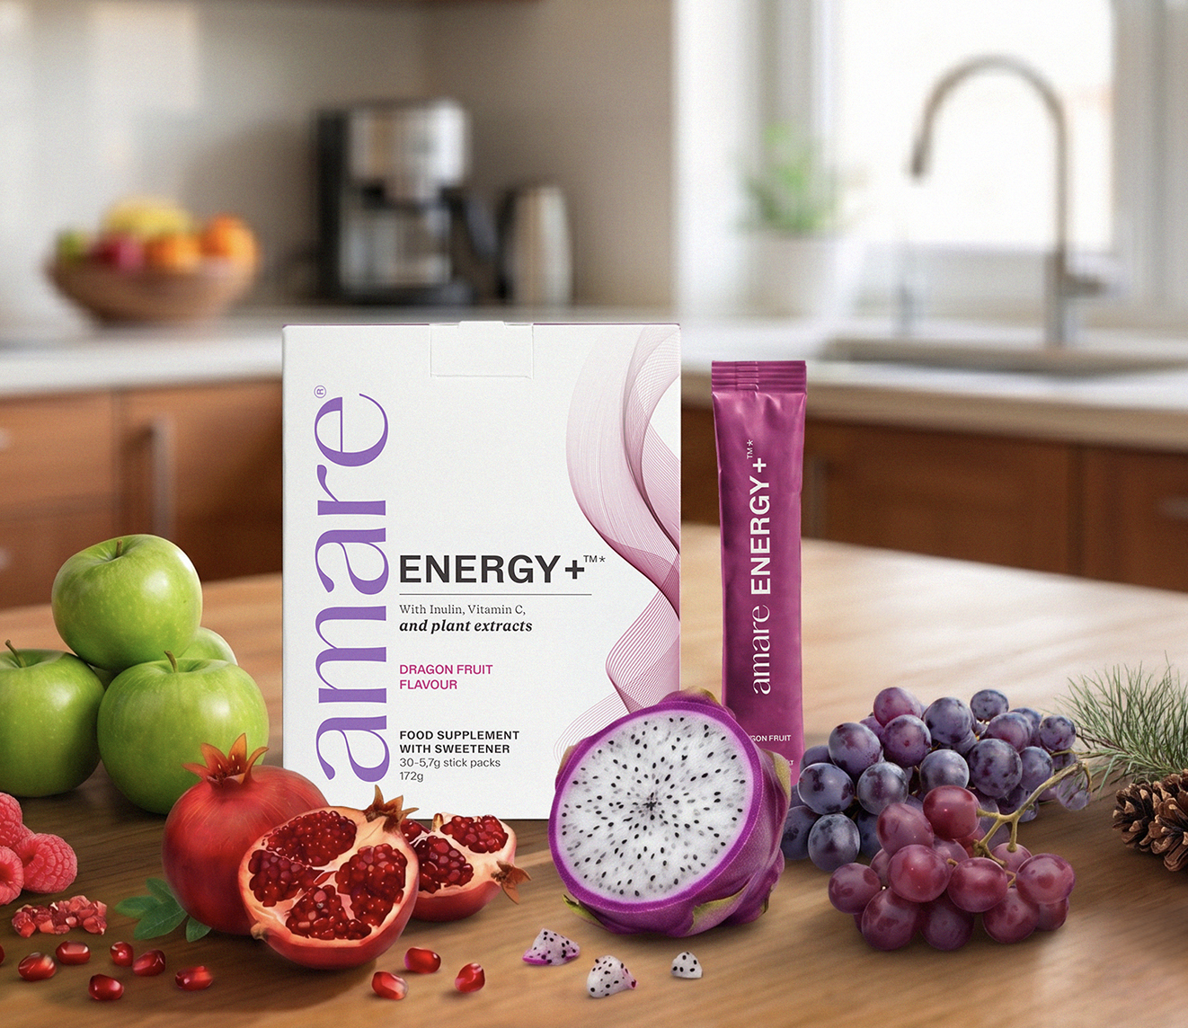
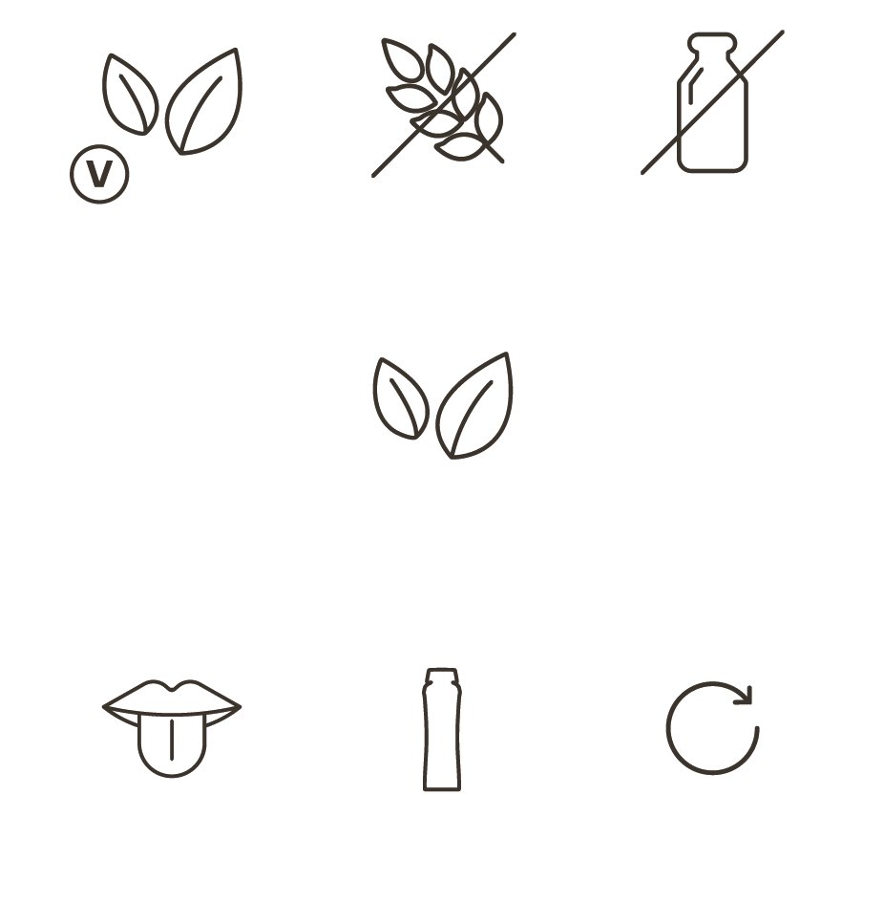
Amare ENERGY+™
Key Features

Slide 9
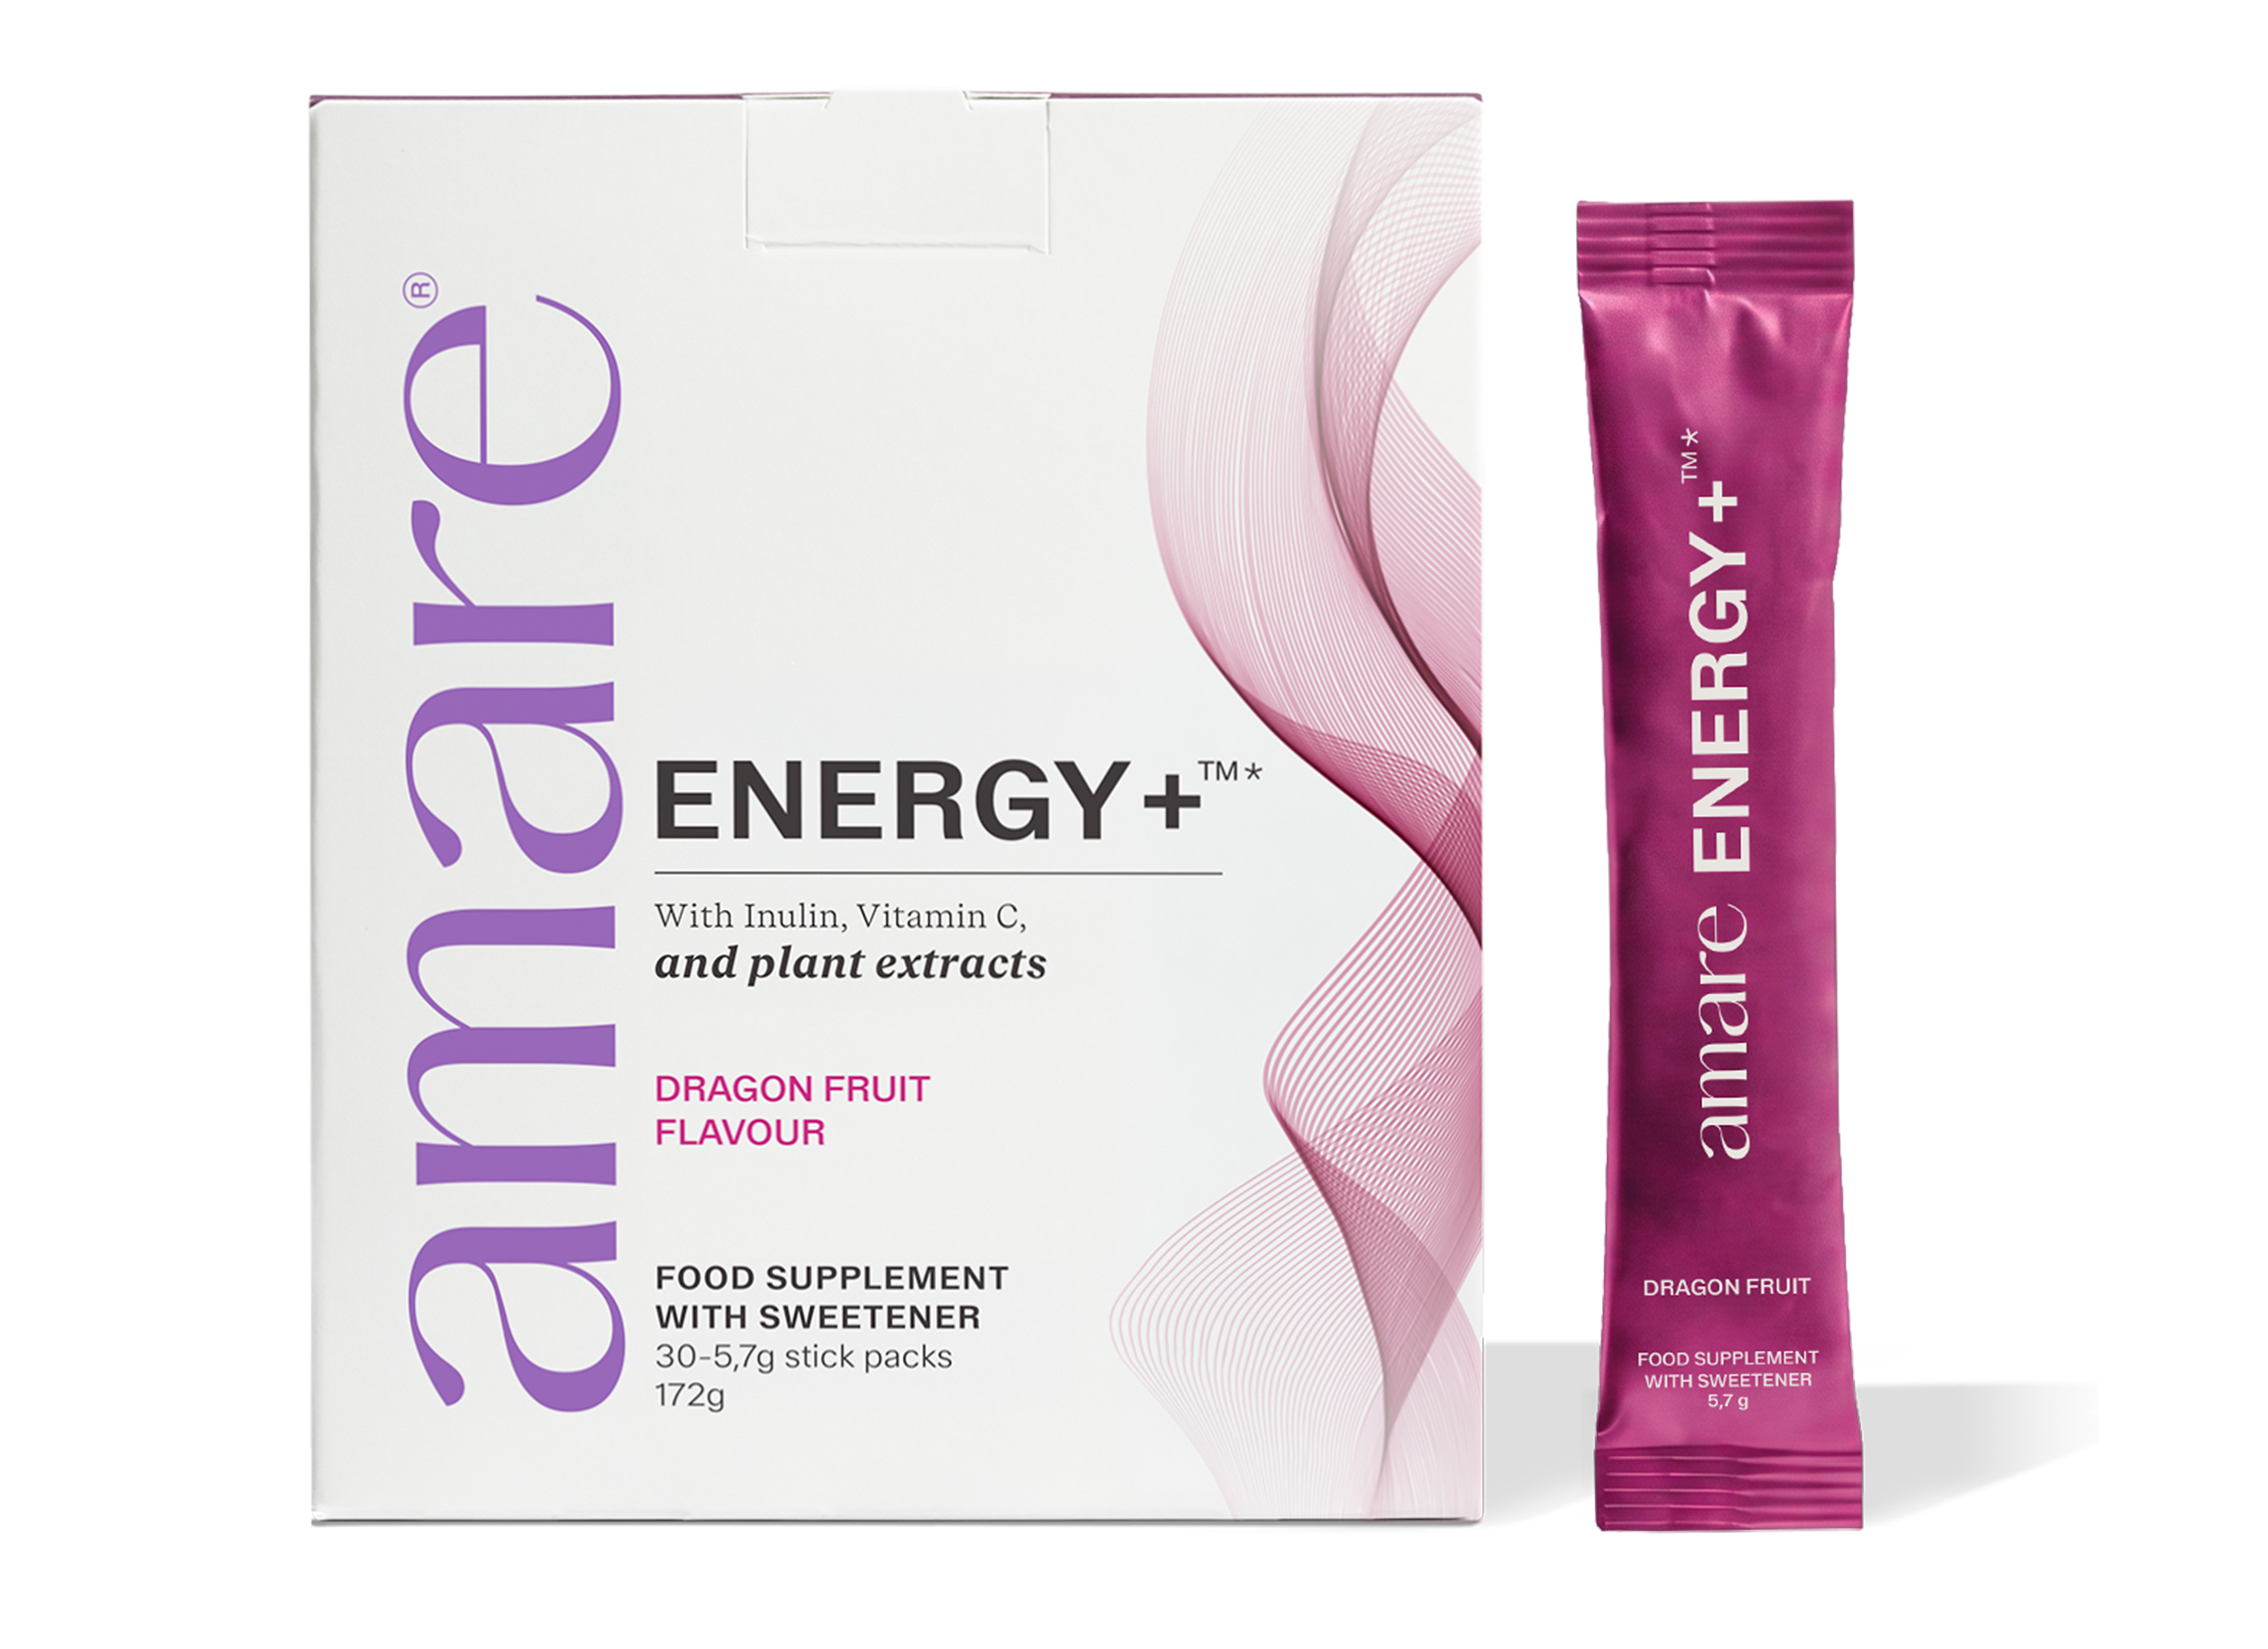
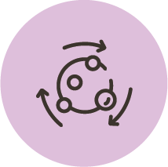


Amare ENERGY+™
Key Benefits
Metabolism
Vitamin C contributes to normal energy-yielding metabolism.
Immune System
Vitamin C contributes to the normal function of the immune system.
Nervous System
*DISCLAIMER: Amare products do not claim to diagnose, treat, cure, or prevent any disease or medical condition. Statements regarding vitamins and minerals are valid only when these nutrients are present in the supplement in amounts specified by relevant EU regulations. The provided information is based on scientific studies of individual ingredients contained within Amare products. These studies have not directly examined Amare products themselves; thus, no direct relationship should be inferred between these study findings and Amare products. Food supplements must not be used as a substitute for a varied and balanced diet and a healthy lifestyle. If you are pregnant, breastfeeding, taking any medications or under medical supervision, please consult a doctor or healthcare professional before use. Keep out of reach of young children. Do not exceed the recommended daily dose. Should not be consumed by children under 12 years of age. For adults only.
Vitamin C contributes the protection of cells from oxidative stress.
Vitamin C contributes the protection the reduction of tiredness and fatigue.
9
Copyright © 2026 Amare Global. All rights reserved.

Slide 10
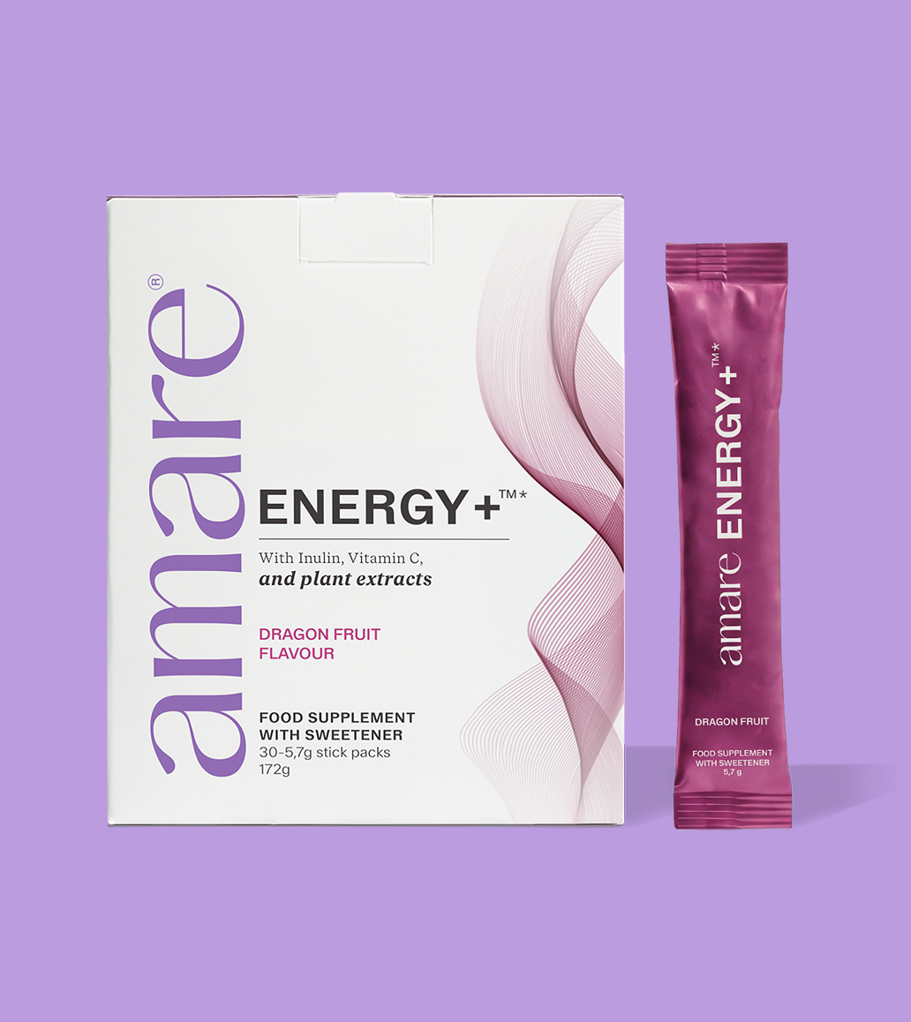
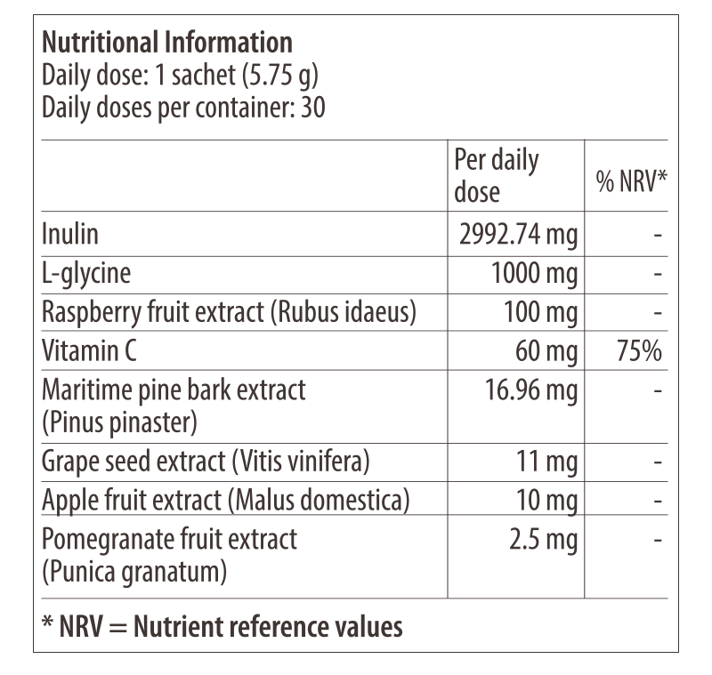
Amare ENERGY+™
Nutritional Information
10
10
10
Copyright © 2026 Amare Global. All rights reserved.

Slide 11
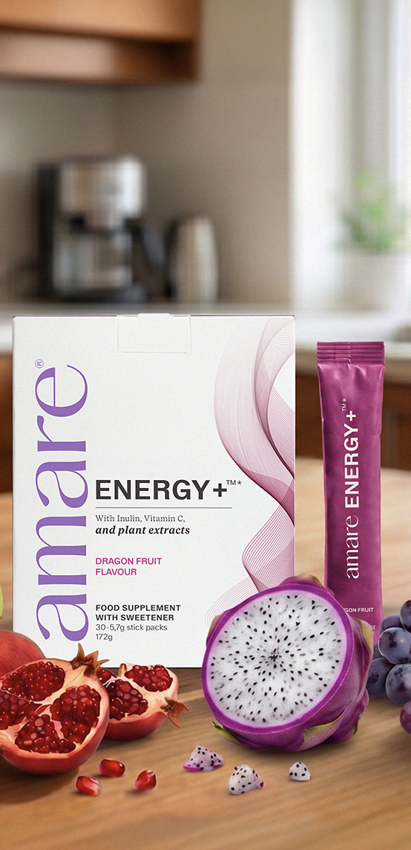
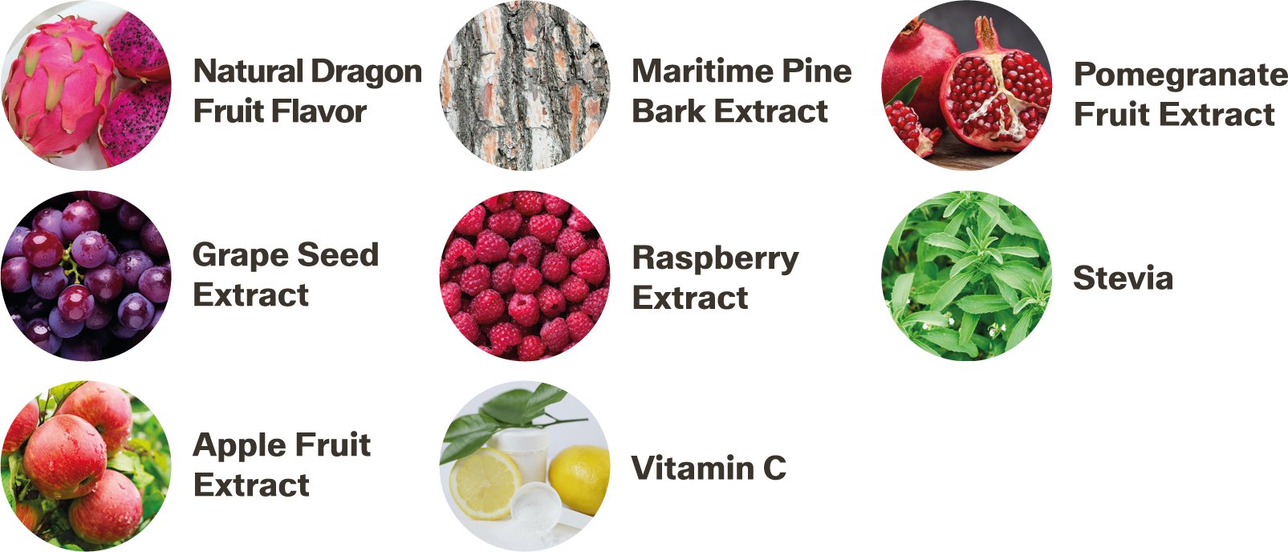
Amare ENERGY+™
Ingredients
Inulin, L-glycine, natural dragon fruit flavor, acidity regulator: citric acid, raspberry extract (Rubus idaeus), sweetener: steviol glycosides from Stevia, vitamin C (L-ascorbic acid), maritime pine bark extract (Pinus pinaster), grape seed extract (Vitis vinifera), apple fruit extract (Malus domestica), pomegranate fruit extract (Punica granatum).
11
11
11
Copyright © 2026 Amare Global. All rights reserved.

Slide 12
You can reach out product brochure in your official language: ENERGY+™ EU Product Brochure
For More Please Check Out
www.amare.com

