Slide 1
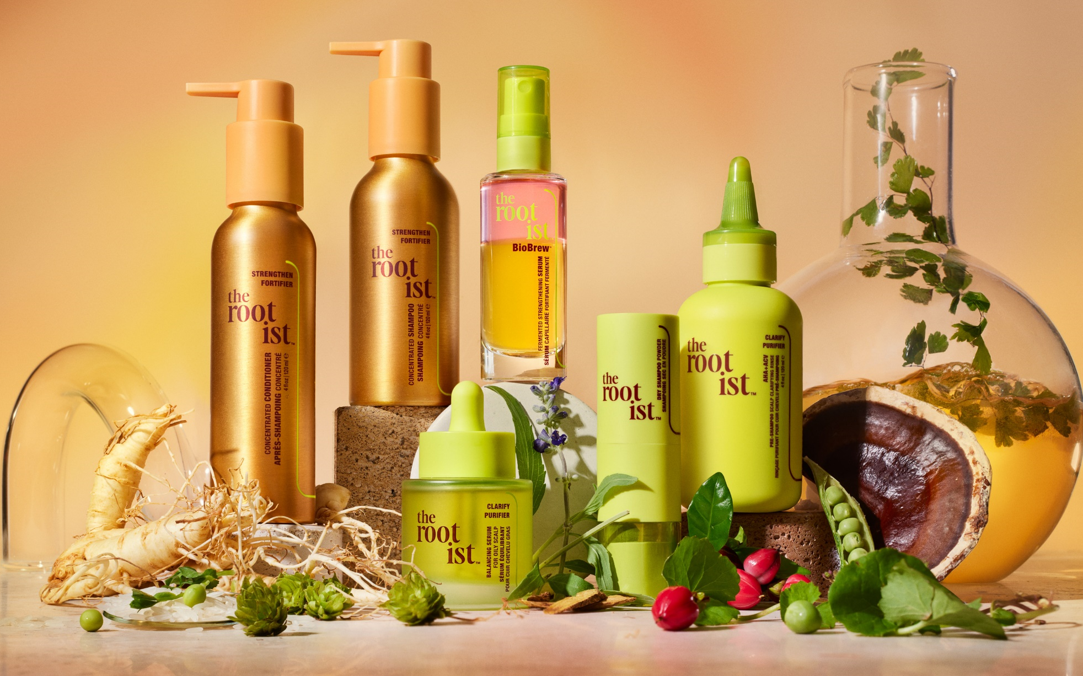
Notes:
The Rootist is...a groundbreaking root, scalp and haircare brand, powered by fermentation

Slide 2

Complete Hair Wellness
Notes:
...and designed for complete hair wellness. (Like Asma said… stress also impacts your hair)

Slide 3
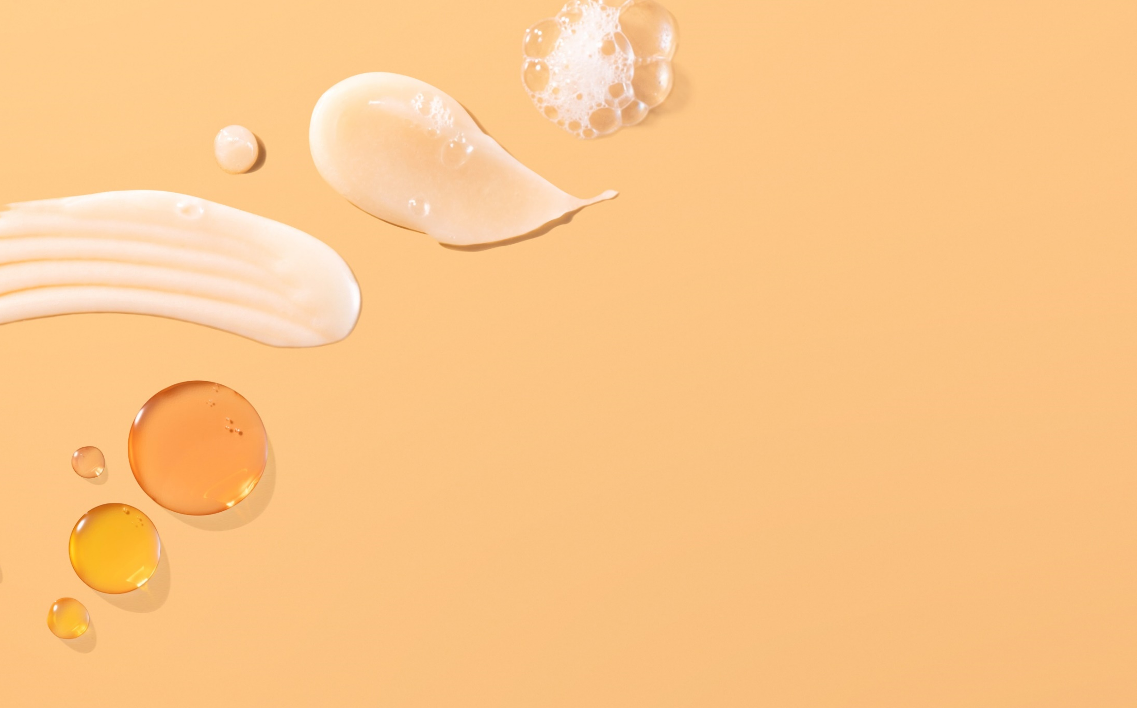
a more effective,
sustainable &
innovative way
Notes:
Formulated to get to the root of haircare concerns in a more effective, sustainable and innovative way

Slide 4
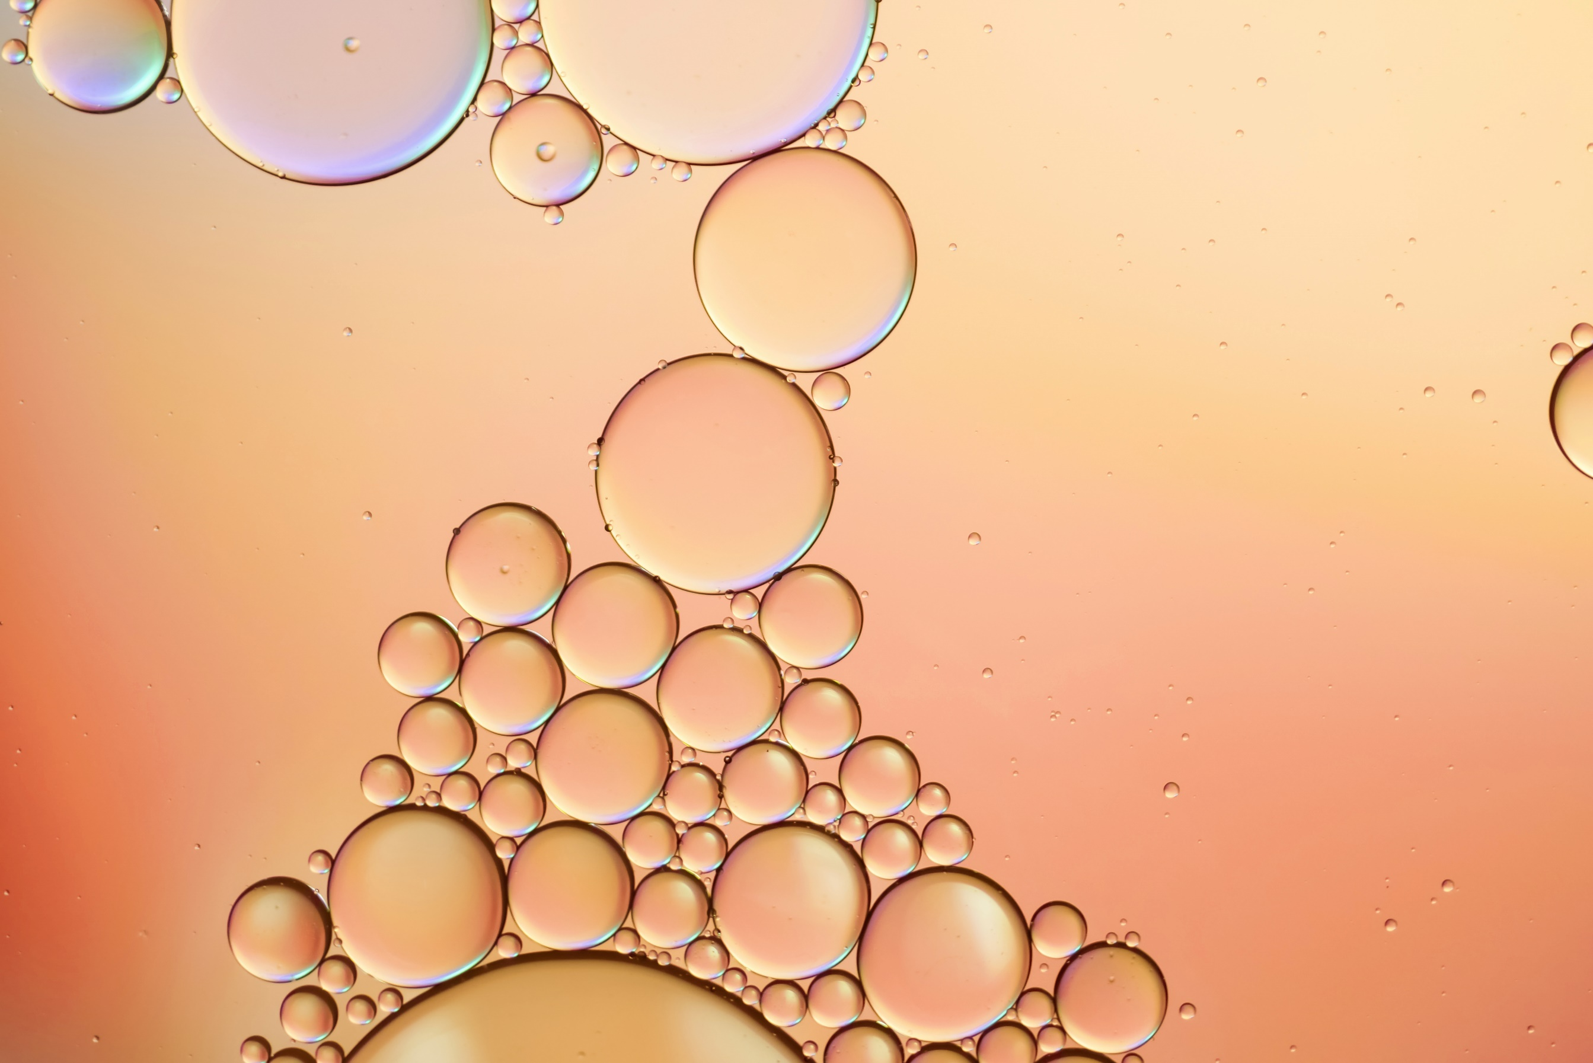

patent-pending
nutrient-rich
superbrew
Notes:
Rootbiomic Ferment™, our patent-pending nutrient-rich superbrew
that promotes anchored roots, balanced scalp and strong, healthy hair from root to tip.

Slide 5
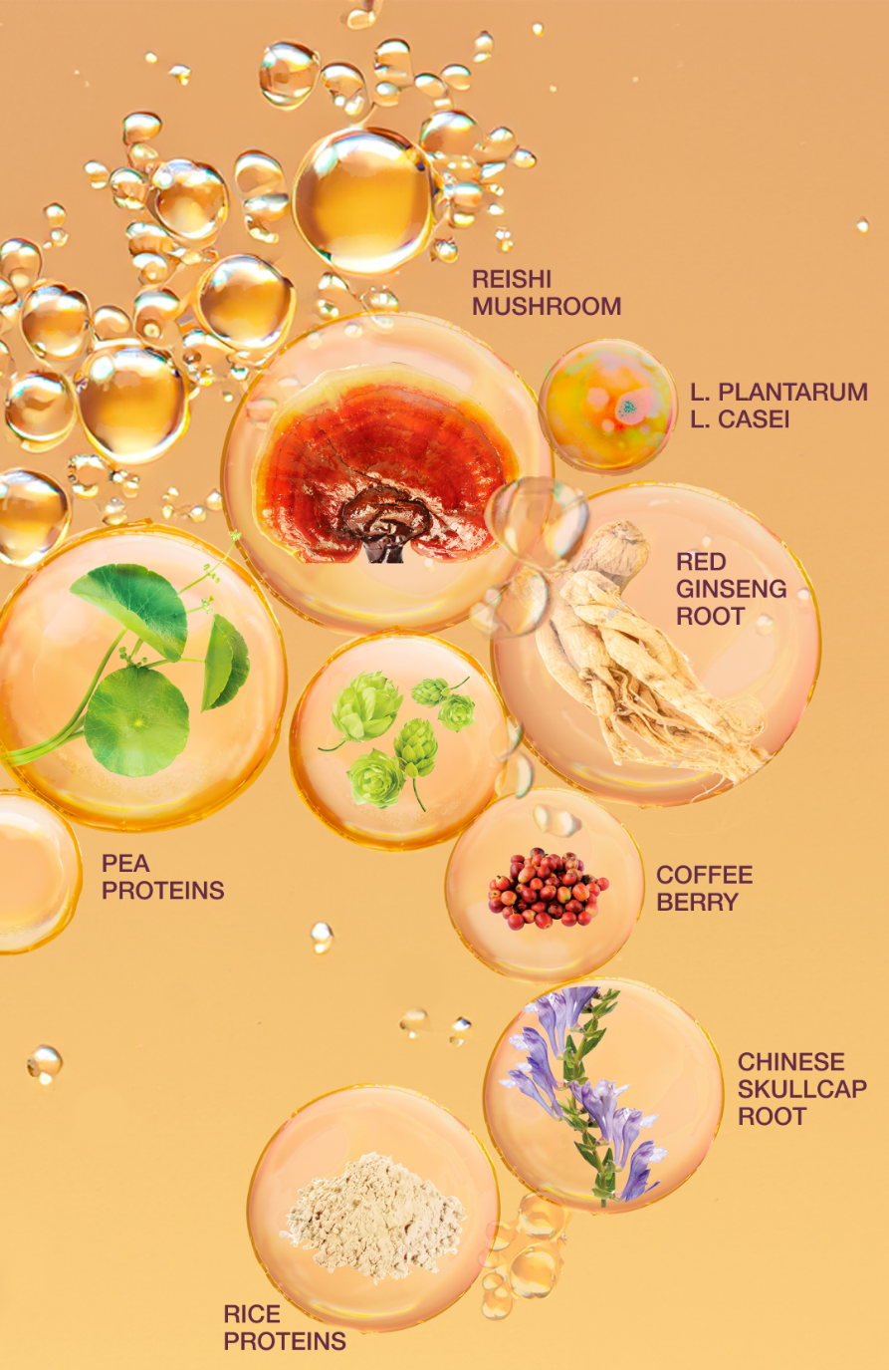
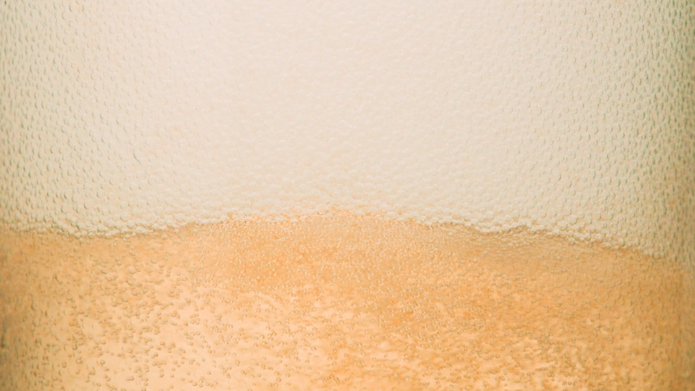
8 ingredients chosen for root, scalp & hair health
↓
proprietary fermentation process = concentrated, bioavailable nutrients
↓
strengthens hair, balances scalp, repairs + protects hair
Notes:
8 clinically effective botanicals with targeted benefits amplified via megasonic extraction
Fermented with 2 organisms isolated from apple & vegan kimchi
The result? Breakthrough, Bioactive Nutrition for Roots+Scalp+Hair
Patent pending in multiple countries

Slide 6
think:
kombucha, for hair.
Notes:
You can think of it as “kombucha, for hair.”

Slide 7
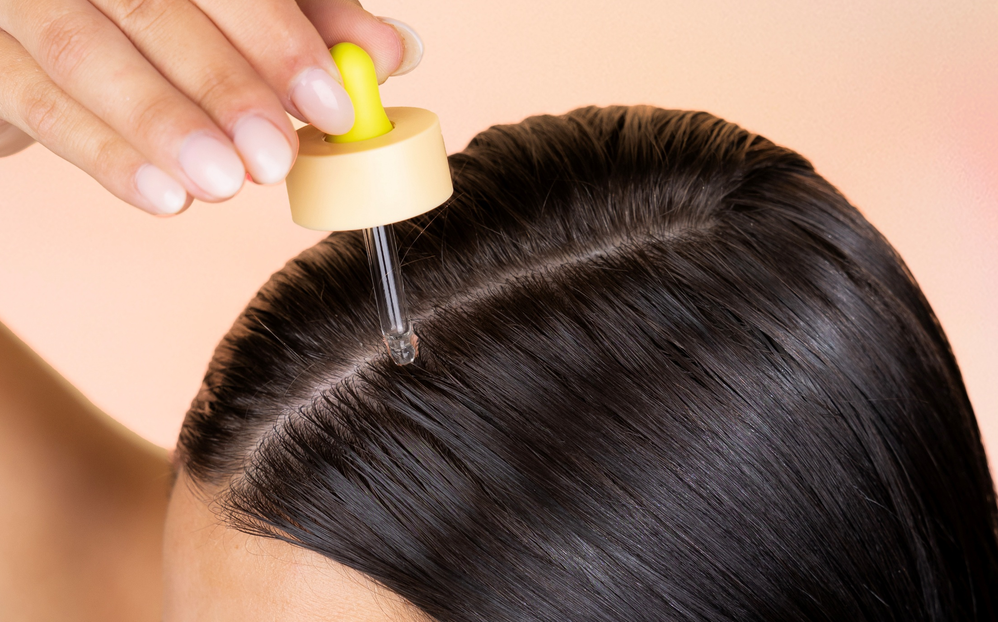
Search interest in the scalp & scalp serums
recently reached an all-time high.
Source: Google Trends. Weeks of March 29 2020 - March 23 2025. Numbers 0-100 represent search interest relative to the highest point on the chart for the given region and time.

Slide 8
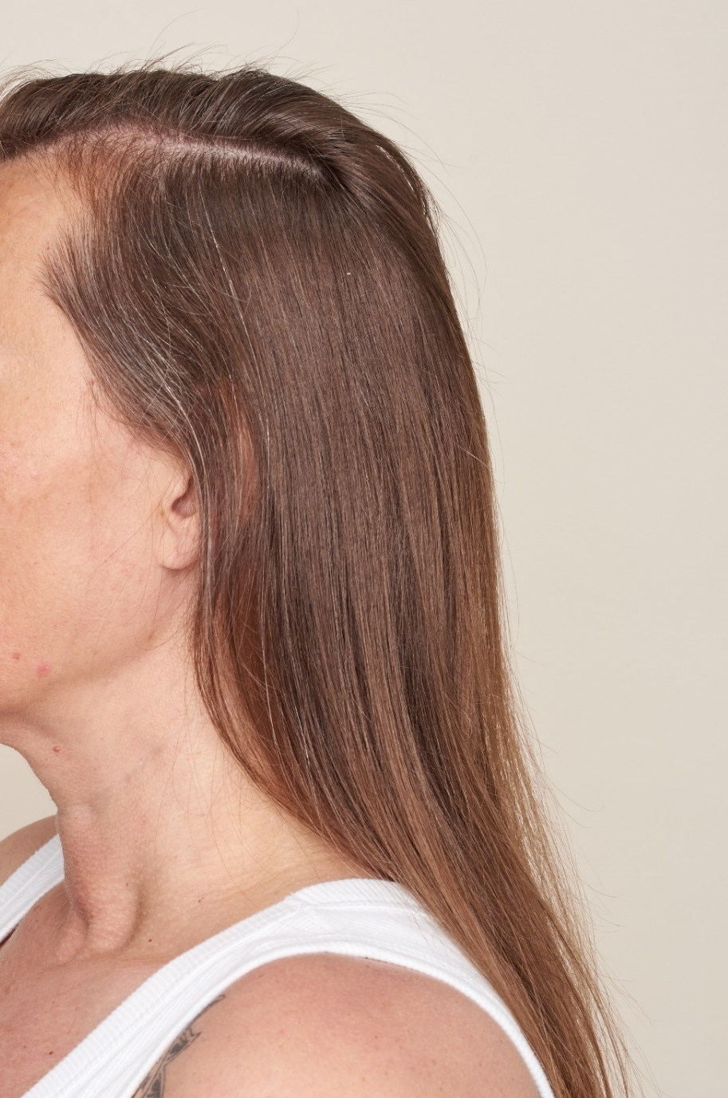
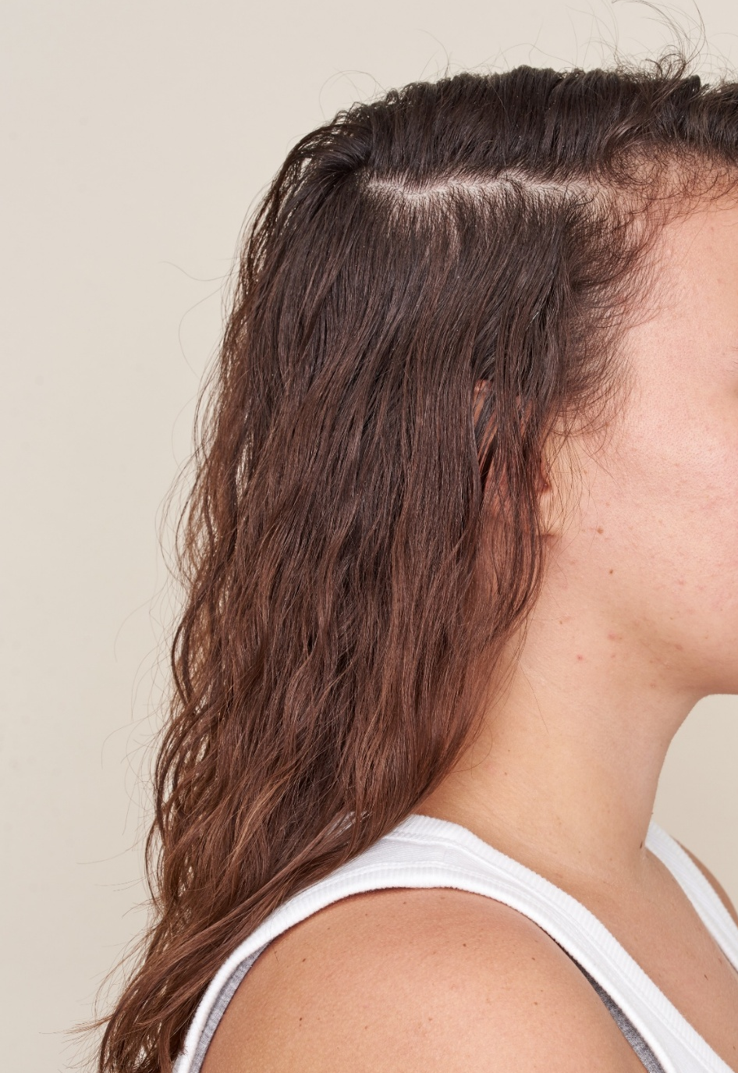
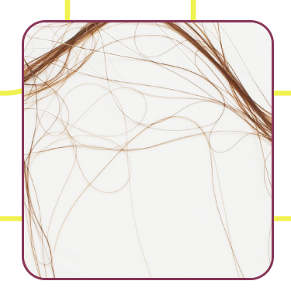
lack of density
is a top trending
hair topic
+4K↑
Increase Avg
Monthly Searches
“Hair Shedding”
last 12 mo vs. prior year
Source: Google US Search Trends from Feb 2024 – Jan 2025 vs. Feb 2023 – Jan 2024. These numbers represent actual data and are not adjusted for platform-specific growth

Slide 9
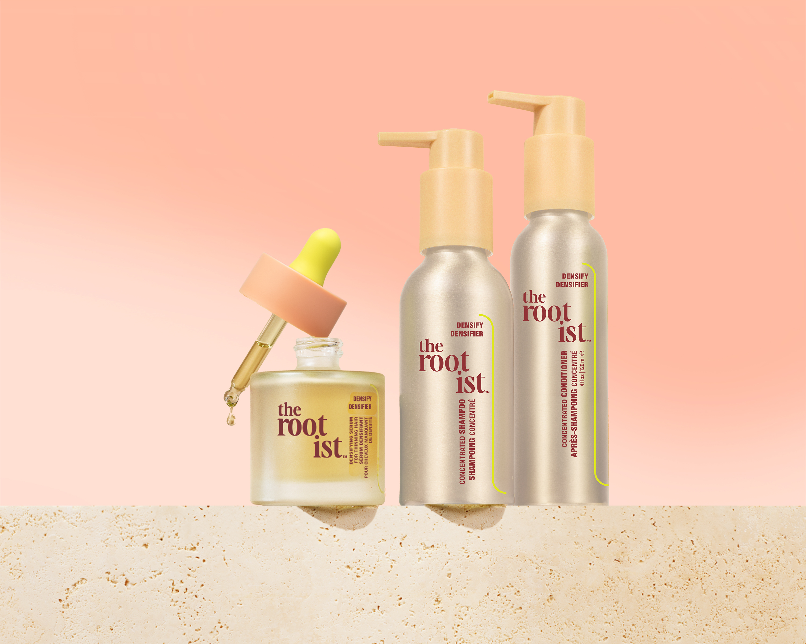


thicker, fuller-looking hair
clinically proven in 90 days*
DENSIFY COLLECTION
scalp microbiome-friendly
sulfate-free + silicone-free
for fine hair

Slide 10
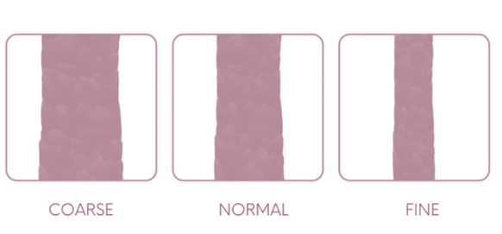
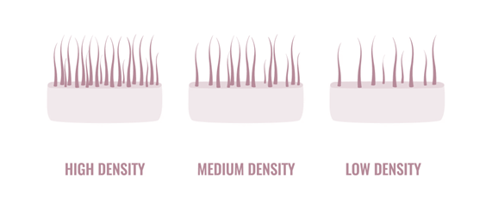

hair texture vs density
Texture
how it feels when you rub a single strand between two fingers
Density
how many hair strands per square inch/fullness of hair
The Densify Collection is formulated for fine hair
OR any hair texture needing volume

Slide 11


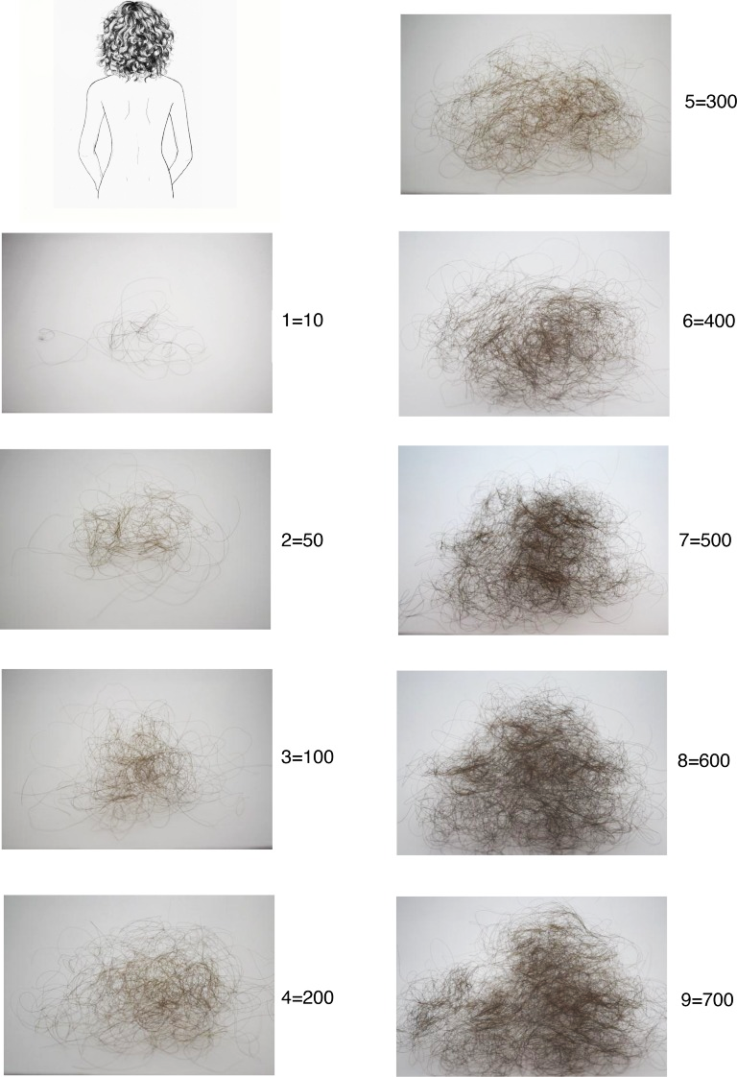
how much hair shedding is normal?
according to dermatologists,
50-200 hairs/day
Visual Scale Source: PubMed PMID: 28220468
Notes:
FACT – It is completely normal to shed anywhere between 50-200 hairs day
Our hair has a natural cycle process. At any given moment about 10-15% of your hair is in telogen
Telogen is the resting stage where our hair sheed
Stressors to our body can result in excess shedding – if you are seeing over 200 hairs/day *look at photos* you can consults derm
Also consider how often you wash and brush can sometimes...

Slide 12
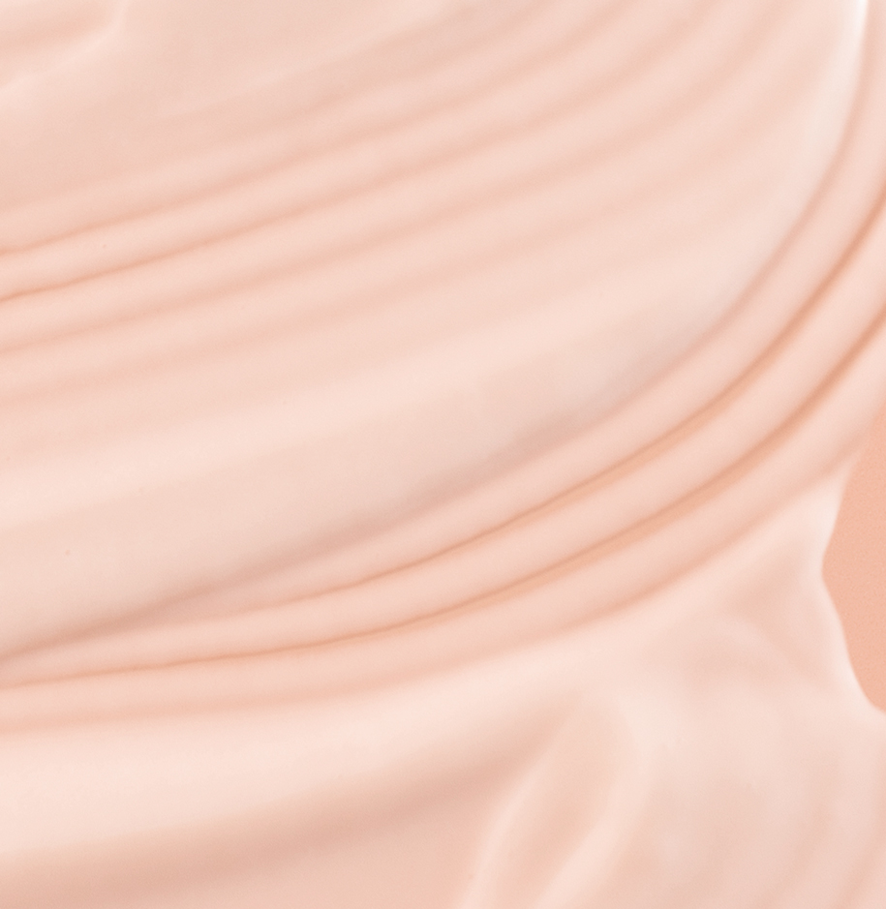
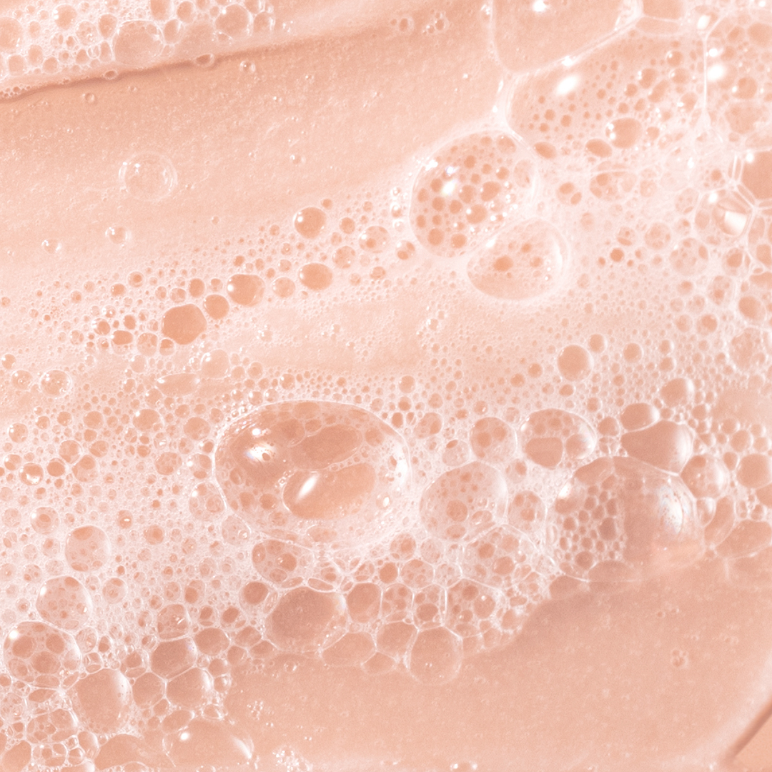
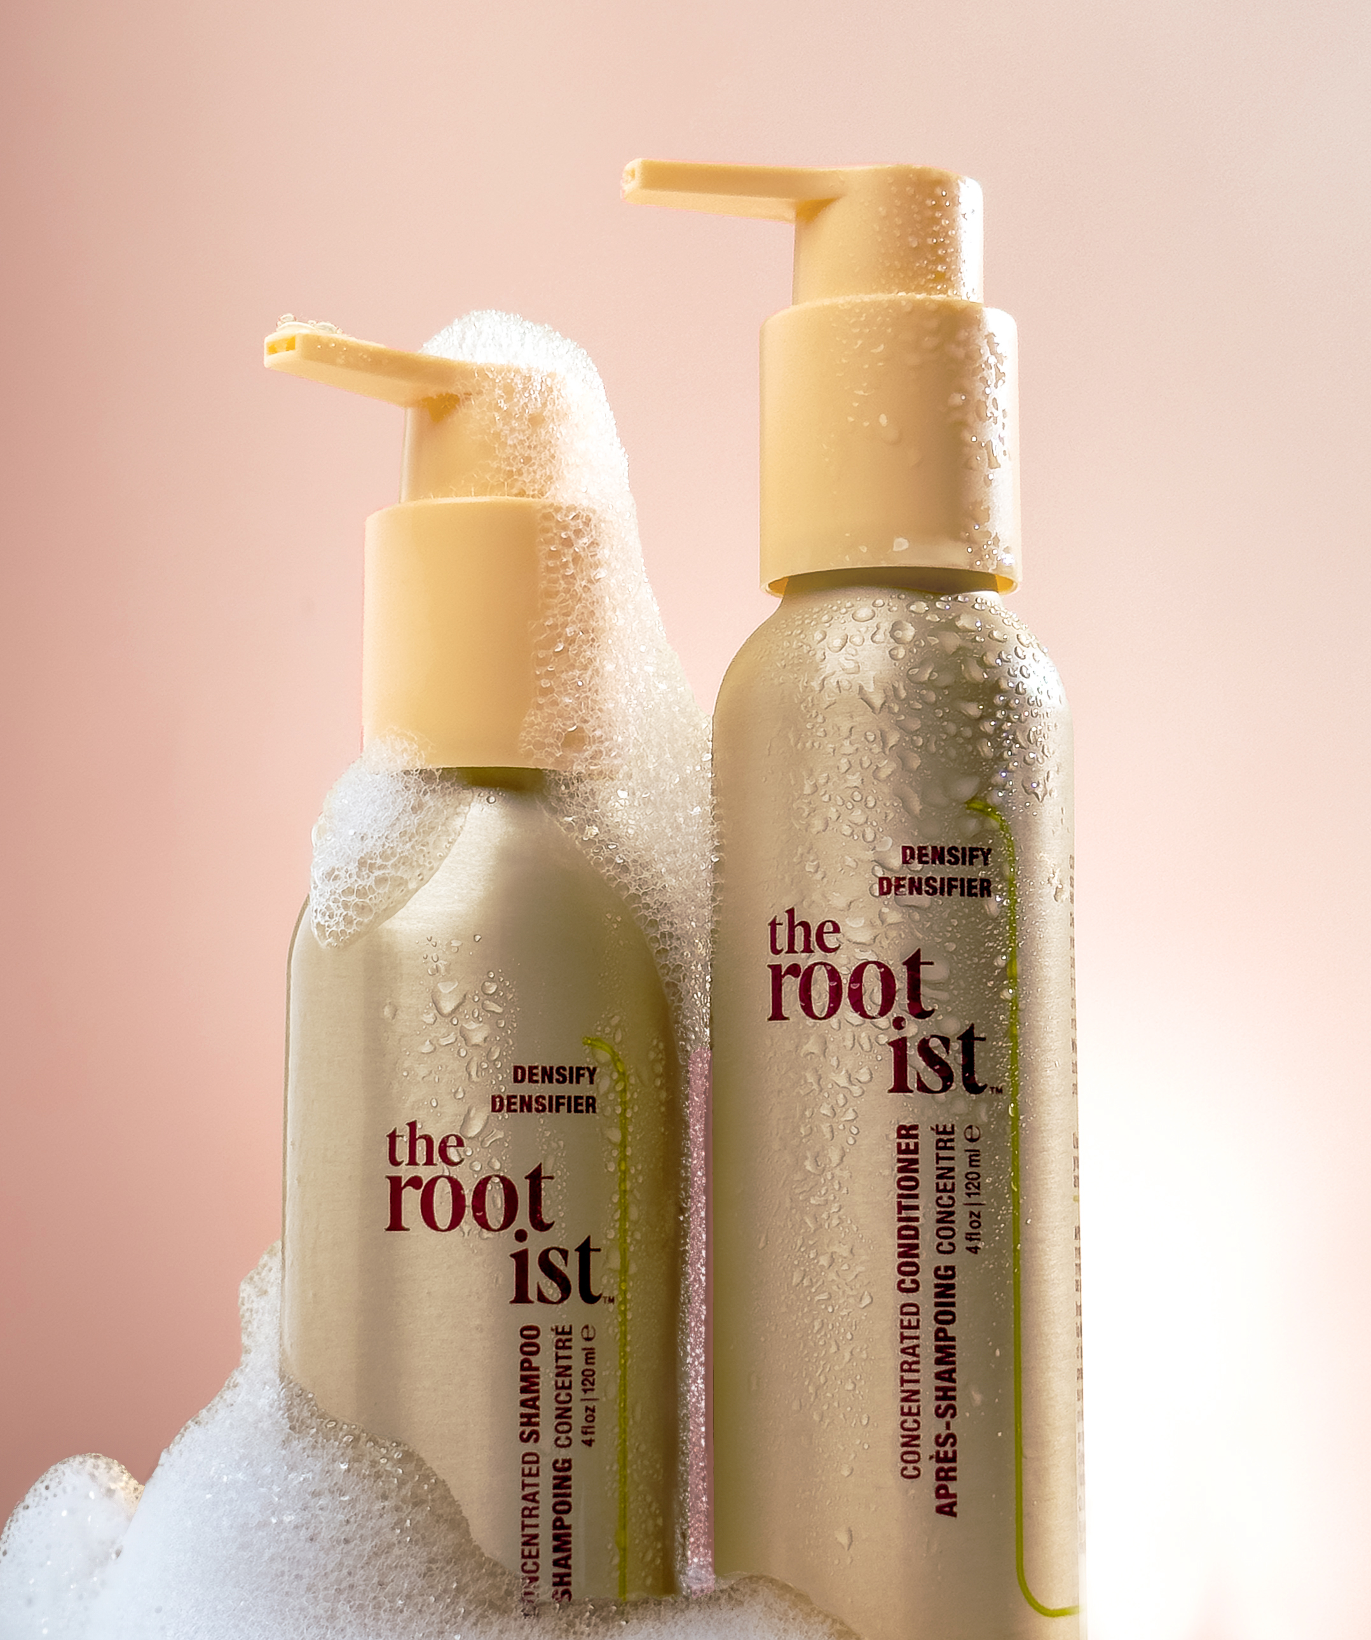
thicker, fuller-looking
hair starts in the shower
DENSIFY CONCENTRATED
SHAMPOO + CONDITIONER
treatment-infused
boosts volume
thickens stands

Slide 13
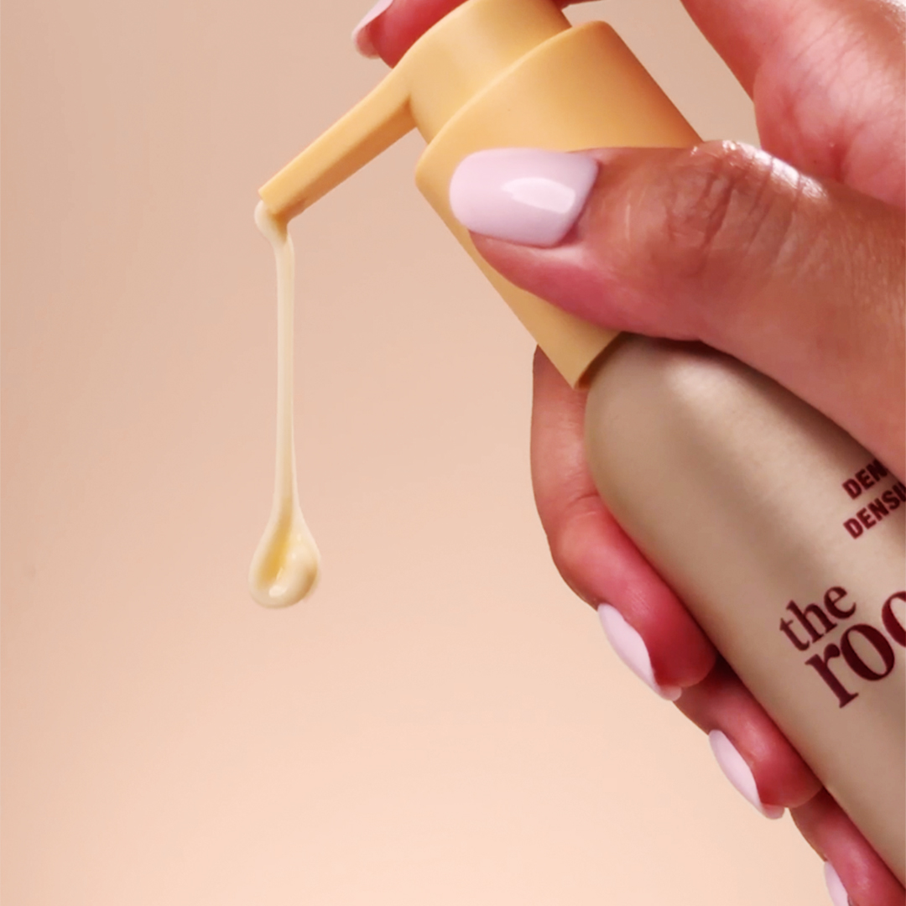
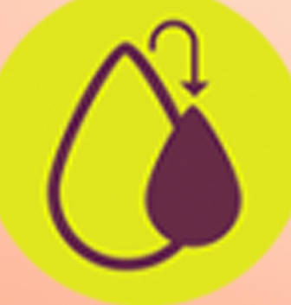

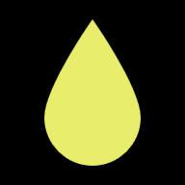
2X concentrated
made with no added water*
Use HALF
your usual amount
Short / Fine Hair : 1 Pump
Medium Hair: 2-3 Pumps
Long / Thick Hair: 3-4 Pumps
* Excludes ingredients with inherent water content

Slide 14
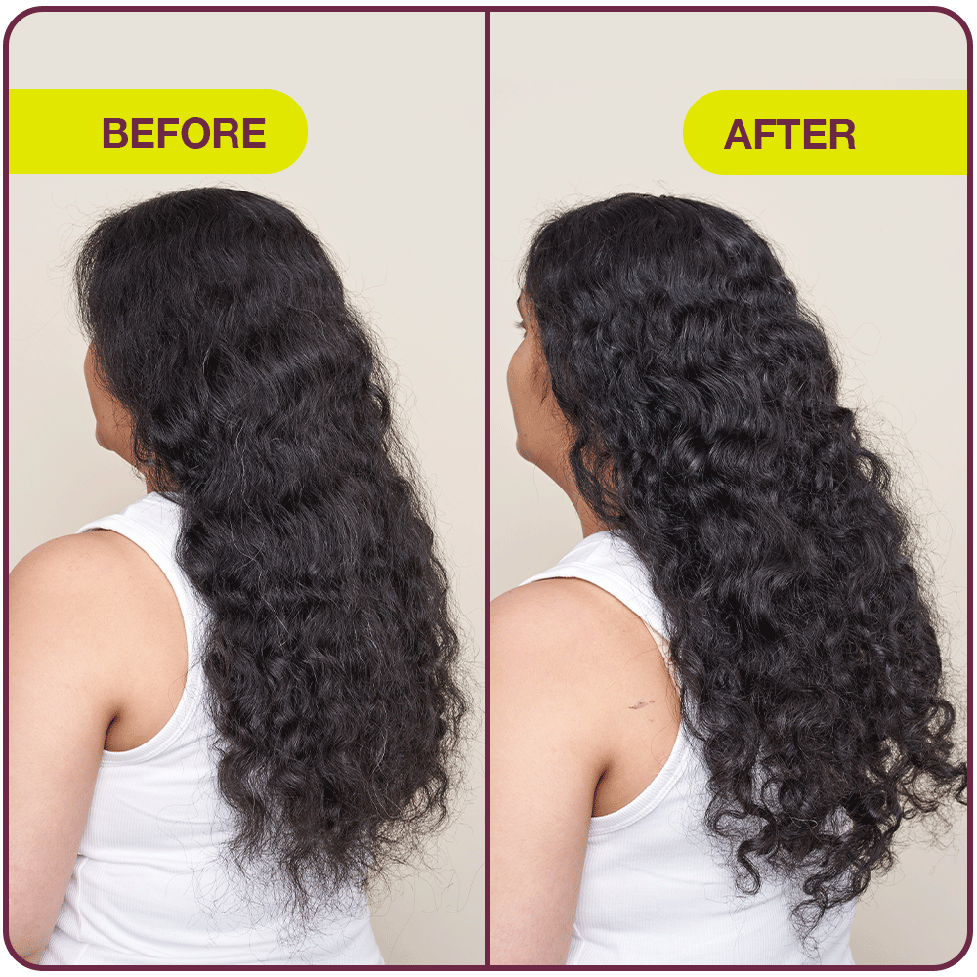
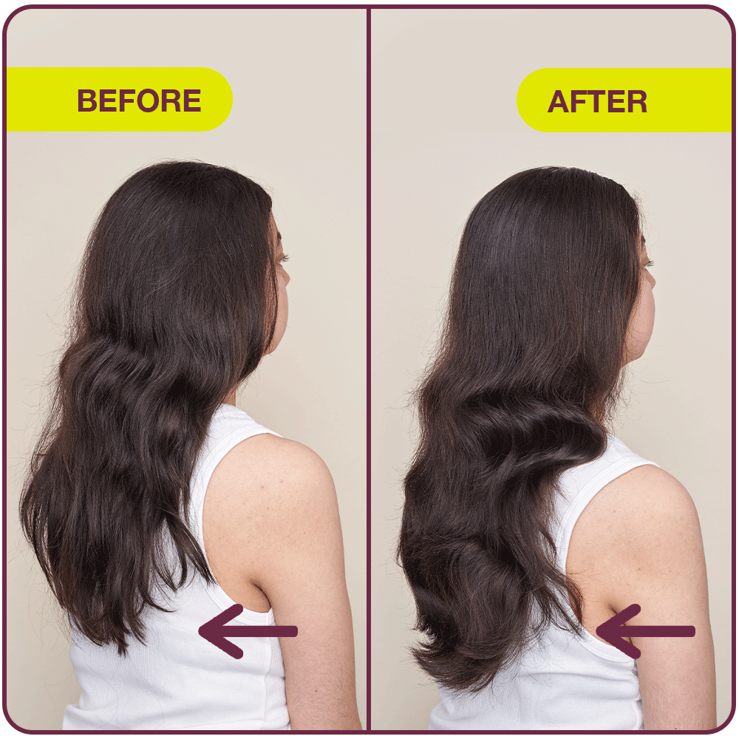
Densify Concentrated Shampoo & Conditioner
Real, Unretouched Results
Unretouched photos after 90 days of use of Densify Shampoo, Conditioner & Serum. Individual results will vary.

Slide 15
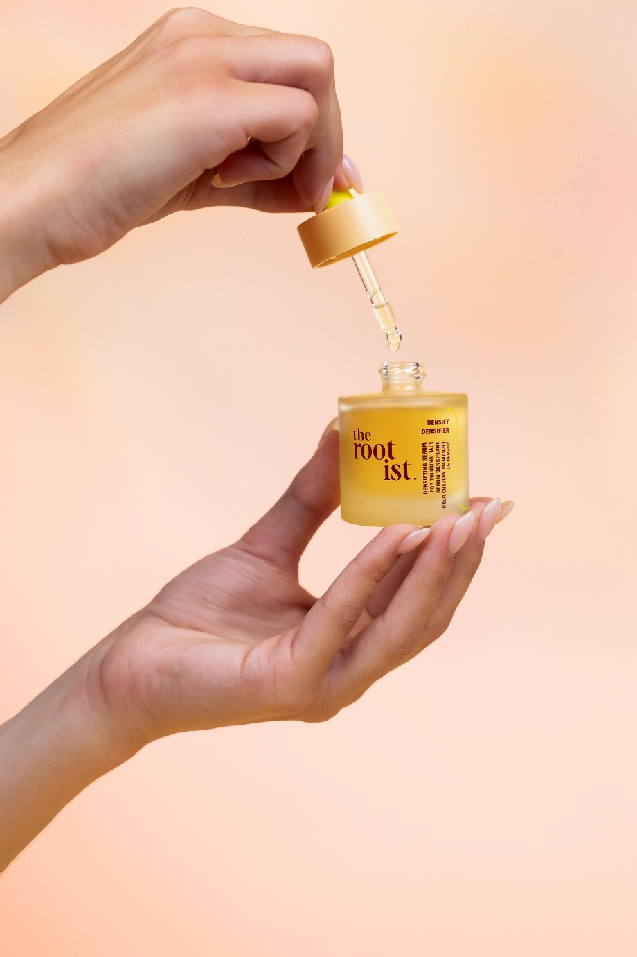

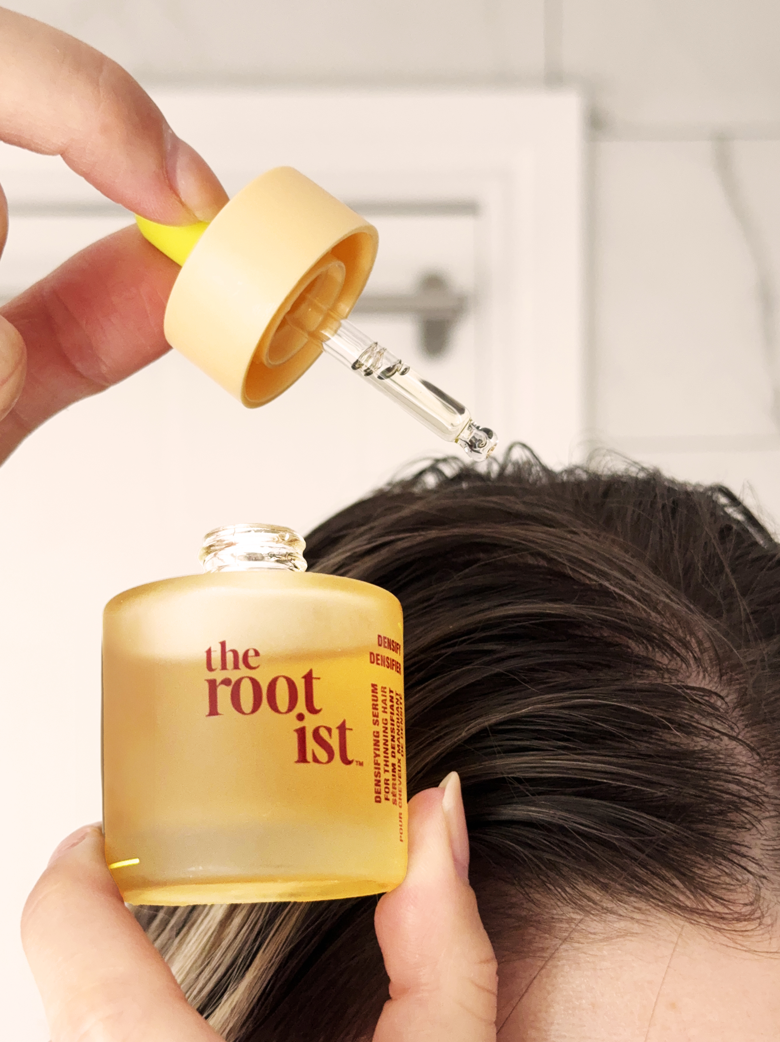
kickstart hair’s
full potential
clinically proven thicker, fuller-looking hair in just 90 days*
reduces hair fallout due to breakage by up to 85% **
oil-free, non-greasy +
won’t weigh down hair
results are rooted in consistency
apply 1x daily to scalp
hair can be damp or dry
DENSIFYING SERUM
FOR FINE HAIR
*Based on an expert grading evaluation on 34 panelists after use of the Densify regimen
**Dry comb test after use of the Densify regimen for 120 days
Notes:
Tested over time (4m)

Slide 16
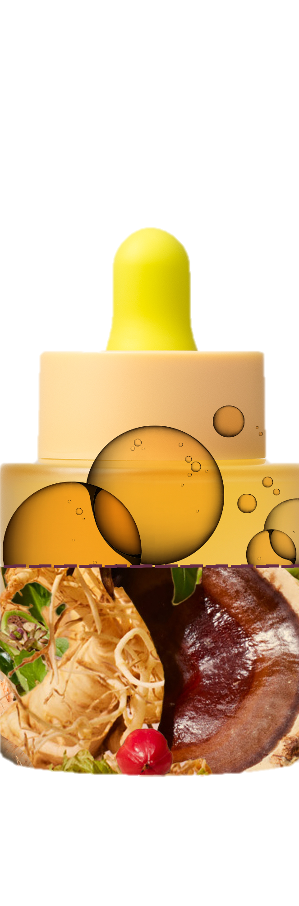
94% concentrated, clinically proven formula
DENSIFYING SERUM
FOR FINE HAIR
feeds necessary nutrition to roots + scalp for stronger, thicker, fuller-looking hair
densifying peptides
exosomes from
turmeric extract
rootbiomic ferment
Notes:
*Will add ingredient claims from product sheets once approved*

Slide 17
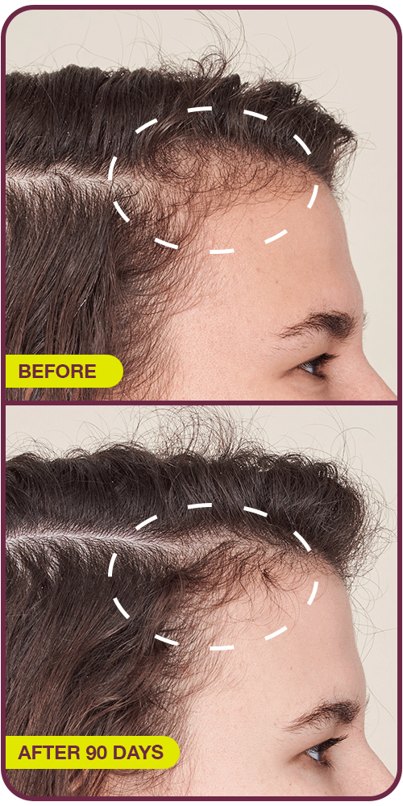
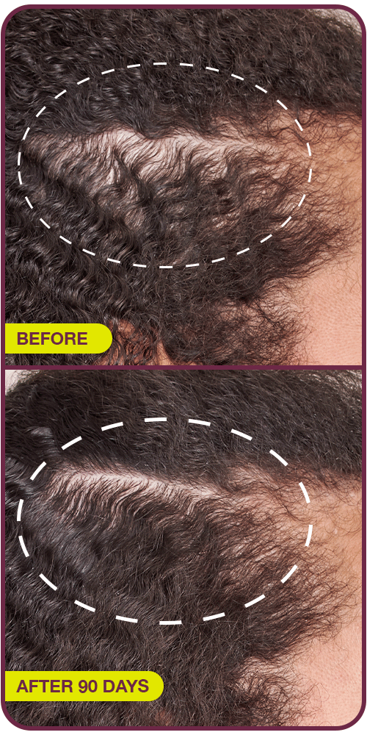
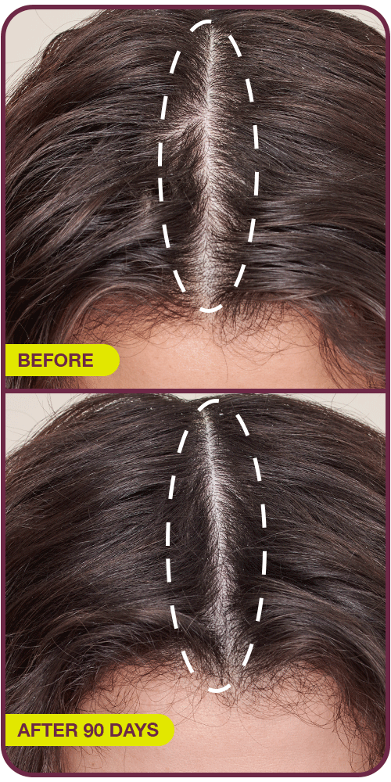
Densifying Serum For Fine Hair
Real, Unretouched Results
Unretouched photos after 90 days of use of Densify Shampoo, Conditioner & Serum. Individual results will vary.

Slide 18
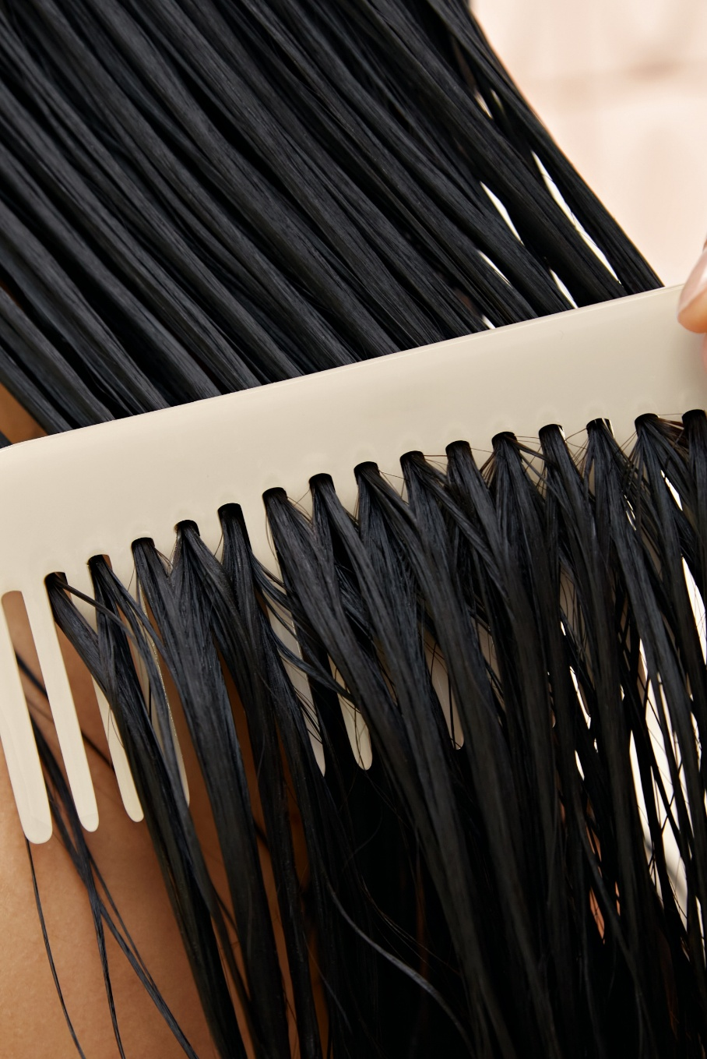

comprehensive clinical testing on full regimen over 120 days
instrumentation (dry comb test to evaluate reduction in breakage)
expert clinical grading
consumer perception
scalp microbiome swabbing
biodegradability
Notes:
Tested over time (4m)

Slide 19

Notes:
Groundbreaking, first of its kind collaboration

Slide 20

Frequently Asked Questions
Q: How long will a bottle of Densifying Serum last?
A: The use up rate of Densifying Serum will depend on how often you apply it and the amount of areas it is applied to. Typically, a bottle of the serum will last for one month.
Q: How long does it take to see results?
A: Results are rooted in consistency. Our clinical study demonstrated results in 90 days with consistent use of the Densify Concentrated Shampoo, Densify Concentrated Conditioner and Densifying Serum For Fine Hair.
Q: Are the products suitable for color treated hair and hair extensions?
A: Yes. All formulas are designed to be suitable for color treated hair. We avoid harsh surfactants and stripping ingredients to help protect the longevity of color. Our products are also formulated without the ingredients you typically want to avoid to protect the longevity of your extensions.
Q: How do I use the Densify Serum?
A: Apply 1x/daily to dry or towel-dried scalp. Distribute evenly throughout the crown, focusing on areas of concern. Massage thoroughly. Do not rinse. Average usage is 2 full droppers
Notes:
You will receive a comprehensive list of FAQs

Slide 21
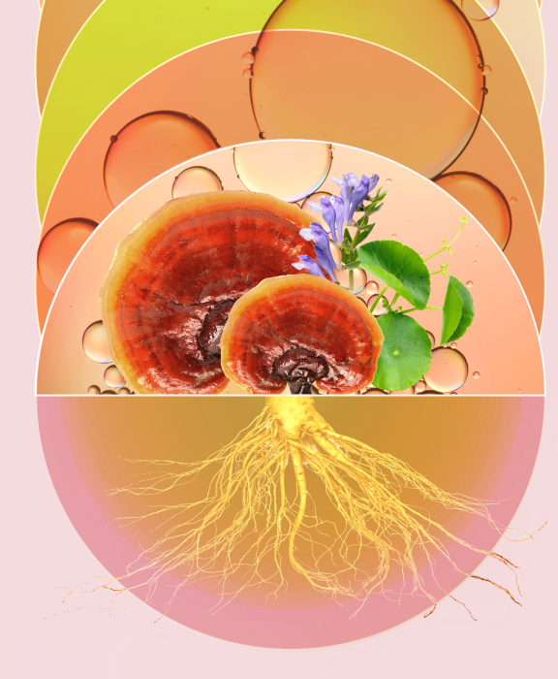
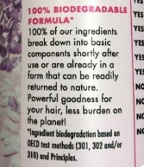
Our Eco-mitments
PRODUCTS:
Made with sustainably sourced ingredients
No added water*
Recyclable and/or refillable packaging, wherever possible, including aluminum & glass bottles, and post consumer recycled (PCR) plastic
Vegan
Biodegradable Formulas**
Respect the Microbiome
* Excluding ingredients with inherent water content
** Ingredient biodegradation based on OECD test methods (301, 302 and/or 310) and Principles.
Notes:
ROOTS+SCALP+HAIR are connected. And so are we.
Our collective actions and choices matter, so we are working to reduce our impact at every step...
That’s why…

Slide 22
Smart Standards
FORMULATED WITHOUT:
Parabens
Phthalates
Mineral Oil
Sulfate SLS + SLEC
Silicones
Talc
Harsh Alcohols*
And much more!
* Specifically, No Alcohol, Alcohol Denat., Ethanol, Ethanol Alcohol, Denatured Alcohol, Methanol, Benzyl Alcohol, Isopropryl Alcohol, SD Alcohol, SD Alcohol 40
Notes:
In keeping with our purpose, from the very beginning, we set strict, smart standards for our formulas.
Our formulas meet the rigorous EU cosmetic ingredient standards + formulated without…

Slide 23
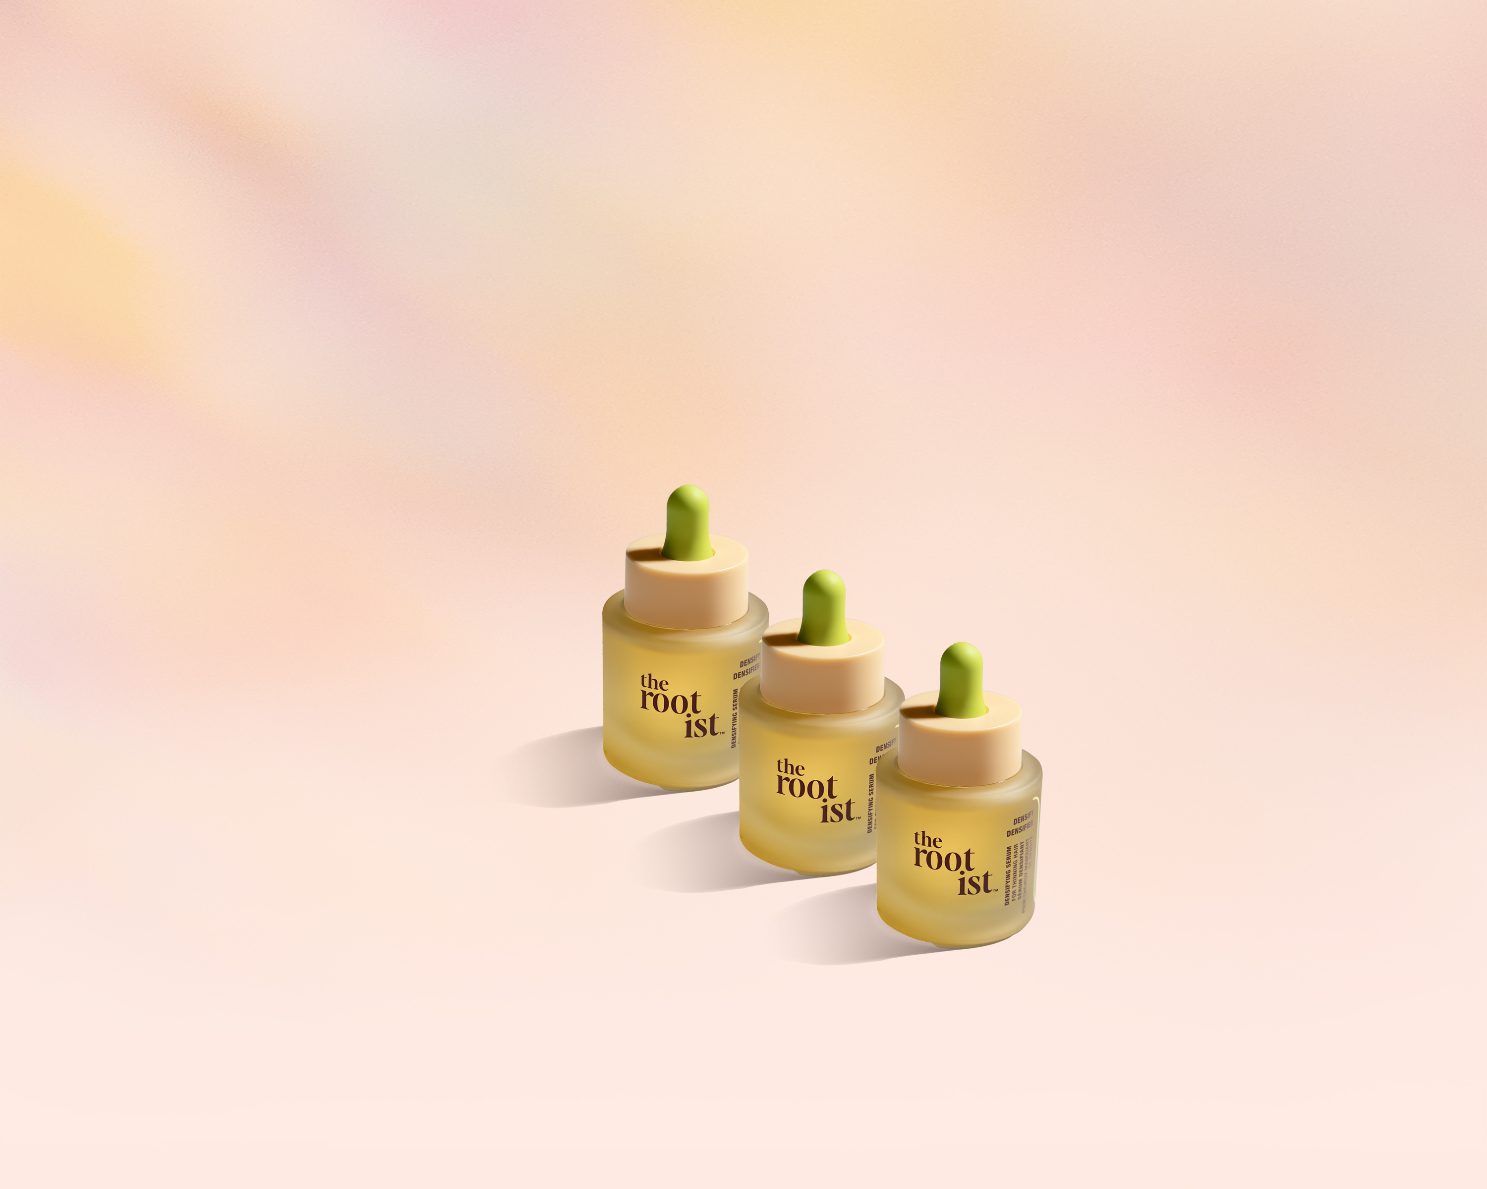
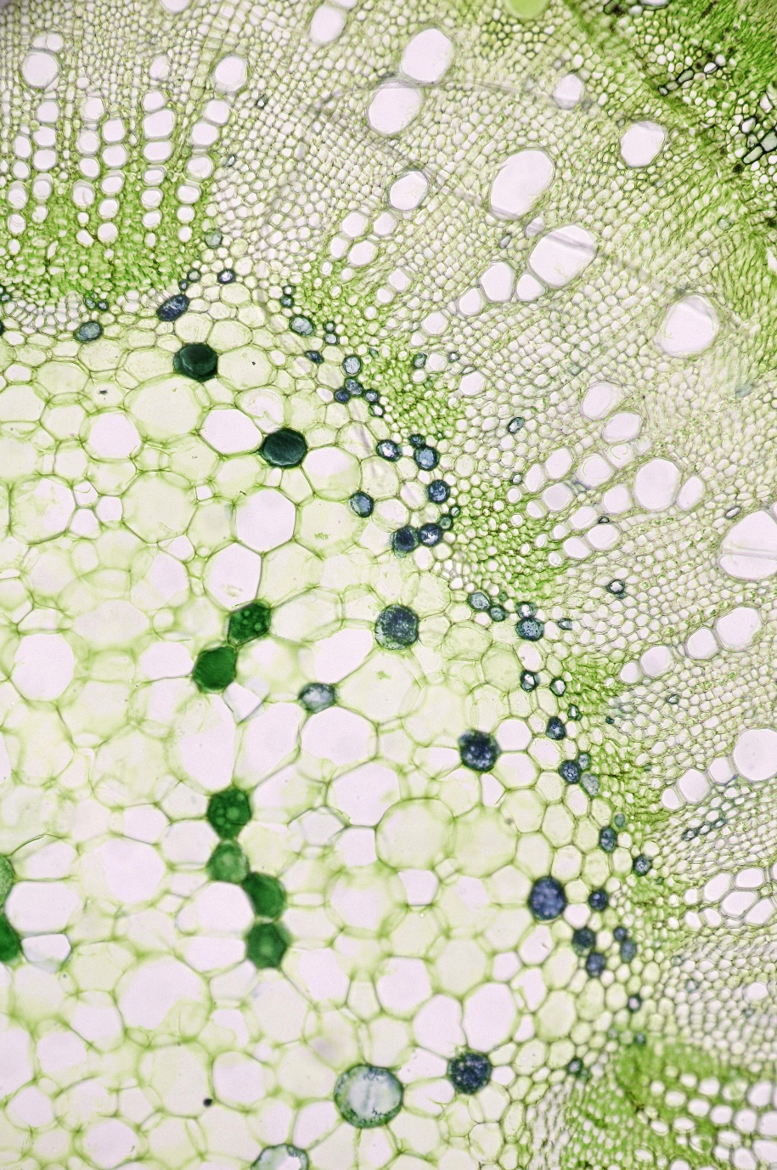
ingredient spotlight:
plant-based exosomes
breakthrough bioactive derived from turmeric extract
delivers powerful nutrients to scalp & roots to improve hair thickness & fullness

