Slide 1
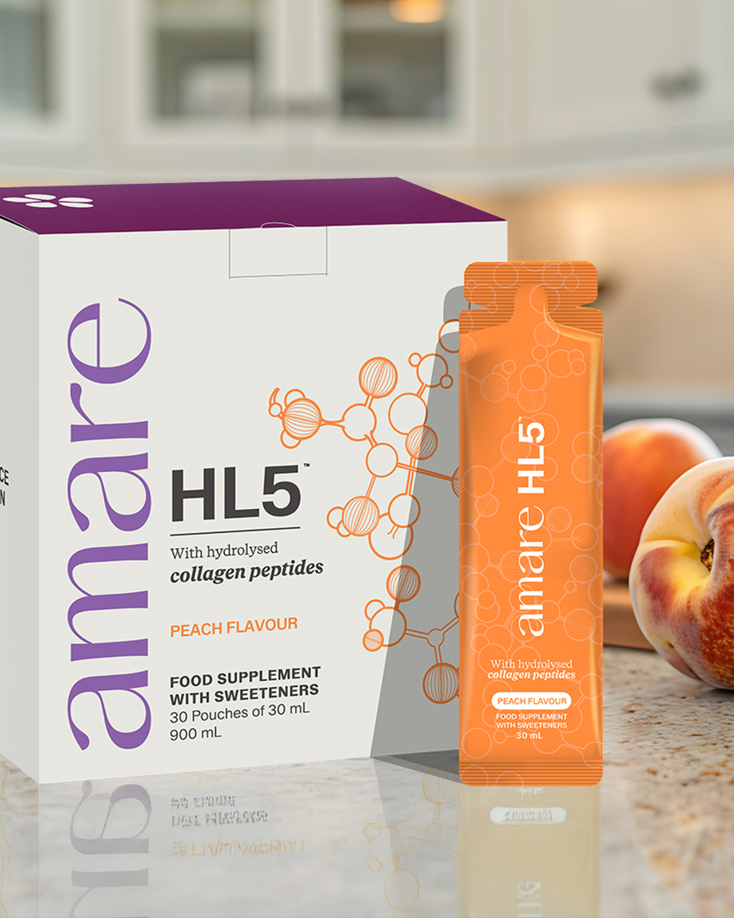


HL5™
1
Copyright © 2026 Amare Global. All rights reserved.

Slide 2
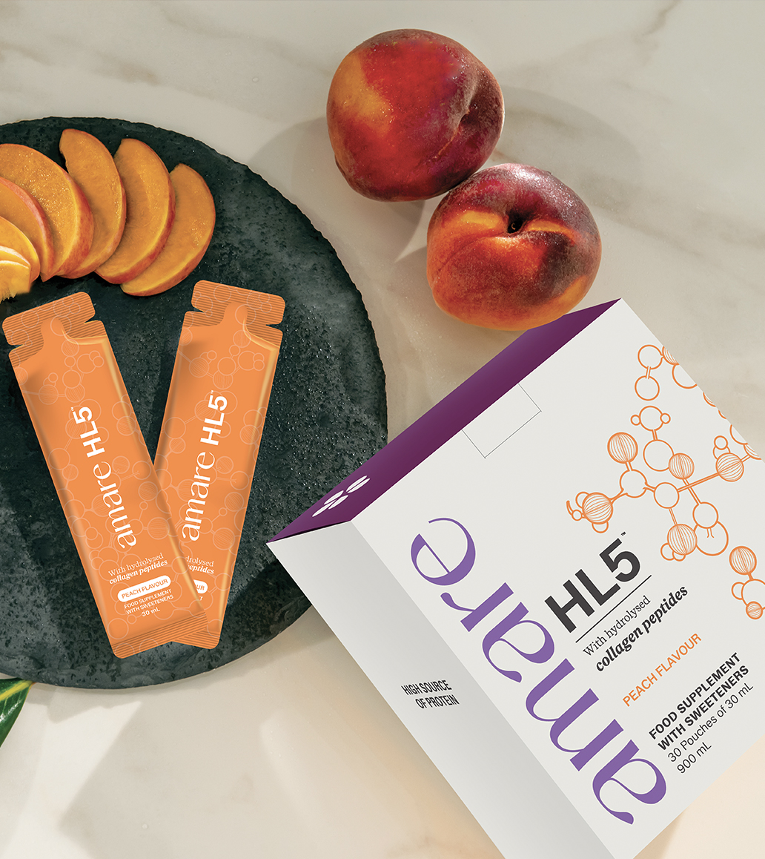
Amare HL5™
What It Is?
Amare HL5™ supports the body’s need for protein with grassfed collagen, hydrolysed for easy absorption.
What sets Amare HL5™ apart from other protein supplements is its use of hydrolyzed collagen. This means that the collagen is broken down into smaller, more absorbable molecules, making it easier for your body to digest and utilize. There are several types of collagen that differ in their structure and where they’re found in the body.
*DISCLAIMER: Food supplements must not be used as a substitute for a varied and balanced diet and a healthy lifestyle. If you are pregnant, breastfeeding, taking any medications or under medical supervision, please consult a doctor or healthcare professional before use. Keep out of reach of young children. Do not exceed the recommended daily dose. For adults only. Amare products do not claim to diagnose, treat, cure, or prevent any disease or medical condition. Statements regarding vitamins and minerals are valid only when these nutrients are present in the supplement in amounts specified by relevant EU regulations. The provided information is based on scientific studies of individual ingredients contained within Amare products. These studies have not directly examined Amare products themselves; thus, no direct relationship should be inferred between these study findings and Amare products. This information relies upon scientific research on certain ingredients in Amare products. None of the studies examined Amare product specifically, and there is not necessarily a relationship between the results of these studies and any Amare product. Amare products are not intended to, and do not, diagnose, treat, cure, prevent, or mitigate any disease or condition.
2
Copyright © 2026 Amare Global. All rights reserved.

Slide 3
Amare HL5™
What It Is?
In humans, there are four main types: Type 1, Type 2, Type 3 and Type 4.
Type 1 is the most prominent type found in humans, in fact, it accounts for 90% of the collagen in our bodies.
Type 3 collagen is a structural protein found in skin, blood vessels, and organs, where it helps support elasticity and tissue integrity.
Amare HL5™ includes both Type 1 and Type 3 Collagen.
*DISCLAIMER: Food supplements must not be used as a substitute for a varied and balanced diet and a healthy lifestyle. If you are pregnant, breastfeeding, taking any medications or under medical supervision, please consult a doctor or healthcare professional before use. Keep out of reach of young children. Do not exceed the recommended daily dose. For adults only. Amare products do not claim to diagnose, treat, cure, or prevent any disease or medical condition. Statements regarding vitamins and minerals are valid only when these nutrients are present in the supplement in amounts specified by relevant EU regulations. The provided information is based on scientific studies of individual ingredients contained within Amare products. These studies have not directly examined Amare products themselves; thus, no direct relationship should be inferred between these study findings and Amare products. This information relies upon scientific research on certain ingredients in Amare products. None of the studies examined Amare product specifically, and there is not necessarily a relationship between the results of these studies and any Amare product. Amare products are not intended to, and do not, diagnose, treat, cure, prevent, or mitigate any disease or condition.
3
Copyright © 2026 Amare Global. All rights reserved.

Slide 4

Amare HL5™
How It Works?
Protein is one of the essential building blocks of the human body, and as we age, easily digestible protein becomes increasingly important for overall well-being. Collagen is a naturally occurring structural protein ,playing a significant role in maintaining muscle and structural integrity of bones.
HL5™ effectively supports your body's protein needs with hydrolyzed collagen peptides, which are easily digestible and rapidly absorbed by the body. HL5™ product contains 5 g of hydrolysed bovine collagen per serving, which contributes to the total protein content.
Approved Protein Health Benefits:
1) Protein contributes to the growth of muscle mass.
2) Protein contributes to the maintenance of muscle mass.
3) Protein contributes to the maintenance of normal bones.
*DISCLAIMER: Food supplements must not be used as a substitute for a varied and balanced diet and a healthy lifestyle. If you are pregnant, breastfeeding, taking any medications or under medical supervision, please consult a doctor or healthcare professional before use. Keep out of reach of young children. Do not exceed the recommended daily dose. For adults only. Amare products do not claim to diagnose, treat, cure, or prevent any disease or medical condition. Statements regarding vitamins and minerals are valid only when these nutrients are present in the supplement in amounts specified by relevant EU regulations. The provided information is based on scientific studies of individual ingredients contained within Amare products. These studies have not directly examined Amare products themselves; thus, no direct relationship should be inferred between these study findings and Amare products. This information relies upon scientific research on certain ingredients in Amare products. None of the studies examined Amare product specifically, and there is not necessarily a relationship between the results of these studies and any Amare product. Amare products are not intended to, and do not, diagnose, treat, cure, prevent, or mitigate any disease or condition.
4
Copyright © 2026 Amare Global. All rights reserved.

Slide 5
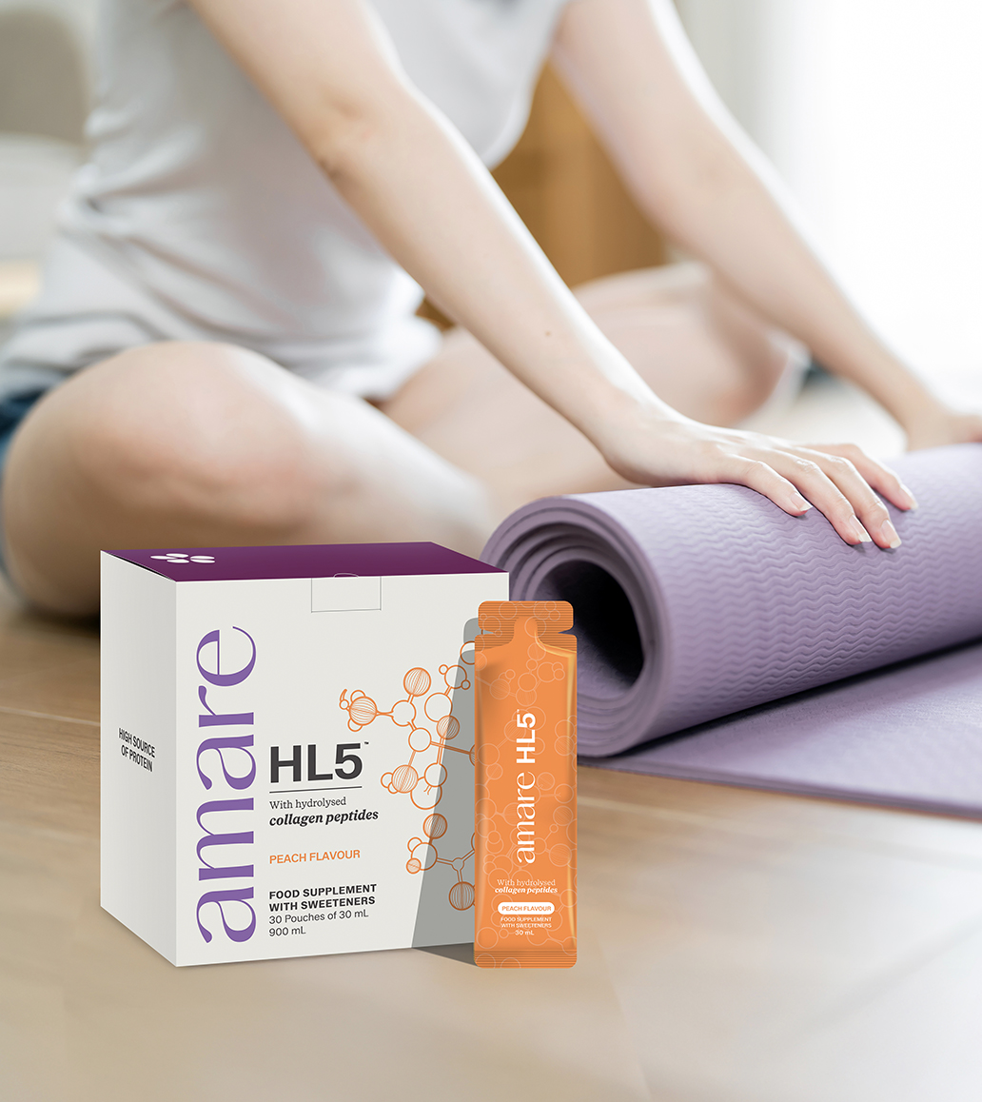

Amare HL5™
Why You’ll Love It?
Collagen is the most abundant protein in our bodies and it helps maintain bones and build muscle.
*DISCLAIMER: Food supplements must not be used as a substitute for a varied and balanced diet and a healthy lifestyle. If you are pregnant, breastfeeding, taking any medications or under medical supervision, please consult a doctor or healthcare professional before use. Keep out of reach of young children. Do not exceed the recommended daily dose. For adults only. Amare products do not claim to diagnose, treat, cure, or prevent any disease or medical condition. Statements regarding vitamins and minerals are valid only when these nutrients are present in the supplement in amounts specified by relevant EU regulations. The provided information is based on scientific studies of individual ingredients contained within Amare products. These studies have not directly examined Amare products themselves; thus, no direct relationship should be inferred between these study findings and Amare products. This information relies upon scientific research on certain ingredients in Amare products. None of the studies examined Amare product specifically, and there is not necessarily a relationship between the results of these studies and any Amare product. Amare products are not intended to, and do not, diagnose, treat, cure, prevent, or mitigate any disease or condition.
5
5
5
5
Copyright © 2026 Amare Global. All rights reserved.

Slide 6
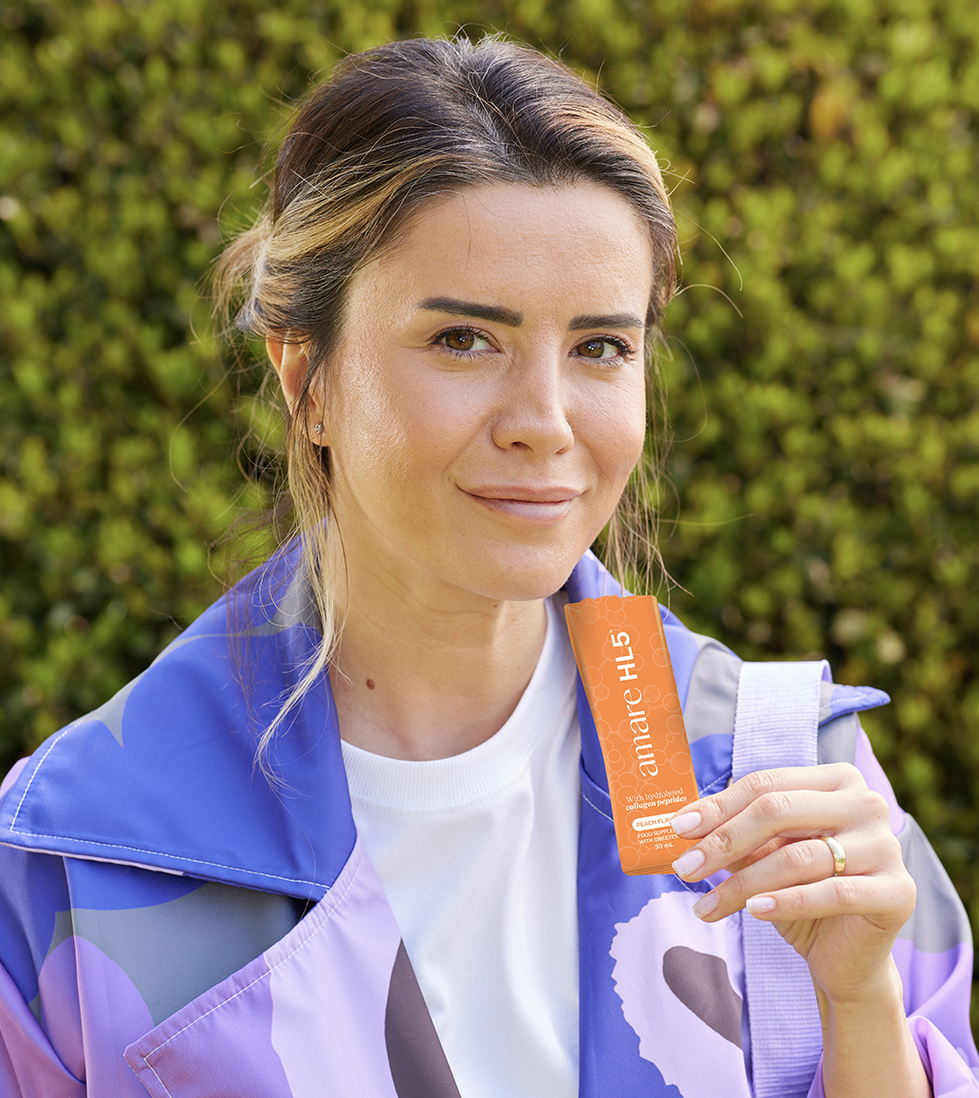
Amare HL5™
How To Use?
For maximum benefit, establish a healthy habit of taking one pouch of Amare HL5™ every day – in the morning, before bedtime, or between meals. Shake well before use.
Caution: Do not exceed the recommended daily dosage. This product should not replace a varied and balanced diet and a healthy lifestyle. Keep out of the reach of children. Do not use or consume if safety seal is missing or broken. Consult a doctor before using this product if you are pregnant, lactating or under medical treatment. For adults only.
*DISCLAIMER: Food supplements must not be used as a substitute for a varied and balanced diet and a healthy lifestyle. If you are pregnant, breastfeeding, taking any medications or under medical supervision, please consult a doctor or healthcare professional before use. Keep out of reach of young children. Do not exceed the recommended daily dose. For adults only. Amare products do not claim to diagnose, treat, cure, or prevent any disease or medical condition. Statements regarding vitamins and minerals are valid only when these nutrients are present in the supplement in amounts specified by relevant EU regulations. The provided information is based on scientific studies of individual ingredients contained within Amare products. These studies have not directly examined Amare products themselves; thus, no direct relationship should be inferred between these study findings and Amare products. This information relies upon scientific research on certain ingredients in Amare products. None of the studies examined Amare product specifically, and there is not necessarily a relationship between the results of these studies and any Amare product. Amare products are not intended to, and do not, diagnose, treat, cure, prevent, or mitigate any disease or condition.
6
Copyright © 2026 Amare Global. All rights reserved.

Slide 7
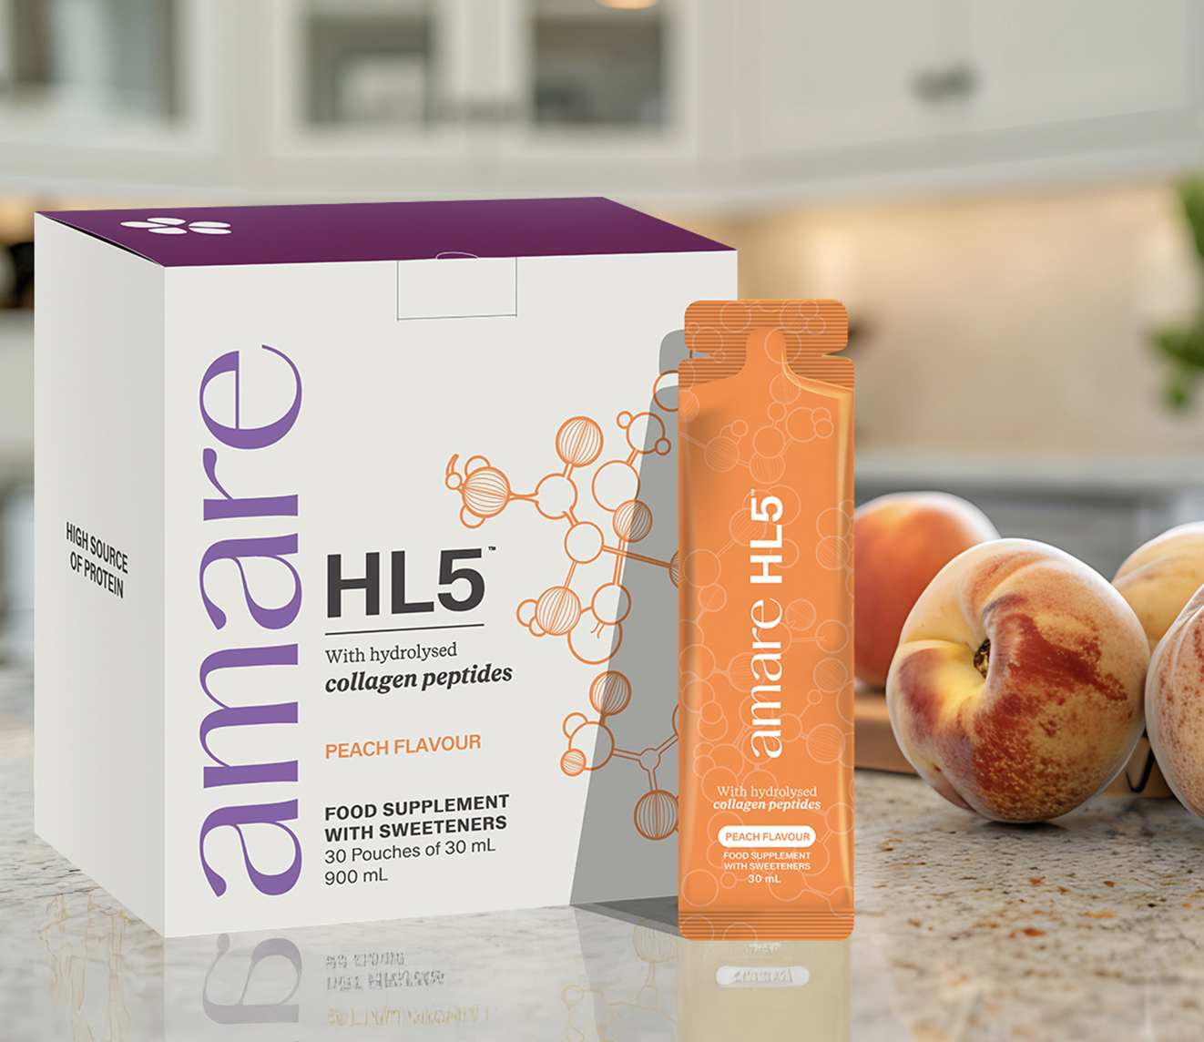

Amare HL5™
Key Features

Slide 8
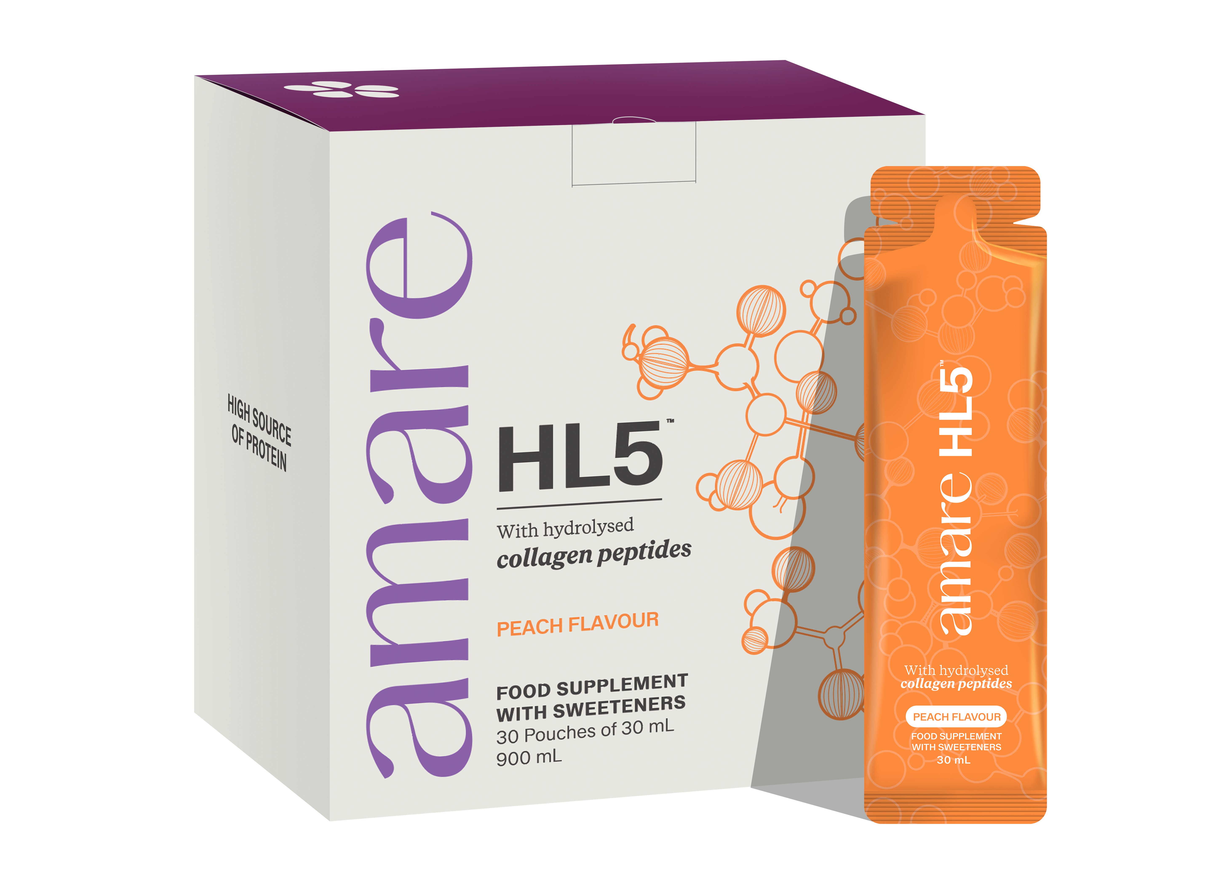


Amare HL5™
Key Benefits
Bones
Protein contributes to the maintenance of normal bones.
Muscles
Protein contributes to the growth of muscle mass.
Protein contributes to the maintenance of muscle mass.
*DISCLAIMER: Food supplements must not be used as a substitute for a varied and balanced diet and a healthy lifestyle. If you are pregnant, breastfeeding, taking any medications or under medical supervision, please consult a doctor or healthcare professional before use. Keep out of reach of young children. Do not exceed the recommended daily dose. For adults only. Amare products do not claim to diagnose, treat, cure, or prevent any disease or medical condition. Statements regarding vitamins and minerals are valid only when these nutrients are present in the supplement in amounts specified by relevant EU regulations. The provided information is based on scientific studies of individual ingredients contained within Amare products. These studies have not directly examined Amare products themselves; thus, no direct relationship should be inferred between these study findings and Amare products. This information relies upon scientific research on certain ingredients in Amare products. None of the studies examined Amare product specifically, and there is not necessarily a relationship between the results of these studies and any Amare product. Amare products are not intended to, and do not, diagnose, treat, cure, prevent, or mitigate any disease or condition.
8
Copyright © 2026 Amare Global. All rights reserved.

Slide 9
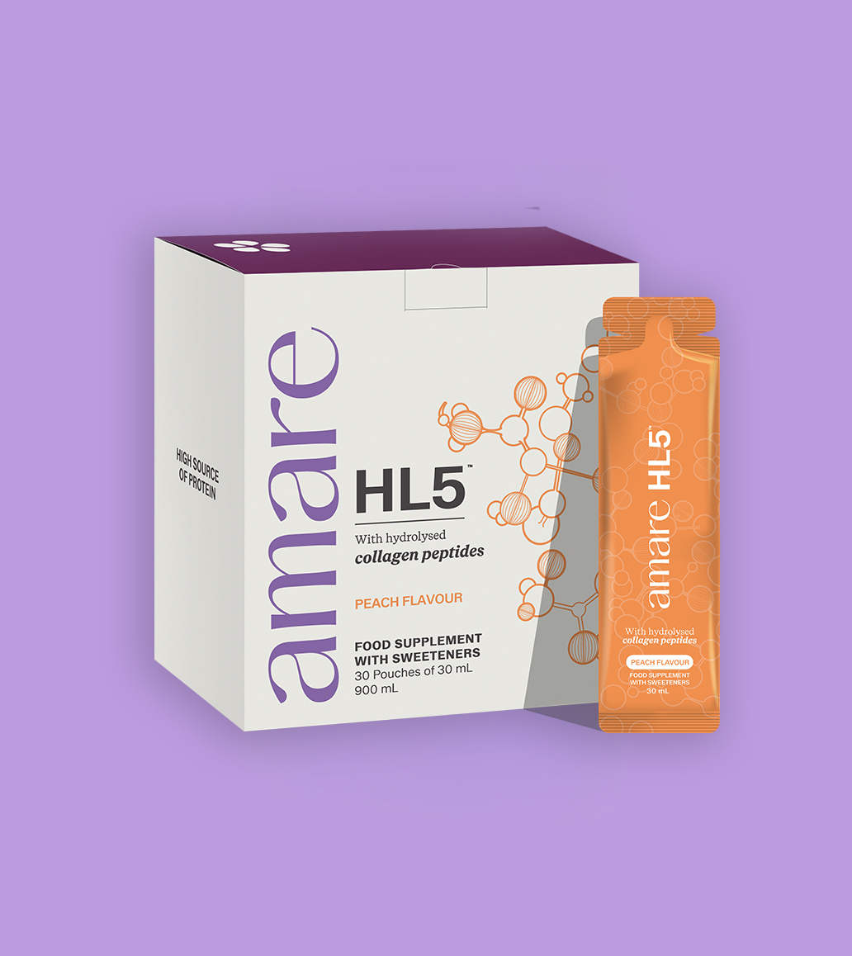
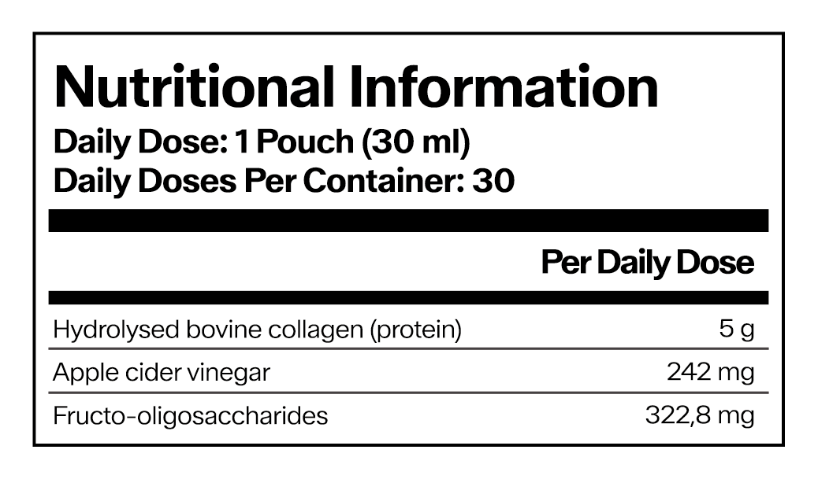
Amare HL5™
Nutritional Information
9
9
9
Copyright © 2026 Amare Global. All rights reserved.

Slide 10
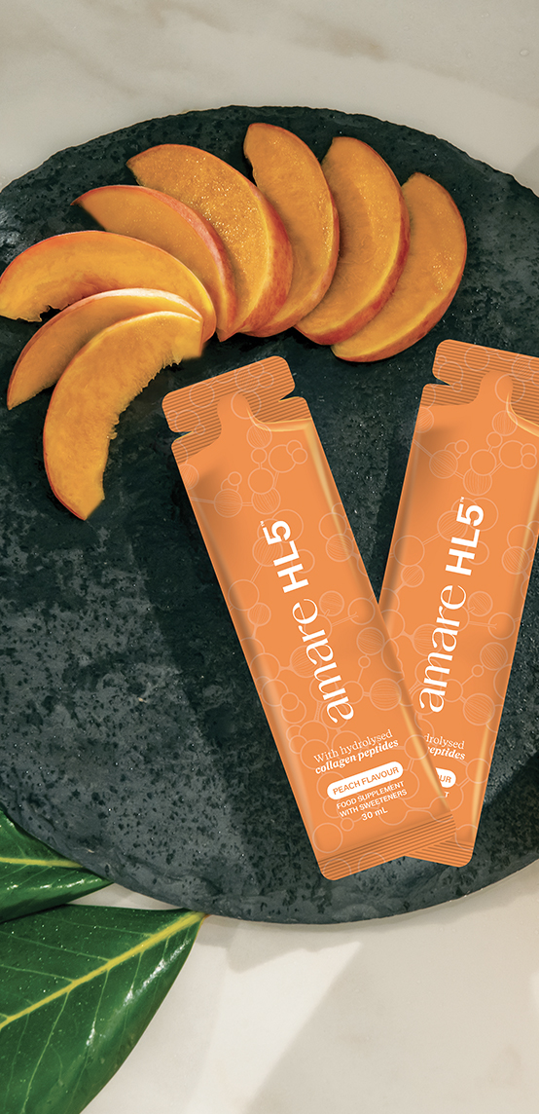
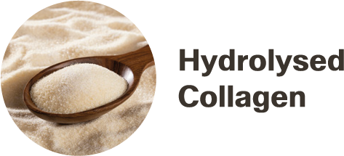


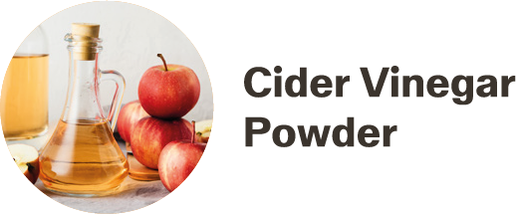
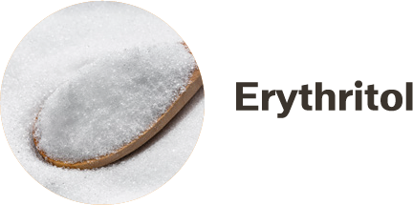
Amare HL5™
Ingredients
Water, hydrolysed bovine collagen(5gr per serving), sweetener: erythritol, acidity regulator: citric acid, flavouring, fructo-oligosaccharides, apple cider vinegar powder (Malus domestica), thickener: xanthan gum, flavouring, preservative: potassium sorbate, sweetener: steviol glycosides from Stevia.
10
10
10
Copyright © 2026 Amare Global. All rights reserved.

Slide 11
You can reach out product brochure in your official language: HL5 EU Product Brochure
For More Please Check Out
www.amare.com

