Slide 1
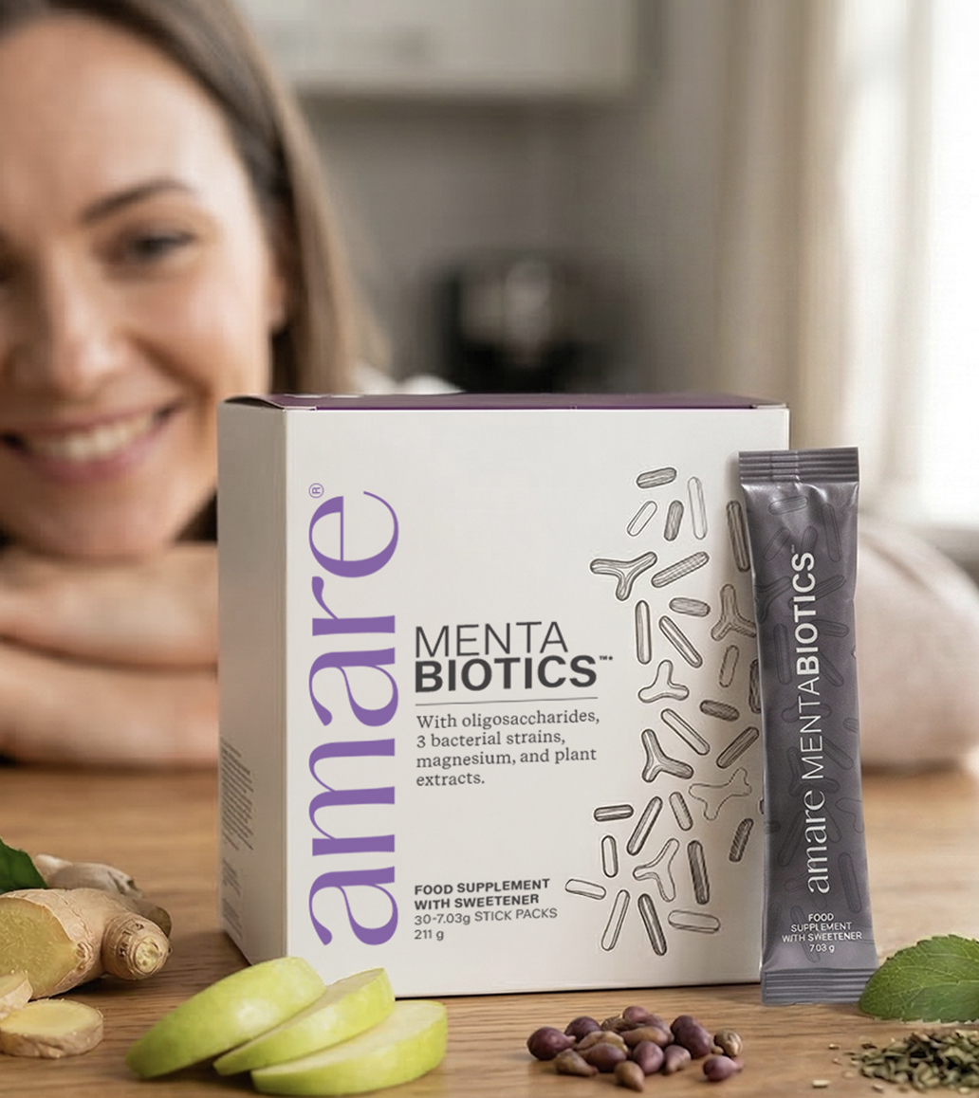


Mentabiotics™*
1
Copyright © 2026 Amare Global. All rights reserved.

Slide 2
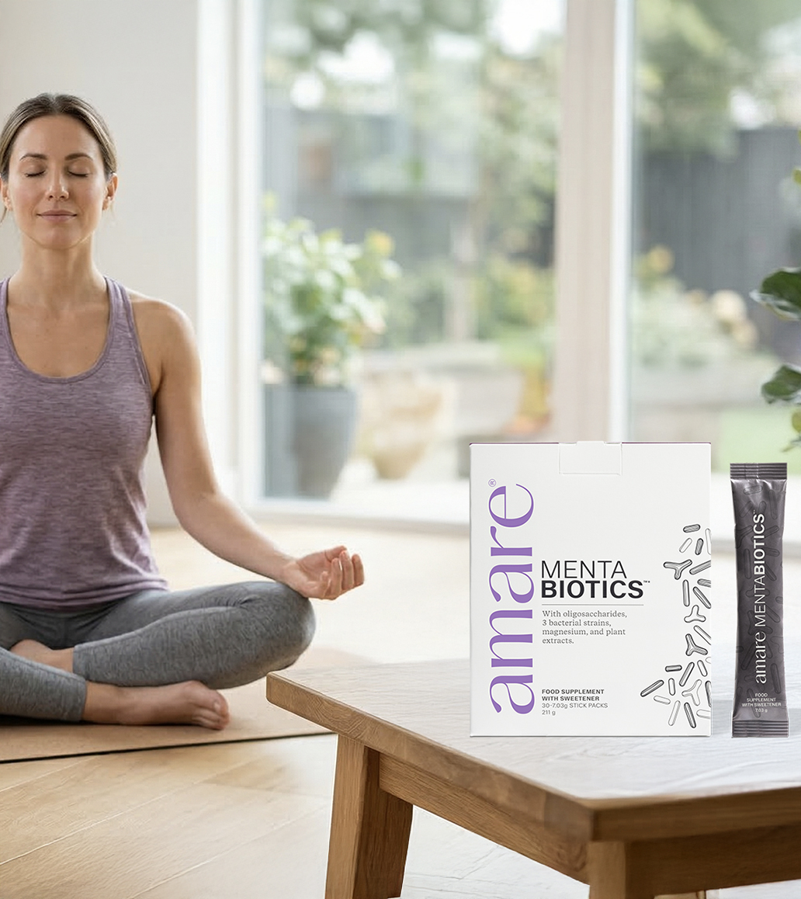
Amare Mentabiotics™*
What It Is?
Mentabiotics™* is a multi‑component formula that combines oligosaccharides, bacterial strains, amino acids, magnesium, and botanical ingredients in a carefully balanced daily supplement. The formulation includes isomalto‑ and galacto‑oligosaccharides, three bacterial strains, L‑glutamine, and plant‑derived extracts such as green tea, grape seed, maritime pine bark, ginger, and apple fruit.
These components reflect growing scientific interest in the diverse nutrients, fibres, bacterial strains, and phyto‑compounds found in food supplements. Each ingredient group contributes its own characteristics to the overall profile of the product.
*DISCLAIMER: This information relies upon scientific research on certain ingredients in Amare products. None of the studies examined Amare product specifically, and there is not necessarily a relationship between the results of these studies and any Amare product. Amare products are not intended to, and do not, diagnose, treat, cure, prevent, or mitigate any disease or condition.
2
Copyright © 2026 Amare Global. All rights reserved.

Slide 3
Amare Mentabiotics™*
What It Is?
Magnesium contributes to normal psychological function, normal energy‑yielding metabolism, and to the reduction of tiredness and fatigue, providing recognised physiological benefits when consumed at the recommended daily dose.
*DISCLAIMER: This information relies upon scientific research on certain ingredients in Amare products. None of the studies examined Amare product specifically, and there is not necessarily a relationship between the results of these studies and any Amare product. Amare products are not intended to, and do not, diagnose, treat, cure, prevent, or mitigate any disease or condition.
3
Copyright © 2026 Amare Global. All rights reserved.

Slide 4
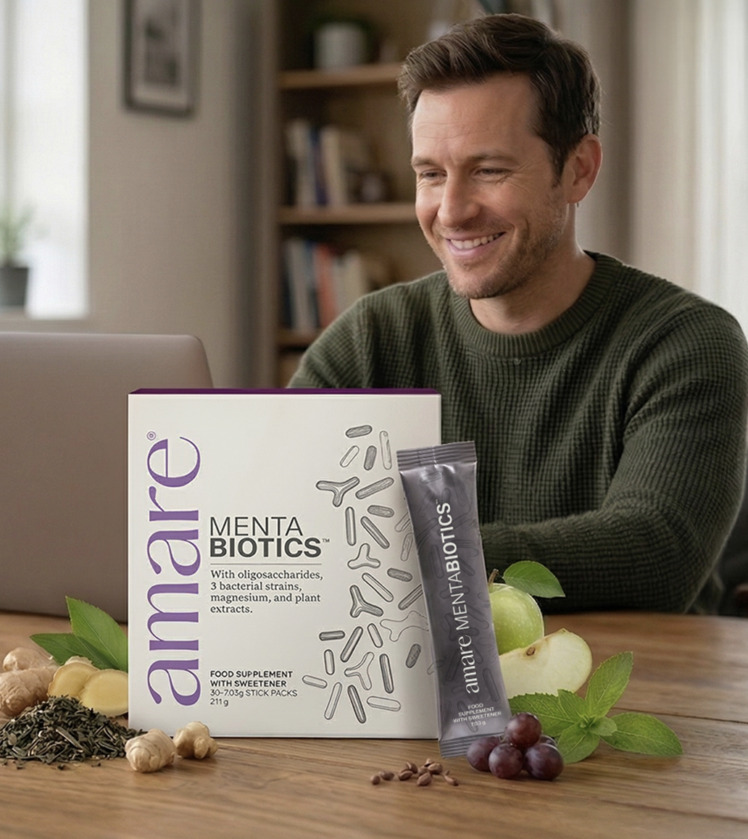

Amare Mentabiotics™*
Why You’ll Love It?
Contains clinically researched probiotic bacterial strains and natural plant extracts
Helps reduce tiredness and supports normal energy metabolism (magnesium)
Naturally sweetened with Stevia, free from artificial colorants or preservatives
Suitable for daily use as part of a balanced lifestyle
Magnesium contributes to normal psychological function, to the reduction of tiredness and fatigue, and to normal energy-yielding metabolism.
*DISCLAIMER: This information relies upon scientific research on certain ingredients in Amare products. None of the studies examined Amare product specifically, and there is not necessarily a relationship between the results of these studies and any Amare product. Amare products are not intended to, and do not, diagnose, treat, cure, prevent, or mitigate any disease or condition.
4
4
4
4
Copyright © 2026 Amare Global. All rights reserved.

Slide 5
Amare Mentabiotics™*
How To Use?
Recommended daily dose and directions of use:
Mix 1 stick in 250 ml of water. Take once per day. Do not exceed the recommended daily dose
WARNINGS: Food supplements should not be used as a substitute for a balanced and varied diet and a healthy lifestyle. Keep out of the reach of young children. The isomalto-oligosaccharide is a source of glucose. Consult your doctor or pharmacist when using anticoagulants. The product contains 1 mg (-)-epigallocatechin-3-gallate (EGCG) per daily dose. It is not recommended to consume a daily amount of 800 mg of EGCG or more.Should not be consumed by pregnant or lactating women and children below 18 years old. Should not be consumed if you are already consuming other products containing green tea on the same day. Should not be consumed on an empty stomach.
*DISCLAIMER: This information relies upon scientific research on certain ingredients in Amare products. None of the studies examined Amare product specifically, and there is not necessarily a relationship between the results of these studies and any Amare product. Amare products are not intended to, and do not, diagnose, treat, cure, prevent, or mitigate any disease or condition.
5
Copyright © 2026 Amare Global. All rights reserved.

Slide 6
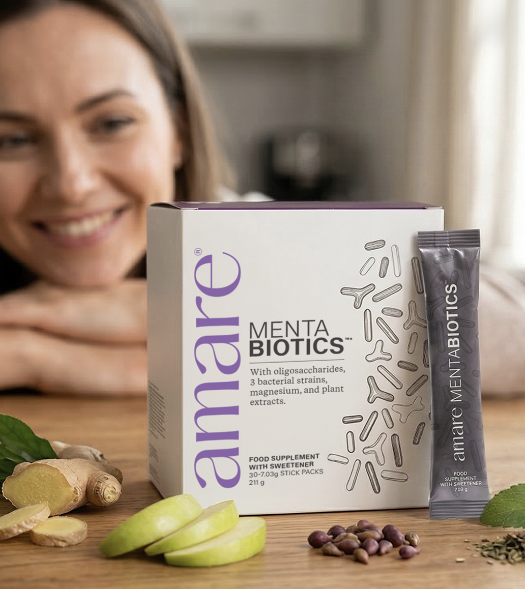
Amare Mentabiotics™*
The SCIENCE of
Amare Mentabiotics™*
Mentabiotics™* is a food supplement containing 3 bacterial strains, dietary fibre, botanical ingredients, and magnesium. Magnesium contributes to normal psychological function and to the reduction of tiredness and fatigue.
Mentabiotics™* is a food supplement that combines oligosaccharides, bacterial strains, magnesium, L‑glutamine, and botanical ingredients in a carefully balanced daily formula.
*DISCLAIMER: This information relies upon scientific research on certain ingredients in Amare products. None of the studies examined Amare product specifically, and there is not necessarily a relationship between the results of these studies and any Amare product. Amare products are not intended to, and do not, diagnose, treat, cure, prevent, or mitigate any disease or condition.
6
Copyright © 2026 Amare Global. All rights reserved.

Slide 7
Amare Mentabiotics™*
The SCIENCE of
Amare Mentabiotics™*
Each serving provides isomalto‑ and galacto‑oligosaccharides, three bacterial strains, and a blend of plant extracts including green tea, grape seed, maritime pine bark, ginger, and apple fruit.
Magnesium contributes to normal psychological function, normal energy‑yielding metabolism, and to the reduction of tiredness and fatigue.
These recognised physiological functions make Mentabiotics™* a supportive addition to your daily routine.
Mentabiotics™* can be enjoyed as part of a balanced lifestyle.
*DISCLAIMER: This information relies upon scientific research on certain ingredients in Amare products. None of the studies examined Amare product specifically, and there is not necessarily a relationship between the results of these studies and any Amare product. Amare products are not intended to, and do not, diagnose, treat, cure, prevent, or mitigate any disease or condition.
7
Copyright © 2026 Amare Global. All rights reserved.

Slide 8
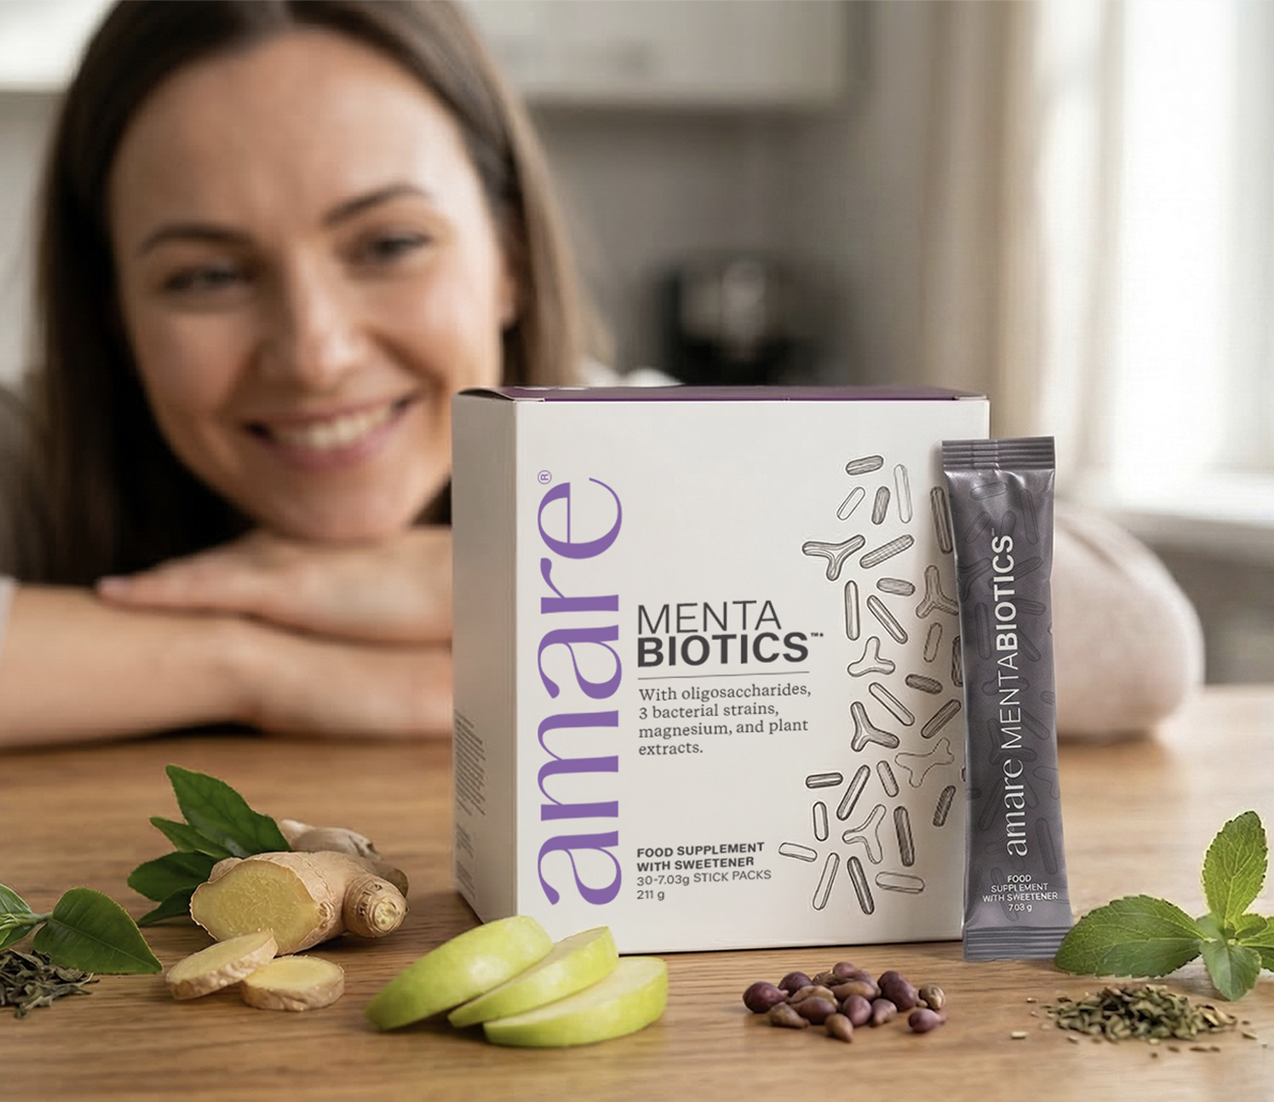
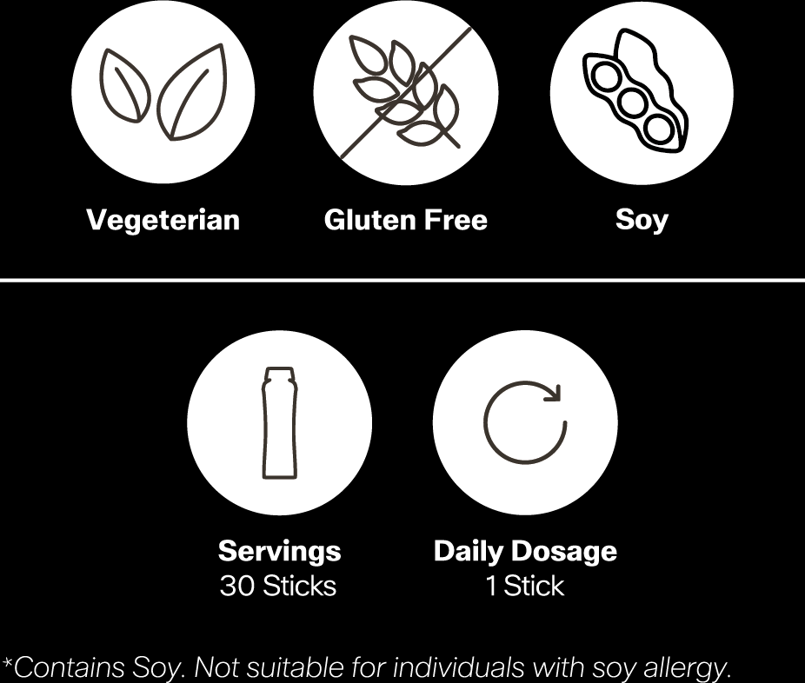
Amare Mentabiotics™*
Key Features

Slide 9
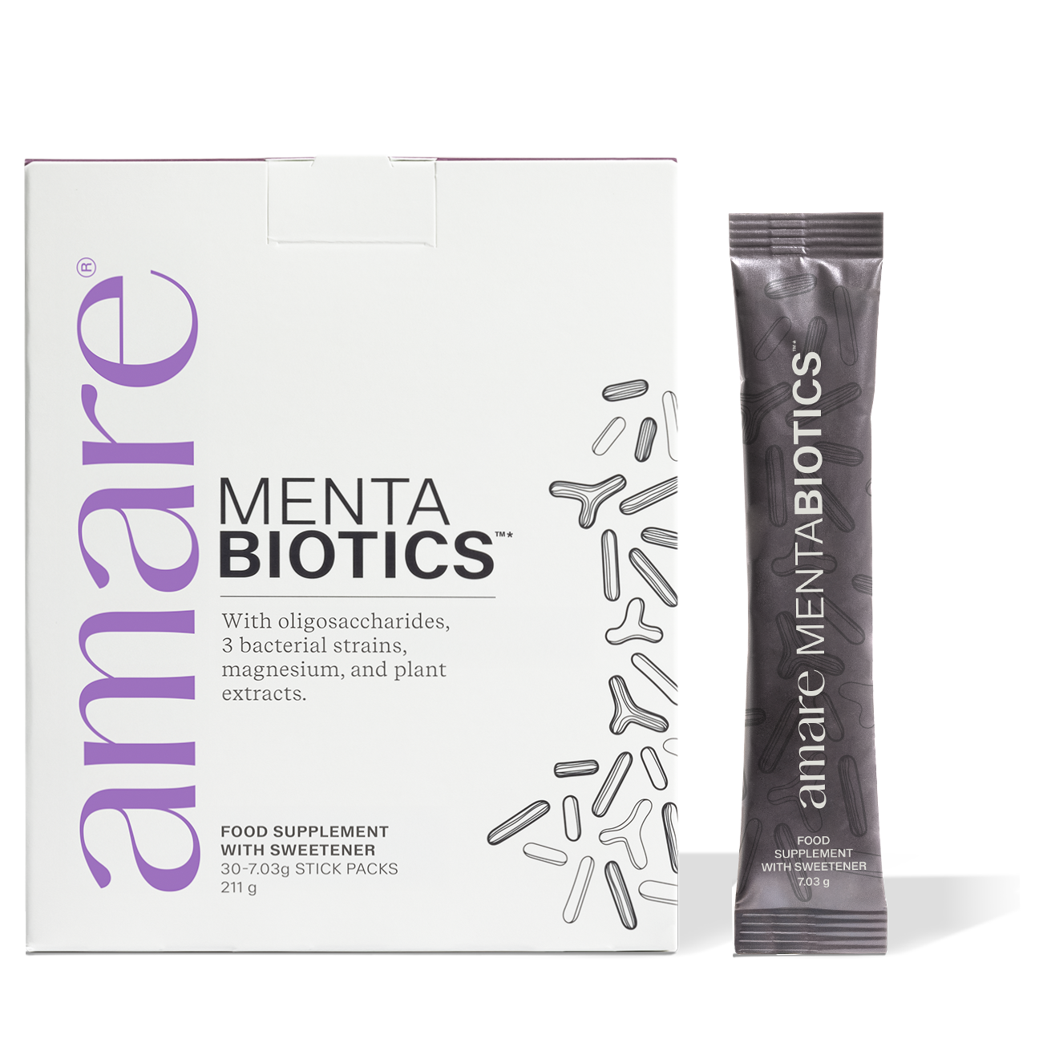
Amare Mentabiotics™*
Key Benefits
Metabolism
Magnesium contributes to normal energy-yielding metabolism helping maintain daily vitality.
Magnesium contributes to the reduction of tiredness and fatigue, making it ideal for busy lifestyles.
Magnesium contributes to electrolyte balance
Brain Function
Magnesium contributes to normal psychological function supporting everyday mental performance
Nervous System
Magnesium contributes to normal functioning of the nervous system
*DISCLAIMER: This information relies upon scientific research on certain ingredients in Amare products. None of the studies examined Amare product specifically, and there is not necessarily a relationship between the results of these studies and any Amare product. Amare products are not intended to, and do not, diagnose, treat, cure, prevent, or mitigate any disease or condition.
9
Copyright © 2026 Amare Global. All rights reserved.

Slide 10
Amare Mentabiotics™*
Key Benefits
And More
Multi-component formula combining fibres, live cultures,
amino acids,
magnesium, and plant ingredients
Includes isomalto- and galacto-oligosaccharides to diversify the fibre profile
Features botanical extracts such as green tea, grape seed, maritime pine bark, ginger, and apple fruit
Contains L-glutamine, a widely used amino acid
Designed for easy daily use as part of a balanced lifestyle
*DISCLAIMER: This information relies upon scientific research on certain ingredients in Amare products. None of the studies examined Amare product specifically, and there is not necessarily a relationship between the results of these studies and any Amare product. Amare products are not intended to, and do not, diagnose, treat, cure, prevent, or mitigate any disease or condition.
10
Copyright © 2026 Amare Global. All rights reserved.

Slide 11
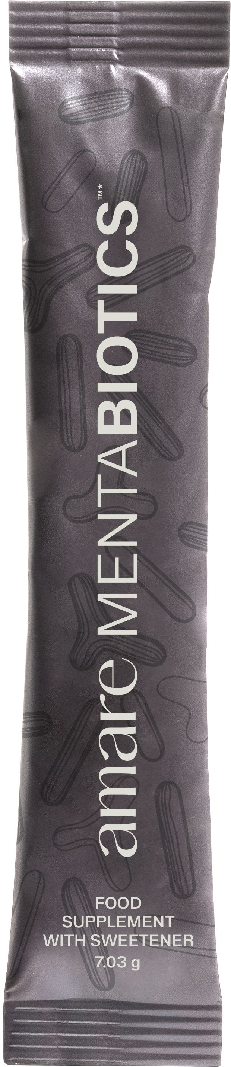
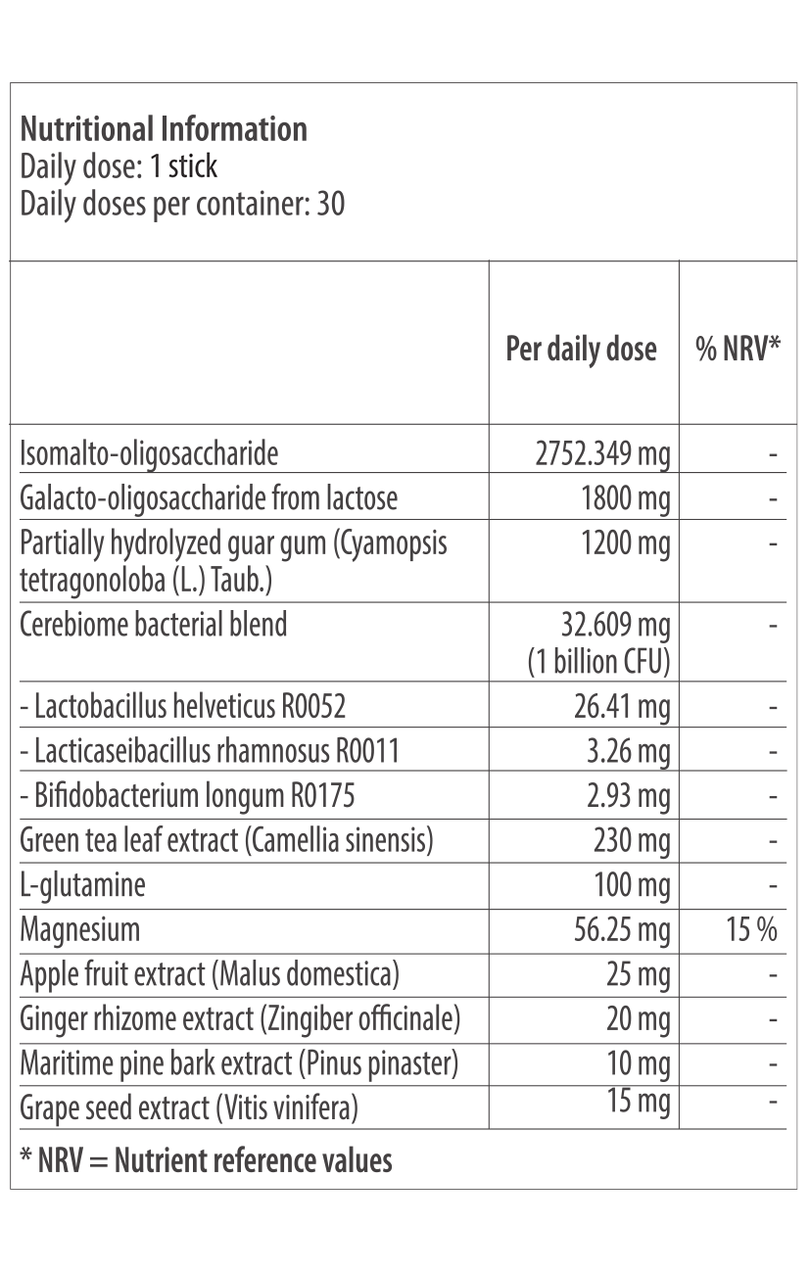
Amare Mentabiotics™*
Nutritional Information
11
11
11
Copyright © 2026 Amare Global. All rights reserved.

Slide 12
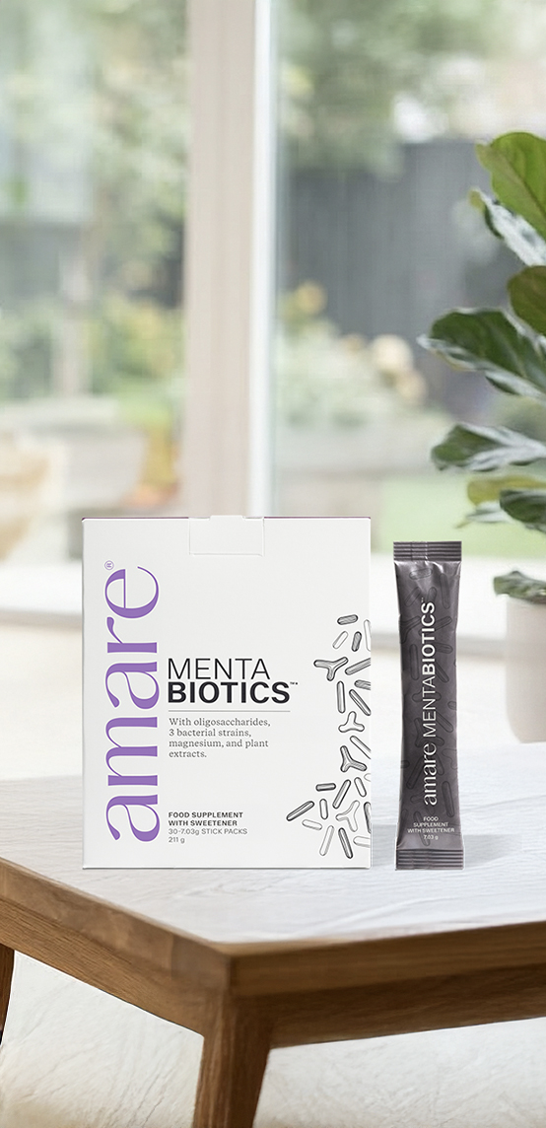
Amare Mentabiotics™*
Ingredients
Green Tea Leaf Extract
Ginger Rhizome
Extract
Magnesium
Oxide
Maritime Pine Bark
Extract
Stevia
Grape Seed
Extract
Apple Fruit
Extract
Isomalto-oligosaccharide, galacto-oligosaccharide from lactose (milk), partially hydrolyzed guar gum (Cyamopsis tetragonoloba (L.) Taub.), green tea leaf extract (Camellia sinensis), L-glutamine, flavouring, magnesium oxide, Cerebiome bacterial blend (Lactobacillus helveticus R0052, Lacticaseibacillus rhamnosus R0011, Bifidobacterium longum R0175) (soy), acidity regulator: citric acid, sweetener: steviol glycosides from Stevia, apple fruit extract (Malus domestica) ginger rhizome extract (Zingiber officinale), maritime pine bark extract (Pinus pinaster), grape seed extract (Vitis vinifera)
12
12
12
Copyright © 2026 Amare Global. All rights reserved.

Slide 13
You can reach out product brochure in your official language: MentaBiotics EU Product Brochure
For More Please Check Out
www.amare.com

