Slide 1
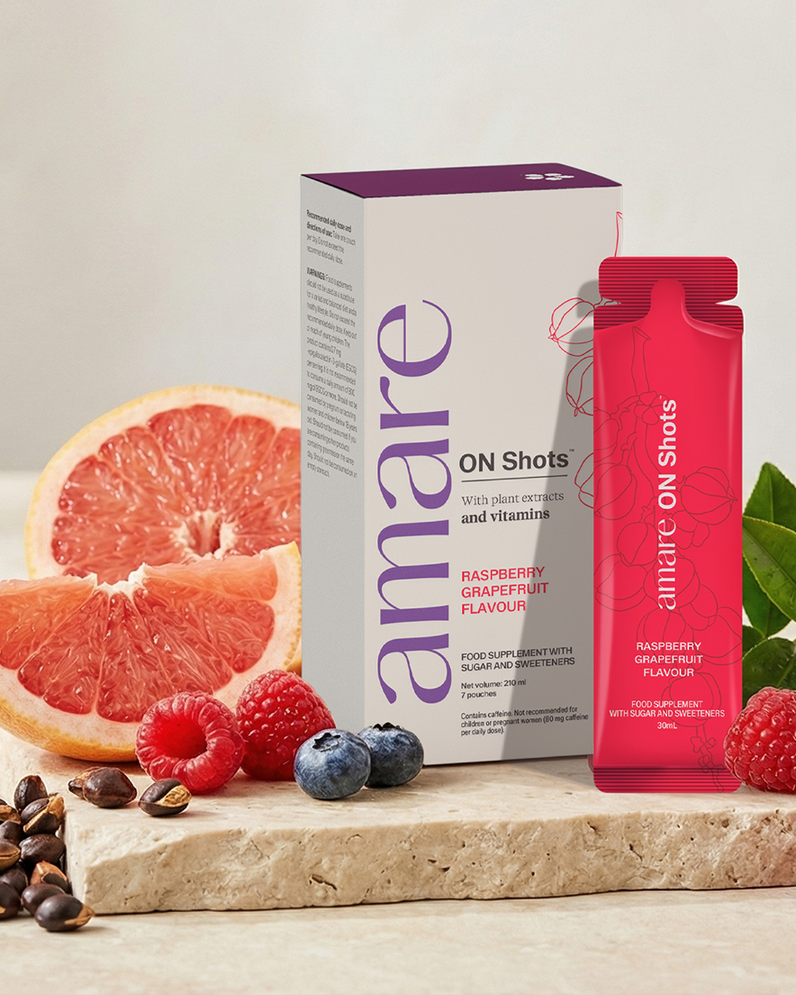


ON SHOTS™
1
Copyright © 2026 Amare Global. All rights reserved.

Slide 2
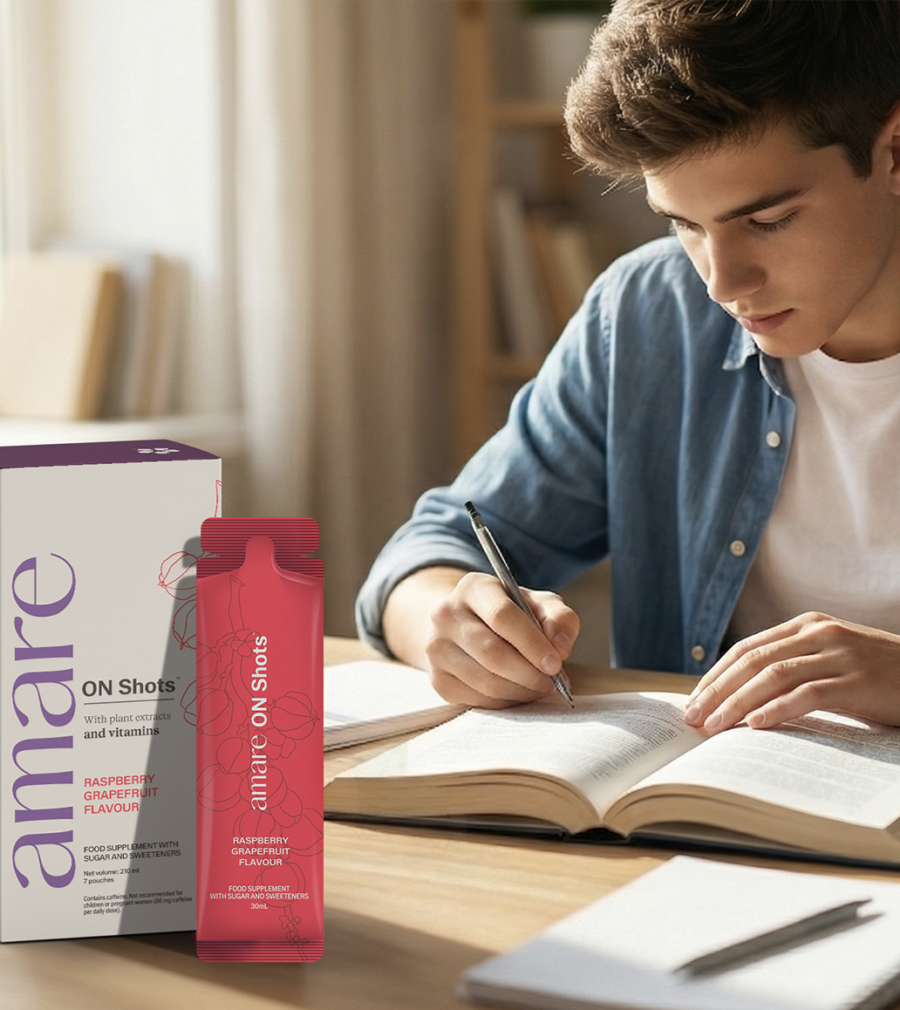
Amare ON Shots™
What It Is?
Amare ON Shots is a food supplement, combining vitamins, plant extracts, amino acids and natural fruit flavours. It provides selected vitamins that contribute to normal energy yielding metabolism and normal psychological function, while offering a refreshing and enjoyable daily ritual.*
Amare ON Shots™ is a food supplement formulated with a combination of vitamins, amino acids and botanical ingredients for daily use. Each daily dose provides B vitamins (B1, B2, B3, B6 and B12), which contribute to normal energy yielding metabolism. Niacin and vitamin B6 contribute to the reduction of tiredness and fatigue.
*DISCLAIMER: Amare products are not intended to diagnose, treat, cure, or prevent any disease or medical condition. Please store your Amare products out of reach of young children. For adults only. The stated health claims are valid provided that the vitamins and minerals contained in the food supplement are present in amounts as defined by applicable regulations. The information provided here is derived from scientific studies carried out on specific ingredients found in Amare products. These studies have not been performed directly on Amare products themselves. Thus, the findings of these studies should not be interpreted as direct evidence of the effects or benefits of Amare products.
2
Copyright © 2026 Amare Global. All rights reserved.

Slide 3
Amare ON Shots™
What It Is?
The formulation contains choline, inositol and amino acids such as taurine and L citrulline, as well as botanical ingredients including green tea, guarana, galangal and blueberry. With real fruit juice powder and natural flavours, Amare ON Shots™ offers a clean, refreshing taste. Free from artificial colours, gluten and GMOs, it is suitable for everyday consumption as part of a balanced diet and healthy lifestyle.
*DISCLAIMER: Amare products are not intended to diagnose, treat, cure, or prevent any disease or medical condition. Please store your Amare products out of reach of young children. For adults only. The stated health claims are valid provided that the vitamins and minerals contained in the food supplement are present in amounts as defined by applicable regulations. The information provided here is derived from scientific studies carried out on specific ingredients found in Amare products. These studies have not been performed directly on Amare products themselves. Thus, the findings of these studies should not be interpreted as direct evidence of the effects or benefits of Amare products.
3
Copyright © 2026 Amare Global. All rights reserved.

Slide 4
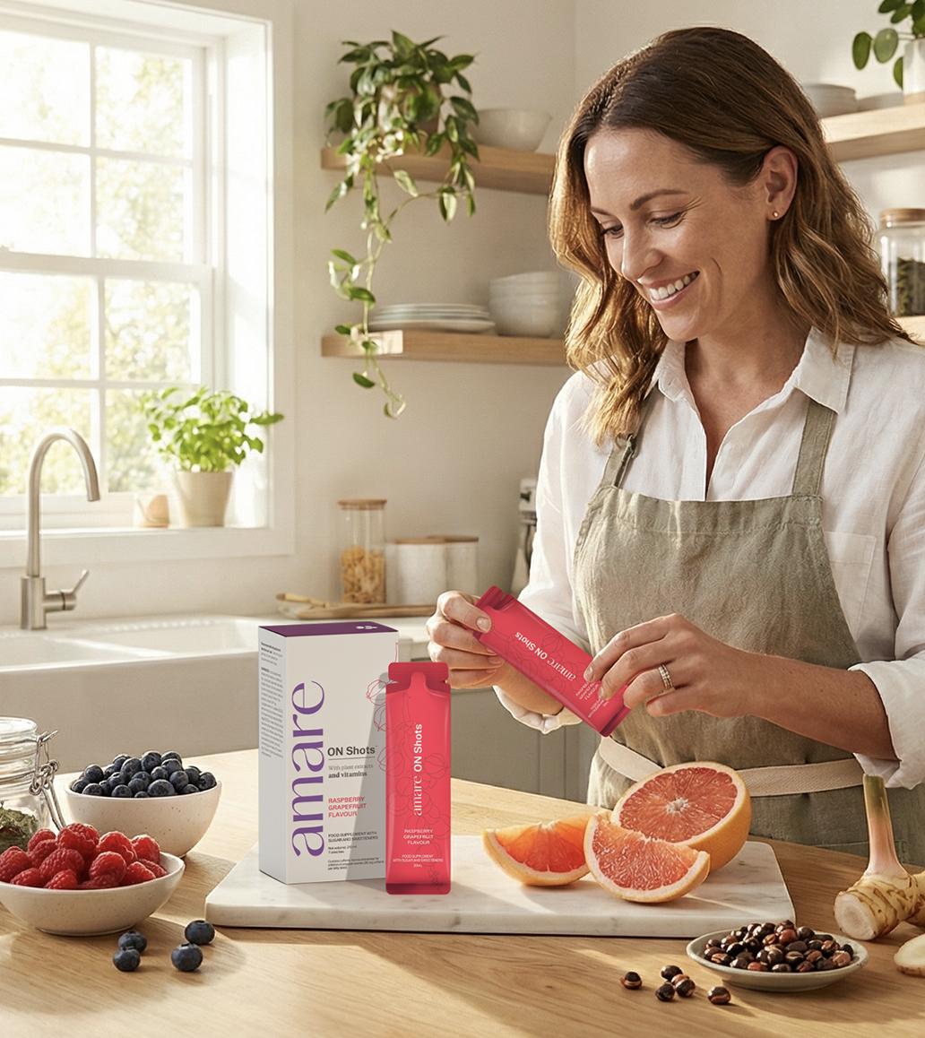
Amare ON Shots™
How It Works?
B Vitamins (B1, B2, B3, B6, B12)
Contribute to normal energy yielding metabolism and contribute to the normal functioning of the nervous system.*
Niacin and vitamin B6 contribute to the reduction of tiredness and fatigue.*
Choline & Inositol
Choline contributes to normal lipid metabolism and normal homocysteine metabolism.*
The product also contains inositol.
*DISCLAIMER: Amare products are not intended to diagnose, treat, cure, or prevent any disease or medical condition. Please store your Amare products out of reach of young children. For adults only. The stated health claims are valid provided that the vitamins and minerals contained in the food supplement are present in amounts as defined by applicable regulations. The information provided here is derived from scientific studies carried out on specific ingredients found in Amare products. These studies have not been performed directly on Amare products themselves. Thus, the findings of these studies should not be interpreted as direct evidence of the effects or benefits of Amare products.
4
Copyright © 2026 Amare Global. All rights reserved.

Slide 5
Amare ON Shots™
How It Works?
Botanical Extracts
• Guarana (natural source of caffeine).
• Green tea extract providing natural polyphenols.
• Alpinia galangal used in botanical preparations.
• Blueberry powder providing natural fruit polyphenols.
*DISCLAIMER: Amare products are not intended to diagnose, treat, cure, or prevent any disease or medical condition. Please store your Amare products out of reach of young children. For adults only. The stated health claims are valid provided that the vitamins and minerals contained in the food supplement are present in amounts as defined by applicable regulations. The information provided here is derived from scientific studies carried out on specific ingredients found in Amare products. These studies have not been performed directly on Amare products themselves. Thus, the findings of these studies should not be interpreted as direct evidence of the effects or benefits of Amare products.
5
Copyright © 2026 Amare Global. All rights reserved.

Slide 6
Amare ON Shots™
How It Works?
Amino Acids (L Citrulline & Taurine)
Included as part of the product’s formulation.
Natural Taste System
Real fruit juice powder (Vaccinium corymbosum), natural raspberry and grapefruit flavours, cane juice syrup, erythritol and stevia provide a balanced and refreshing flavour profile.
*DISCLAIMER: Amare products are not intended to diagnose, treat, cure, or prevent any disease or medical condition. Please store your Amare products out of reach of young children. For adults only. The stated health claims are valid provided that the vitamins and minerals contained in the food supplement are present in amounts as defined by applicable regulations. The information provided here is derived from scientific studies carried out on specific ingredients found in Amare products. These studies have not been performed directly on Amare products themselves. Thus, the findings of these studies should not be interpreted as direct evidence of the effects or benefits of Amare products.
6
Copyright © 2026 Amare Global. All rights reserved.

Slide 7
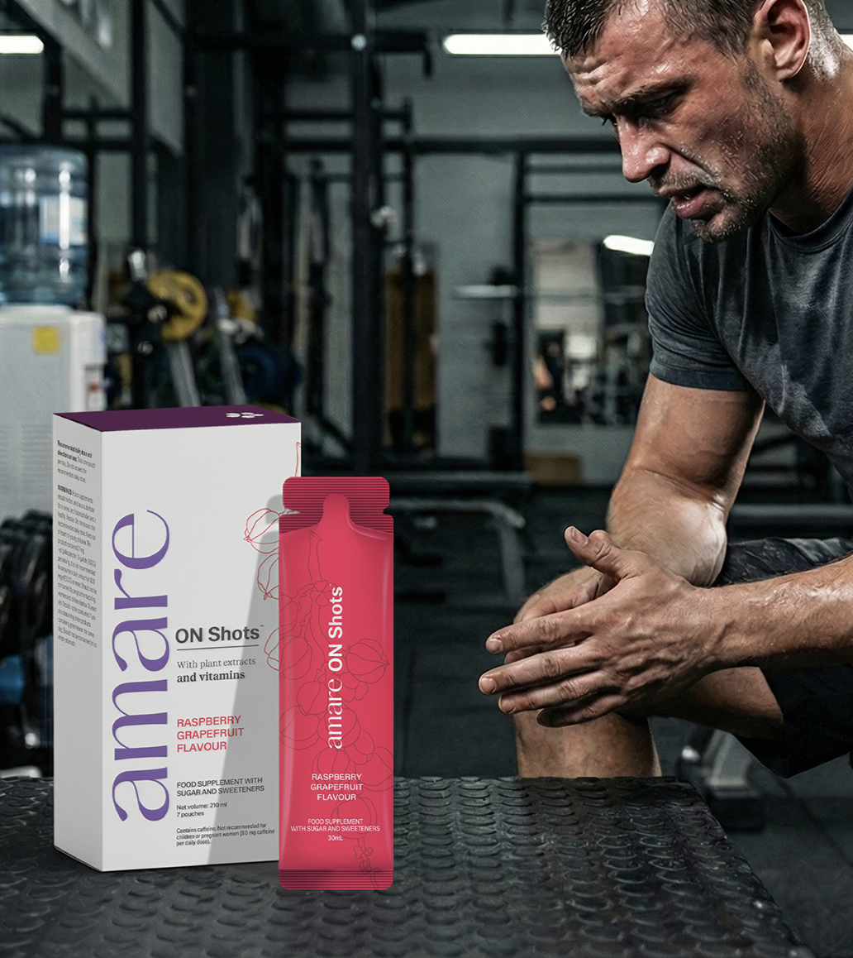

Amare ON Shots™
Why You’ll Love It?
• Contributes to normal energy-yielding metabolism with vitamins B1, B2, B3 and B6.*
• Niacin and vitamin B6 contribute to the reduction of tiredness and fatigue.*
• Vitamin B1, B6 and B12 contribute to normal psychological function.*
• Contains natural caffeine from guarana.
• Includes choline, inositol and amino acids such as taurine and L-citrulline.
*DISCLAIMER: Amare products are not intended to diagnose, treat, cure, or prevent any disease or medical condition. Please store your Amare products out of reach of young children. For adults only. The stated health claims are valid provided that the vitamins and minerals contained in the food supplement are present in amounts as defined by applicable regulations. The information provided here is derived from scientific studies carried out on specific ingredients found in Amare products. These studies have not been performed directly on Amare products themselves. Thus, the findings of these studies should not be interpreted as direct evidence of the effects or benefits of Amare products.
7
7
7
7
Copyright © 2026 Amare Global. All rights reserved.

Slide 8
Amare ON Shots™
Why You’ll Love It?
• Features botanical ingredients including green tea, Alpinia galangal and blueberry.
• No artificial colours, no GMOs, no artificial preservatives.
• Naturally flavoured with fruit juices and natural grapefruit & raspberry flavours.
*DISCLAIMER: Amare products are not intended to diagnose, treat, cure, or prevent any disease or medical condition. Please store your Amare products out of reach of young children. For adults only. The stated health claims are valid provided that the vitamins and minerals contained in the food supplement are present in amounts as defined by applicable regulations. The information provided here is derived from scientific studies carried out on specific ingredients found in Amare products. These studies have not been performed directly on Amare products themselves. Thus, the findings of these studies should not be interpreted as direct evidence of the effects or benefits of Amare products.
8
8
8
8
Copyright © 2026 Amare Global. All rights reserved.

Slide 9
Amare ON Shots™
How To Use?
Take one pouch per day. There are 7 sachets in one box. Do not exceed the recommended daily dose. For adults. Contains caffeine. (80 mg caffeine per daily dose) Not recommended for children or pregnant women.
WARNINGS: Food supplements should not be used as a substitute for a varied and balanced diet and a healthy lifestyle. Do not exceed the recommended daily dose. Keep out of reach of young children. The product contains 0.7 mg -epigallocatechin-3 gallate (EGCG) per serving. It is not recommended to consume a daily amount of 800 mg of EGCG or more. Should not be consumed by pregnant or lactating women and children below 18 years old. Should not be consumed if you are consuming other products containing green tea on the same day. Should not be consumed on an empty stomach.
*DISCLAIMER: Amare products are not intended to diagnose, treat, cure, or prevent any disease or medical condition. Please store your Amare products out of reach of young children. For adults only. The stated health claims are valid provided that the vitamins and minerals contained in the food supplement are present in amounts as defined by applicable regulations. The information provided here is derived from scientific studies carried out on specific ingredients found in Amare products. These studies have not been performed directly on Amare products themselves. Thus, the findings of these studies should not be interpreted as direct evidence of the effects or benefits of Amare products.
9
Copyright © 2026 Amare Global. All rights reserved.

Slide 10
Amare ON Shots™
How To Use?
ALLERGEN STATEMENT:
This product does not intentionally contain common allergens as defined by EU Regulation (EU) No 1169/2011. Produced in facilities that follow strict hygiene and quality protocols.
STORAGE CONDITIONS:
Store in a cool, dry place. Do not use if the seal is broken.
*DISCLAIMER: Amare products are not intended to diagnose, treat, cure, or prevent any disease or medical condition. Please store your Amare products out of reach of young children. For adults only. The stated health claims are valid provided that the vitamins and minerals contained in the food supplement are present in amounts as defined by applicable regulations. The information provided here is derived from scientific studies carried out on specific ingredients found in Amare products. These studies have not been performed directly on Amare products themselves. Thus, the findings of these studies should not be interpreted as direct evidence of the effects or benefits of Amare products.
10
Copyright © 2026 Amare Global. All rights reserved.

Slide 11
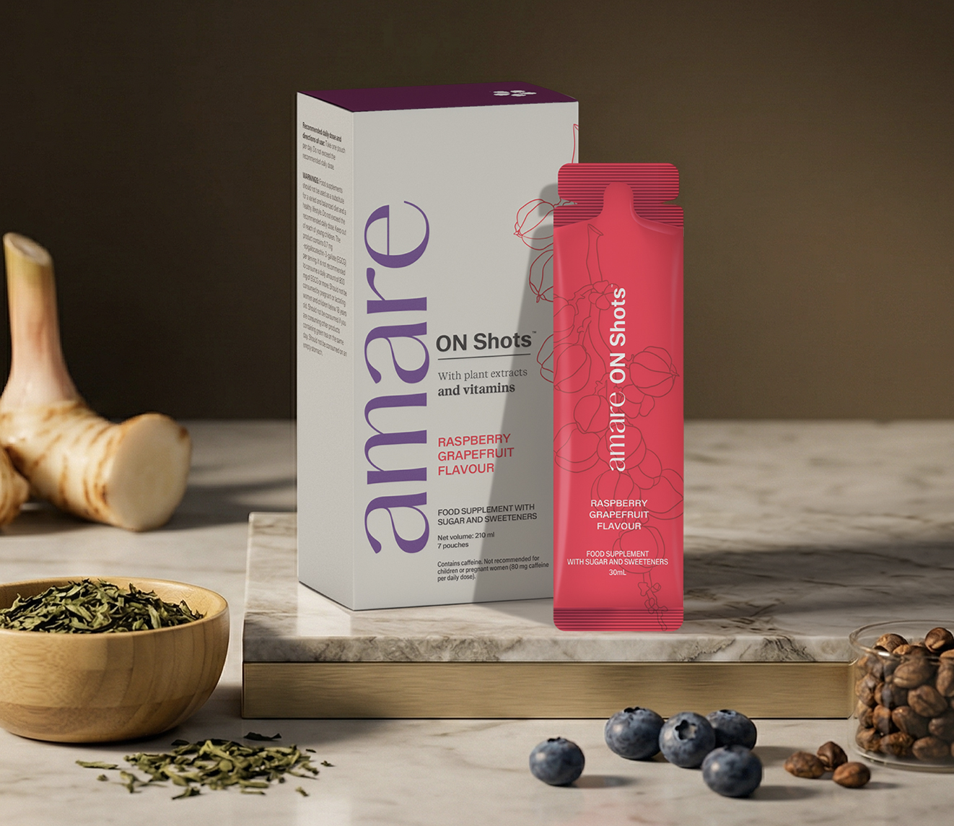

Amare ON Shots™
Key Features

Slide 12

Amare ON Shots™
Vitamins
Vitamins
Vitamin B1
Vitamin B2
Vitamin B3 (Niacin)
Vitamin B6
Vitamin B12
*DISCLAIMER: Amare products are not intended to diagnose, treat, cure, or prevent any disease or medical condition. Please store
your Amare products out of reach of young children. For adults only. The stated health claims are valid provided that the vitamins and
minerals contained in the food supplement are present in amounts as defined by applicable regulations. The information provided
here is derived from scientific studies carried out on specific ingredients found in Amare products. These studies have not been
performed directly on Amare products themselves. Thus, the findings of these studies should not be interpreted as direct evidence
of the effects or benefits of Amare products.
12
Copyright © 2026 Amare Global. All rights reserved.

Slide 13
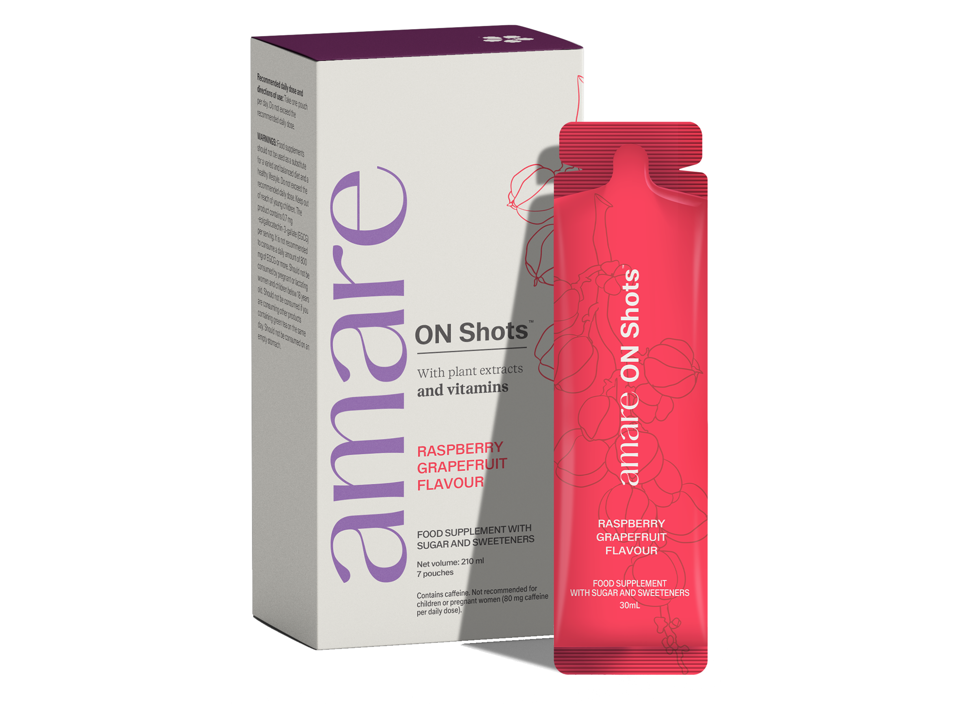
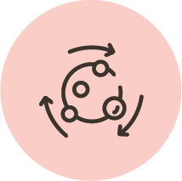

Amare ON Shots™
Key Benefits
Metabolism
B Vitamins (B1, B2, B3, B6, B12)
Contribute to normal energy yielding metabolism.
Choline contributes to normal lipid metabolism and normal homocysteine metabolism.
Nervous System
B Vitamins (B1, B2, B3, B6, B12)
Contribute to the normal functioning of the nervous system.
Niacin and vitamin B6 contribute to the reduction of tiredness and fatigue.
*DISCLAIMER: Amare products are not intended to diagnose, treat, cure, or prevent any disease or medical condition. Please store
your Amare products out of reach of young children. For adults only. The stated health claims are valid provided that the vitamins and
minerals contained in the food supplement are present in amounts as defined by applicable regulations. The information provided
here is derived from scientific studies carried out on specific ingredients found in Amare products. These studies have not been
performed directly on Amare products themselves. Thus, the findings of these studies should not be interpreted as direct evidence
of the effects or benefits of Amare products.
13
Copyright © 2026 Amare Global. All rights reserved.

Slide 14
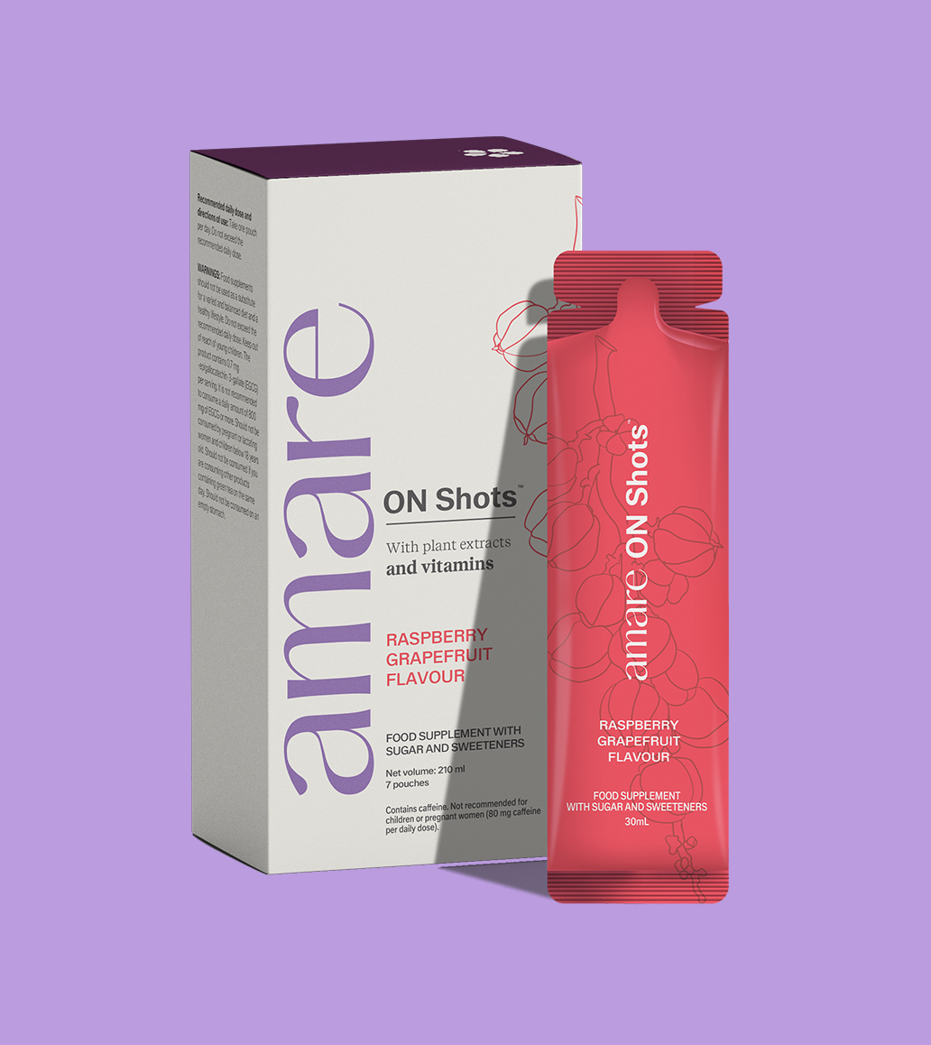
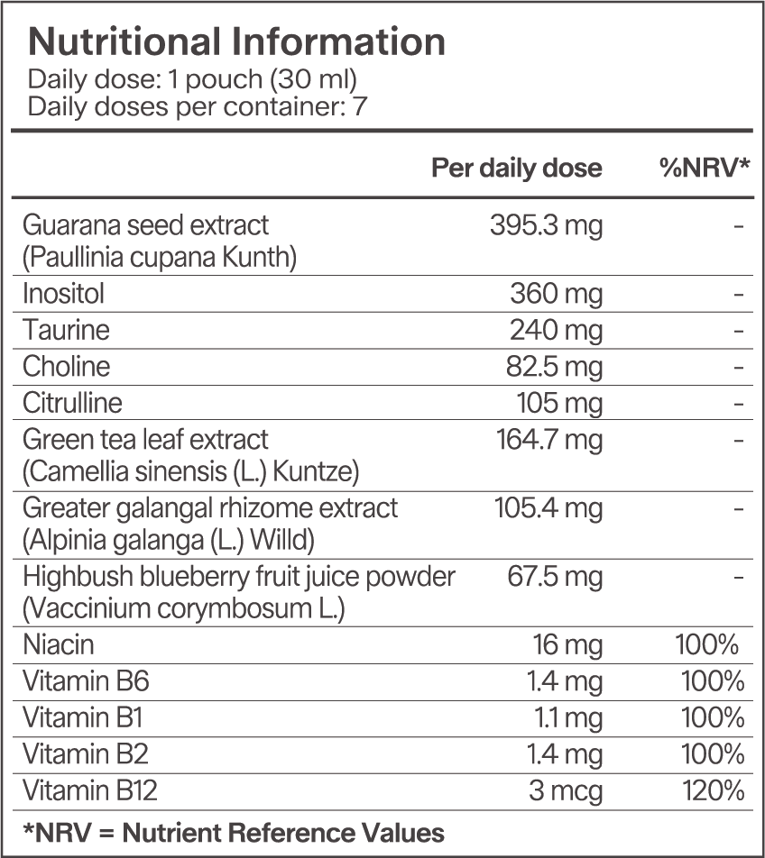
Amare ON Shots™
Nutritional Information
14
14
14
Copyright © 2026 Amare Global. All rights reserved.

Slide 15
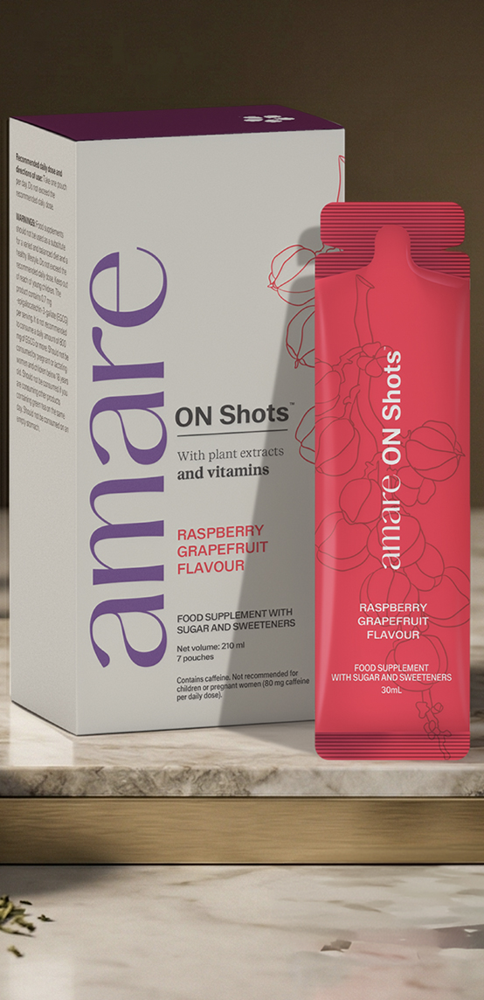
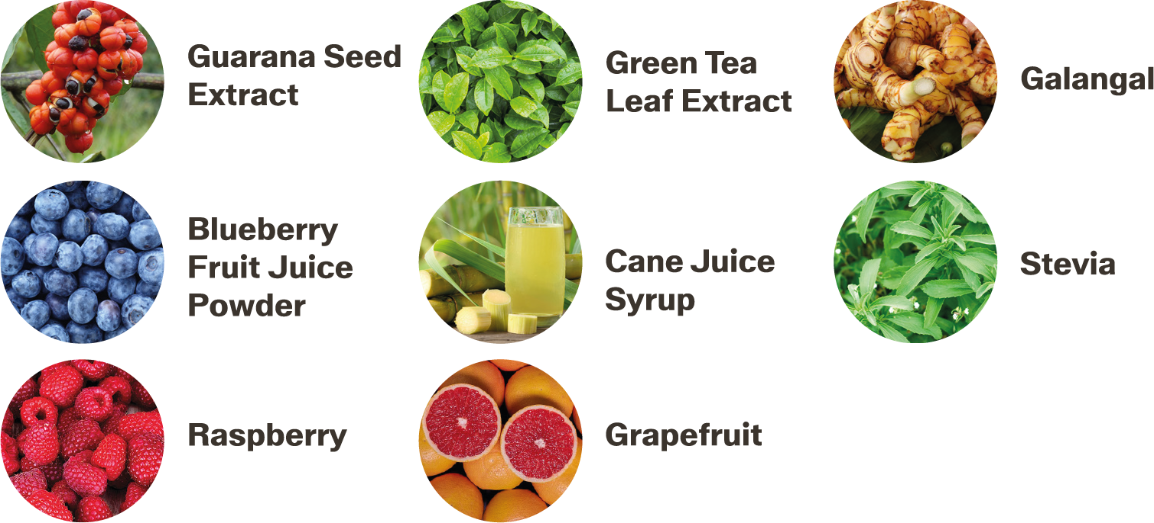
Amare ON Shots™
Ingredients
Water, cane juice syrup (Saccharum officinarum L), sweetener: erythritol, guarana seed extract (Paullinia cupana Kunth), inositol, taurine, choline bitartrate, green tea leaf extract (Camellia sinensis (L.) Kuntze), acidity regulator: citric acid, acidity regulator: malic acid, flavouring, L-citrulline, greater galangal rhizome extract (Alpinia galanga (L.) Willd), highbush blueberry fruit juice powder (Vaccinium corymbosum L.), flavouring, flavouring, thickener: xanthan gum, preservative: potassium sorbate, niacin (nicotinamide), sweetener: steviol glycosides from Stevia, vitamin B6 (pyridoxine hydrochloride), vitamin B1 (thiamin hydrochloride), vitamin B2 (riboflavin), vitamin B12 (methylcobalamin).Flavor: Raspberry and Grapefruit.
15
15
15
Copyright © 2026 Amare Global. All rights reserved.

Slide 16
You can reach out product brochure in your official language: ON Shots™ EU Product Brochure
For More Please Check Out
www.amare.com

