Slide 1
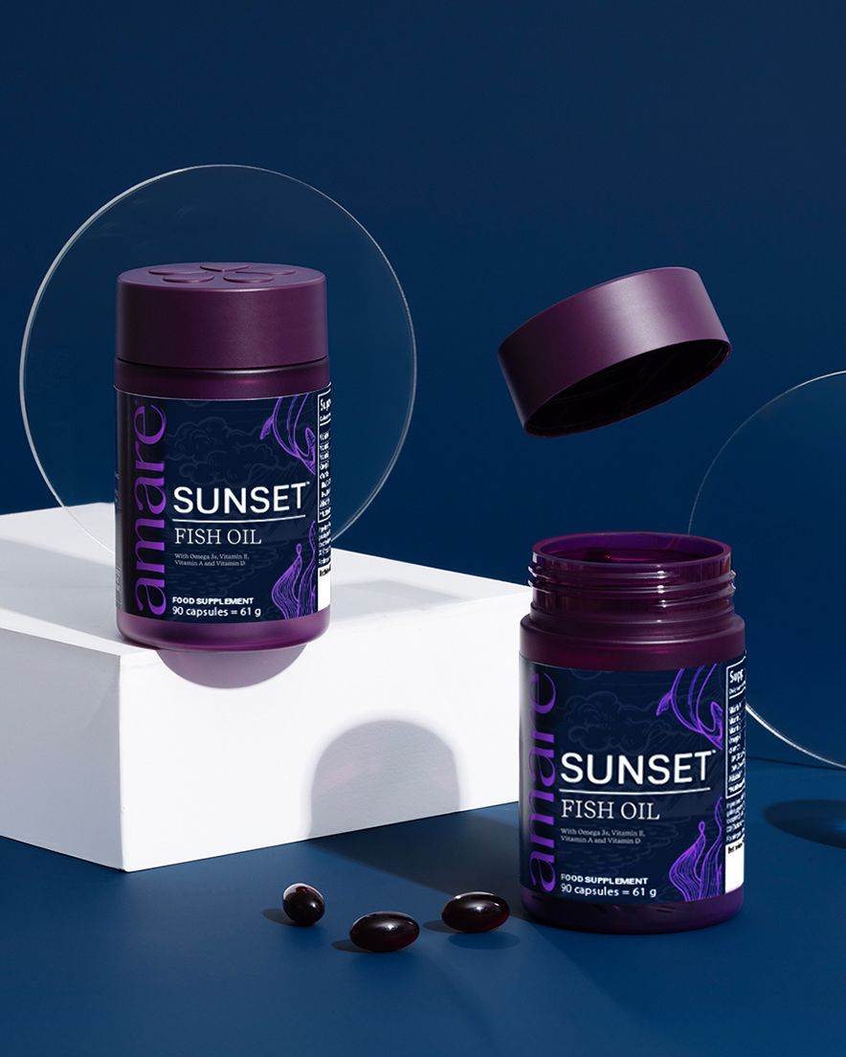


Sunset™
1
Copyright © 2026 Amare Global. All rights reserved.

Slide 2
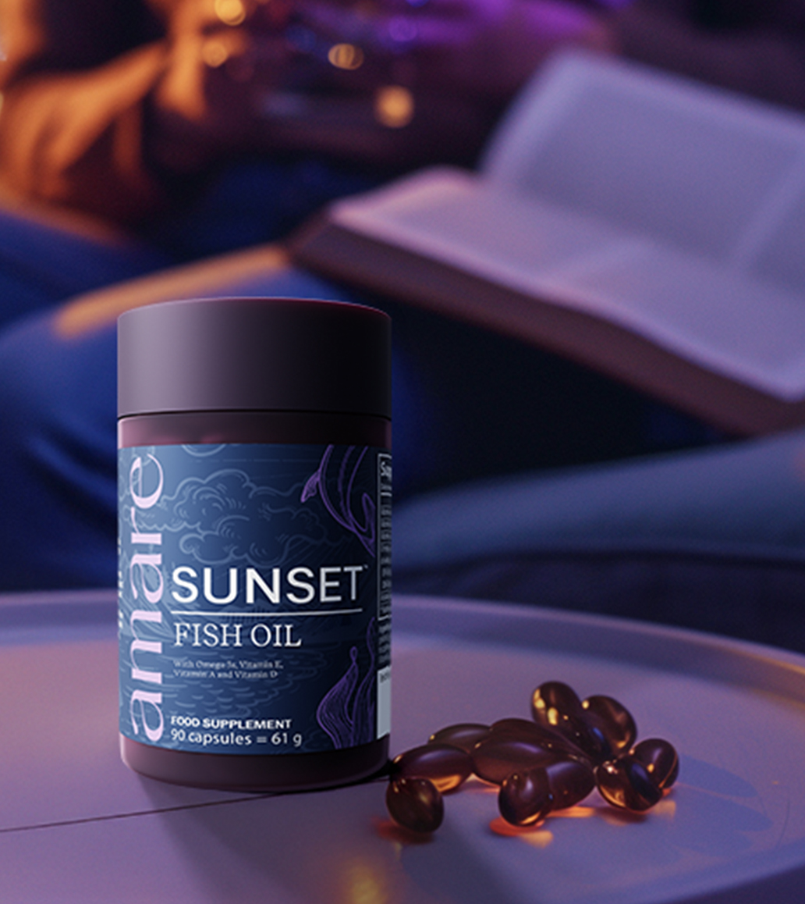
Amare Sunset™
What It Is?
What sets Amare Sunset™ apart from other supplements is its unique blend of ingredients. Each ingredient is carefully selected and sourced to ensure a maximum effectiveness. The Vitamins and nutrients in Amare Sunset™ are also easily absorbed by the body, so you can be sure you are getting the most out of each dose.
Amare Sunset™ delivers Vitamin E in its natural form (D-alpha tocopherol), well-known for protecting cells from oxidative stress. Additionally, it provides Vitamin A, essential for maintaining normal vision, skin health, and immune function.
*DISCLAIMER: Amare products are not intended to diagnose, treat, cure, or prevent any disease or medical condition. Please store your Amare products out of reach of young children. For adults only. The stated health claims are valid provided that the vitamins and minerals contained in the food supplement are present in amounts as defined by applicable regulations. The information provided here is derived from scientific studies carried out on specific ingredients found in Amare products. These studies have not been performed directly on Amare products themselves. Thus, the findings of these studies should not be interpreted as direct evidence of the effects or benefits of Amare products.
2
Copyright © 2026 Amare Global. All rights reserved.

Slide 3
Amare Sunset™
What It Is?
Vitamin D3, often called the "Sunshine Vitamin," contributes to the maintenance of strong bones, normal immune function, and plays a role in maintaining overall mental well-being. Amare Sunset™ contains Vitamin A in the form of Retinyl Palmitate, a form of Vitamin A known for its efficient absorption and utilization by the body. Retinyl Palmitate provides Vitamin A directly, unlike beta carotene which the body must convert. Vitamin A contributes to maintaining normal vision, healthy skin, and supports normal immune system function.
*DISCLAIMER: Amare products are not intended to diagnose, treat, cure, or prevent any disease or medical condition. Please store your Amare products out of reach of young children. For adults only. The stated health claims are valid provided that the vitamins and minerals contained in the food supplement are present in amounts as defined by applicable regulations. The information provided here is derived from scientific studies carried out on specific ingredients found in Amare products. These studies have not been performed directly on Amare products themselves. Thus, the findings of these studies should not be interpreted as direct evidence of the effects or benefits of Amare products.
3
Copyright © 2026 Amare Global. All rights reserved.

Slide 4
Amare Sunset™
What It Is?
Amare Sunset™ also contains Omega-3 fatty acids EPA and DHA, which contribute to normal heart function (beneficial effects are obtained with a daily intake of 250 mg EPA and DHA). DHA additionally supports normal brain function and vision (beneficial effects are obtained with a daily intake of 250 mg DHA).
Choose Amare Sunset™ to confidently nourish your body each day with essential nutrients like Vitamins A, D, E and Omega-3 fatty acids.
*DISCLAIMER: Amare products are not intended to diagnose, treat, cure, or prevent any disease or medical condition. Please store your Amare products out of reach of young children. For adults only. The stated health claims are valid provided that the vitamins and minerals contained in the food supplement are present in amounts as defined by applicable regulations. The information provided here is derived from scientific studies carried out on specific ingredients found in Amare products. These studies have not been performed directly on Amare products themselves. Thus, the findings of these studies should not be interpreted as direct evidence of the effects or benefits of Amare products.
4
Copyright © 2026 Amare Global. All rights reserved.

Slide 5
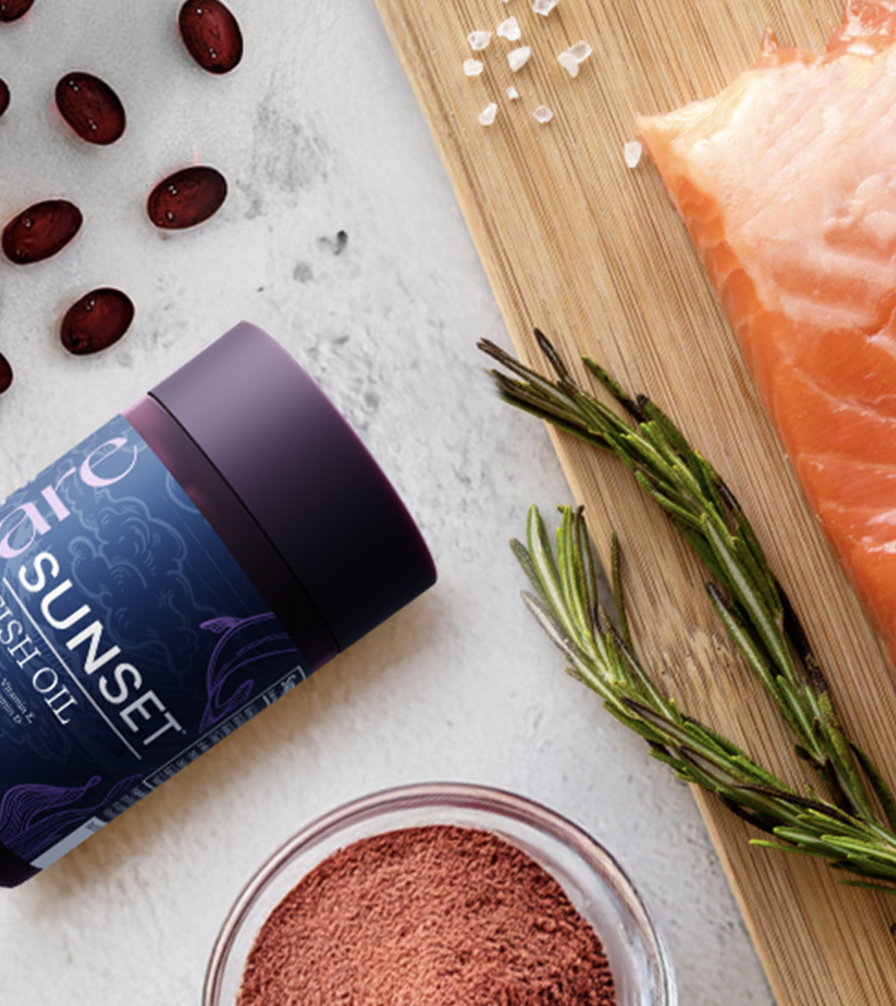
Amare Sunset™
How It Works?
Omega-3 fatty acids are essential nutrients that cannot be naturally produced by the human body and must be obtained through diet or supplementation. Amare Sunset™ provides high-quality Omega-3 fatty acids (EPA and DHA) sourced responsibly from wild fish, including salmon, recognized for its natural purity. Make Amare Sunset™ part of your daily health routine to support these essential aspects of your well-being and to promote vitality from within.
Amare Sunset™ combines carefully selected nutrients including Omega-3 fatty acids (EPA and DHA), Vitamins E, A and D3, along with Astaxanthin, forming a valuable addition to your daily nutritional routine.
*DISCLAIMER: Amare products are not intended to diagnose, treat, cure, or prevent any disease or medical condition. Please store your Amare products out of reach of young children. For adults only. The stated health claims are valid provided that the vitamins and minerals contained in the food supplement are present in amounts as defined by applicable regulations. The information provided here is derived from scientific studies carried out on specific ingredients found in Amare products. These studies have not been performed directly on Amare products themselves. Thus, the findings of these studies should not be interpreted as direct evidence of the effects or benefits of Amare products.
5
Copyright © 2026 Amare Global. All rights reserved.

Slide 6
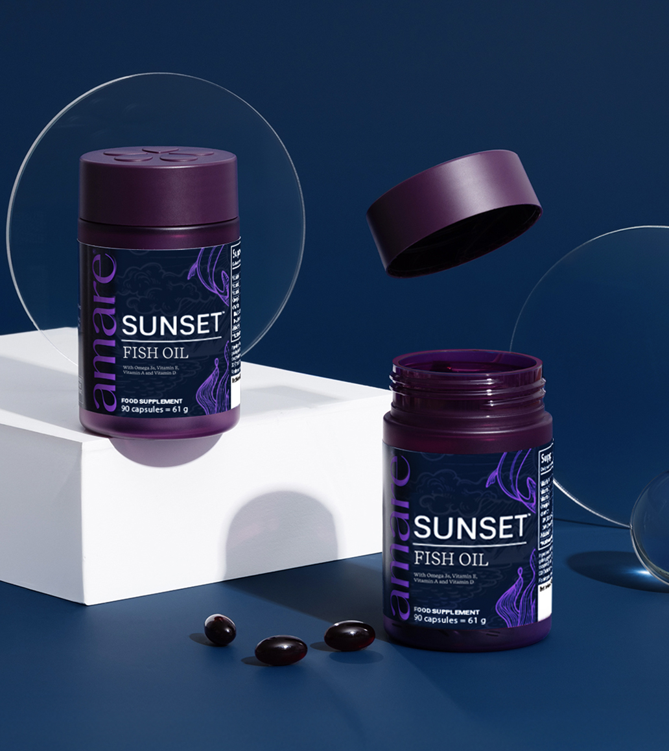

Amare Sunset™
Why You’ll Love It?
Amare Sunset™ is a proprietary combination of EPA and DHA derived from Wild Fish Oils (including Wild Salmon among other wild fish), Vitamin A, Vitamin E and the essential Vitamin D. Amare Sunset™ features fish oil as source of Omega-3 (EPA and DHA), the powerful Vitamins A, D, and one of the major versions of Vitamin E, D-Alpha – Tocopherol, from rice bran oil.
With Amare Sunset™, you can feel confident that you are providing your body essential nutrients to support your overall well-being. A carefully formulated, convenient blend of Omega-3 fatty acids, Vitamins E, A, D3, and Astaxanthin; Amare Sunset™ is your daily partner for balanced nutrition. Take control of your wellness today and incorporate Amare Sunset™ into your daily routine.
*DISCLAIMER: Amare products are not intended to diagnose, treat, cure, or prevent any disease or medical condition. Please store your Amare products out of reach of young children. For adults only. The stated health claims are valid provided that the vitamins and minerals contained in the food supplement are present in amounts as defined by applicable regulations. The information provided here is derived from scientific studies carried out on specific ingredients found in Amare products. These studies have not been performed directly on Amare products themselves. Thus, the findings of these studies should not be interpreted as direct evidence of the effects or benefits of Amare products.
6
6
6
6
Copyright © 2026 Amare Global. All rights reserved.

Slide 7
Amare Sunset™
How To Use?
Take 3 capsules together with your evening meal. Do not exceed the recommended daily dosage.
For adults only. 90 Gel Capsules (For 1 Month of use.) This product should not replace a varied diet and a healthy lifestyle. Keep out of the reach of children. Do not use or consume if safety seal is missing or broken. Consult a doctor before using this product if you are pregnant, lactating or under medical treatment.
*DISCLAIMER: Amare products are not intended to diagnose, treat, cure, or prevent any disease or medical condition. Please store your Amare products out of reach of young children. For adults only. The stated health claims are valid provided that the vitamins and minerals contained in the food supplement are present in amounts as defined by applicable regulations. The information provided here is derived from scientific studies carried out on specific ingredients found in Amare products. These studies have not been performed directly on Amare products themselves. Thus, the findings of these studies should not be interpreted as direct evidence of the effects or benefits of Amare products.
7
Copyright © 2026 Amare Global. All rights reserved.

Slide 8
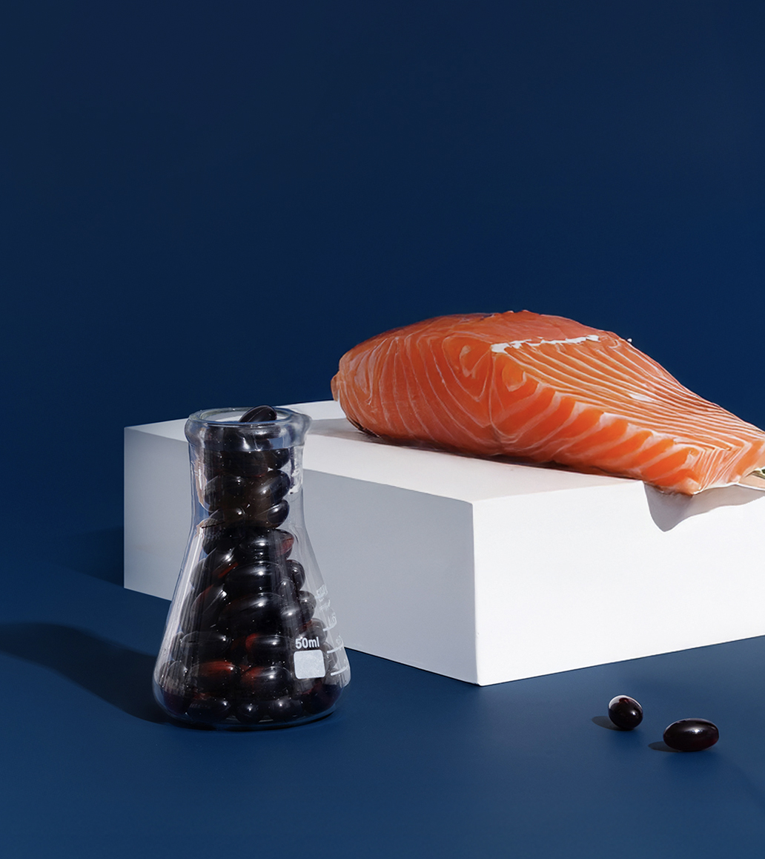
Amare Sunset™
The SCIENCE of
Amare Sunset™
Amare Sunset™, your daily food supplement formulated with carefully selected, naturally sourced Omega-3 fatty acids and Vitamin E, is designed to support your overall well-being. This premium blend provides essential lipid-soluble nutrients such as Vitamin D3, EPA and DHA (Omega-3), Astaxanthin, and Vitamins E (D-Alpha-Tocopherol) and Vitamin A (Retinyl Palmitate).
Include Amare Sunset™ to your daily routine to nourish and maintain these vital health systems, helping you embrace life with vitality and confidence everyday while supporting the wellness of your brain and heart.
*DISCLAIMER: Amare products are not intended to diagnose, treat, cure, or prevent any disease or medical condition. Please store your Amare products out of reach of young children. For adults only. The stated health claims are valid provided that the vitamins and minerals contained in the food supplement are present in amounts as defined by applicable regulations. The information provided here is derived from scientific studies carried out on specific ingredients found in Amare products. These studies have not been performed directly on Amare products themselves. Thus, the findings of these studies should not be interpreted as direct evidence of the effects or benefits of Amare products.
8
Copyright © 2026 Amare Global. All rights reserved.

Slide 9
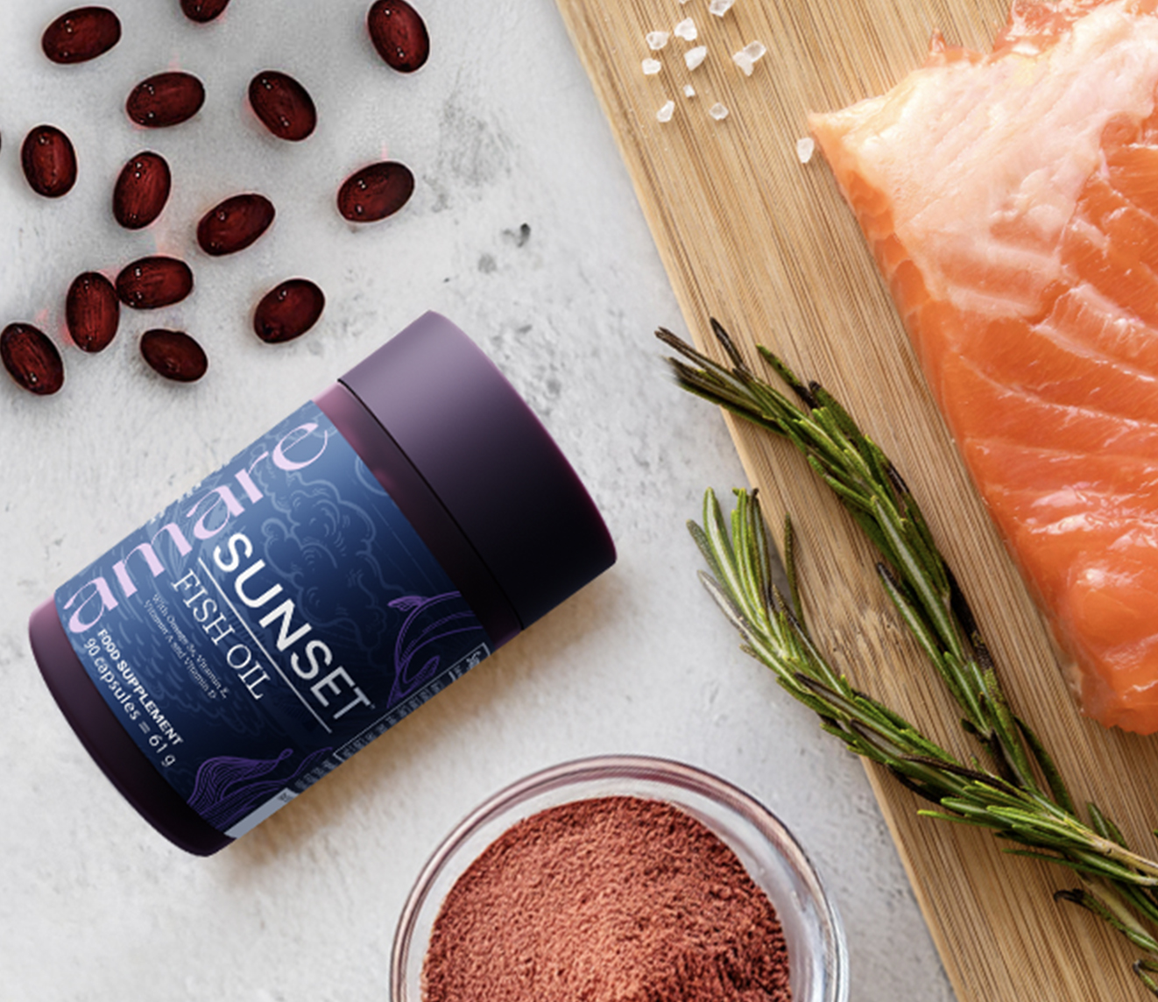
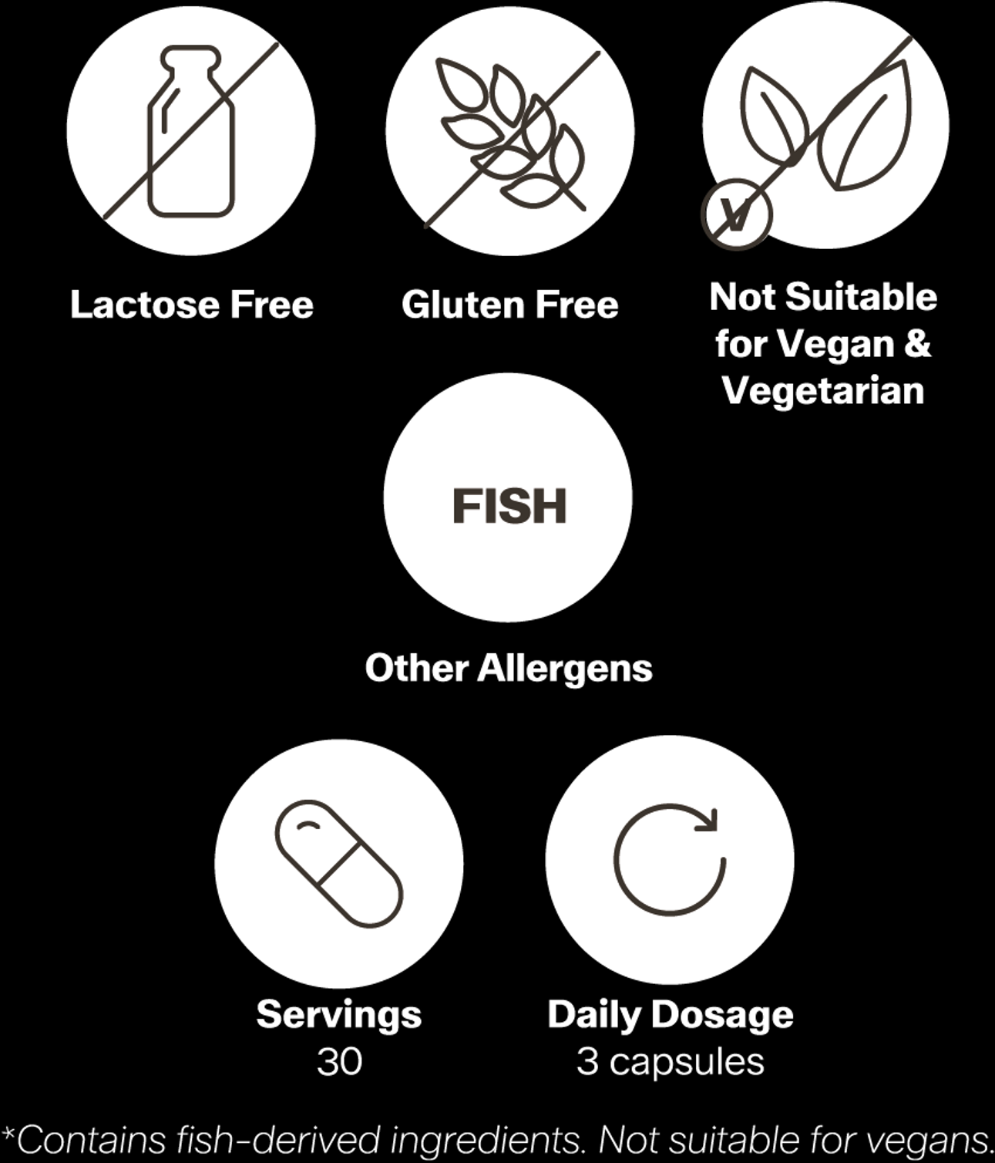
Amare Sunset™
Key Features

Slide 10

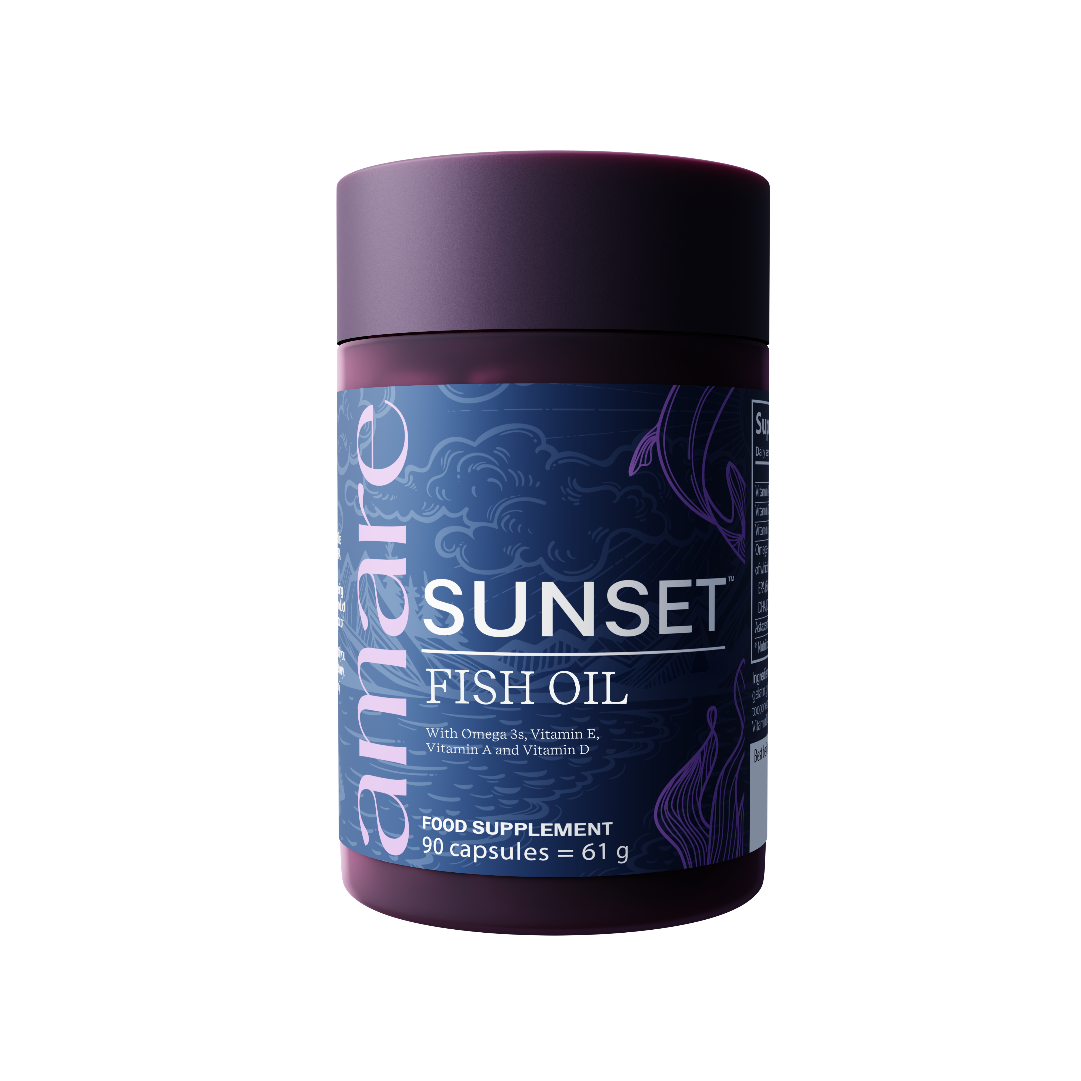



Amare Sunset™
Heart
Key Benefits
EPA and DHA contribute to the normal function of the heart
(the beneficial effect is obtained with a daily intake of 250 mg).
Brain Function
DHA contributes to maintenance of normal brain.
(Beneficial effect is achieved with a daily intake of 250 mg DHA.)
Vision
DHA contributes to the maintenance of normal vision.
(Beneficial effect is achieved with a daily intake of 250 mg DHA.)
Vitamin A in this stable and bioavailable form contributes to maintaining normal vision.
*DISCLAIMER: Amare products are not intended to diagnose, treat, cure, or prevent any disease or medical condition. Please store your Amare products out of reach of young children. For adults only. The stated health claims are valid provided that the vitamins and minerals contained in the food supplement are present in amounts as defined by applicable regulations. The information provided here is derived from scientific studies carried out on specific ingredients found in Amare products. These studies have not been performed directly on Amare products themselves. Thus, the findings of these studies should not be interpreted as direct evidence of the effects or benefits of Amare products.
Metabolism
Vitamin A contributes to normal iron metabolism.
Vitamin D contributes to normal absorption/utilisation of calcium and phosphorus.
10
Copyright © 2026 Amare Global. All rights reserved.

Slide 11
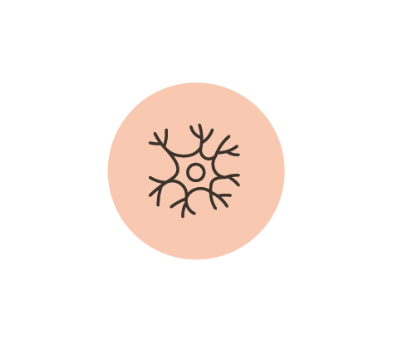



Amare Sunset™
Cells
Key Benefits
Vitamin A contributes to the maintenance of normal mucous membranes.
Vitamin A has a role in the process of cell specialisation.
Vitamin D has a role in the process of cell division.
Skin
Vitamin A in this stable and bioavailable form contributes to maintaining normal vision, healthy skin, and supports the normal function of your immune system.
Immune System
Vitamin A contributes to the normal function of the immune system.
Vitamin D contributes to the normal function of the immune system.
Vitamin E contributes to the protection of cells from oxidative stress, helping your body maintain its vitality day.
*DISCLAIMER: Amare products are not intended to diagnose, treat, cure, or prevent any disease or medical condition. Please store your Amare products out of reach of young children. For adults only. The stated health claims are valid provided that the vitamins and minerals contained in the food supplement are present in amounts as defined by applicable regulations. The information provided here is derived from scientific studies carried out on specific ingredients found in Amare products. These studies have not been performed directly on Amare products themselves. Thus, the findings of these studies should not be interpreted as direct evidence of the effects or benefits of Amare products.
Bold
Vitamin D contributes to normal blood calcium levels.
11
Copyright © 2026 Amare Global. All rights reserved.

Slide 12



Amare Sunset™
Bones
Key Benefits
Pantothenic acid contributes to normal energy-yielding metabolism.
Muscles
Vitamin D contributes to the maintenance of normal muscle function.
Teeth
Vitamin D contributes to the maintenance of normal teeth.
*DISCLAIMER: Amare products are not intended to diagnose, treat, cure, or prevent any disease or medical condition. Please store your Amare products out of reach of young children. For adults only. The stated health claims are valid provided that the vitamins and minerals contained in the food supplement are present in amounts as defined by applicable regulations. The information provided here is derived from scientific studies carried out on specific ingredients found in Amare products. These studies have not been performed directly on Amare products themselves. Thus, the findings of these studies should not be interpreted as direct evidence of the effects or benefits of Amare products.
12
Copyright © 2026 Amare Global. All rights reserved.

Slide 13
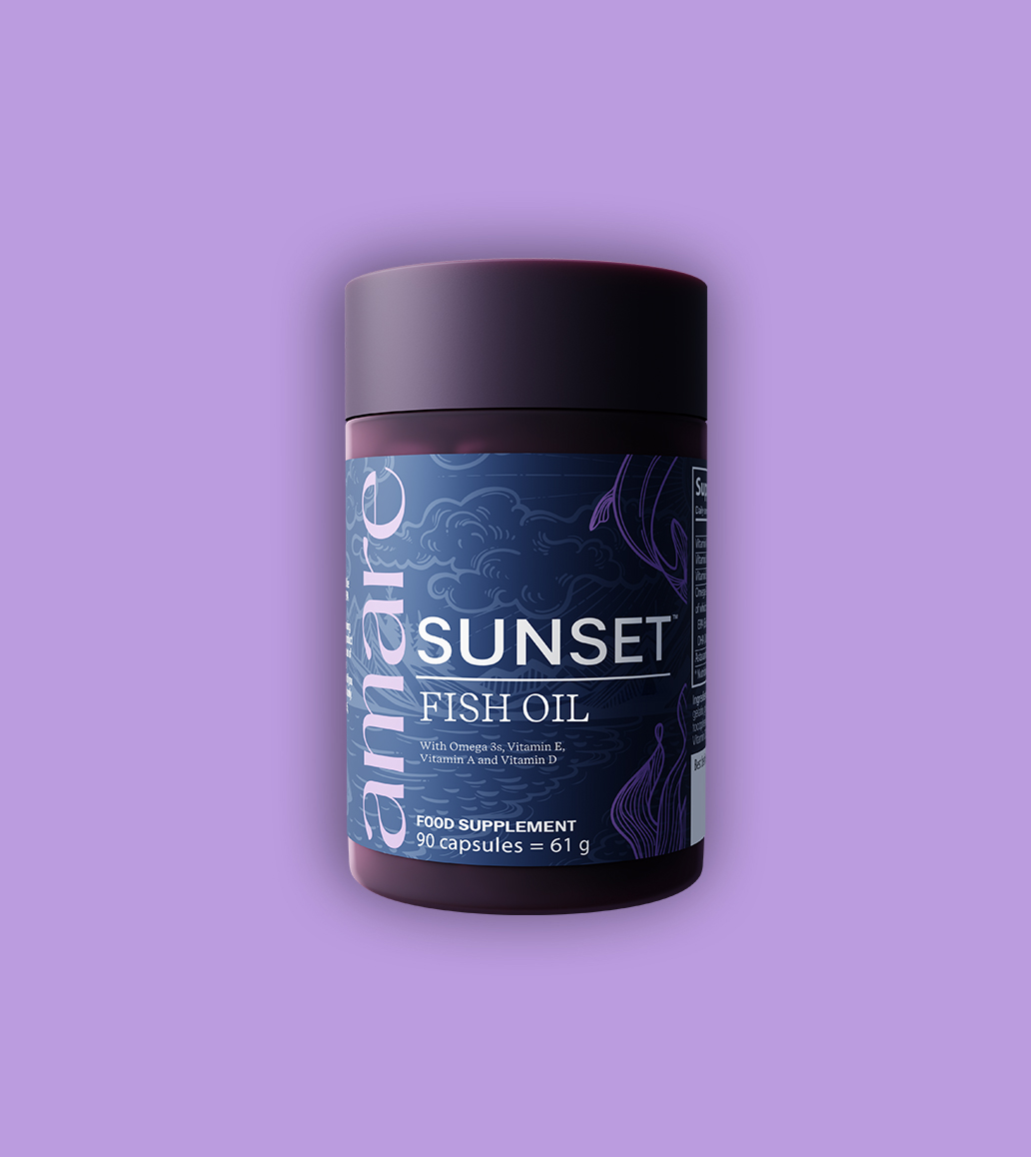
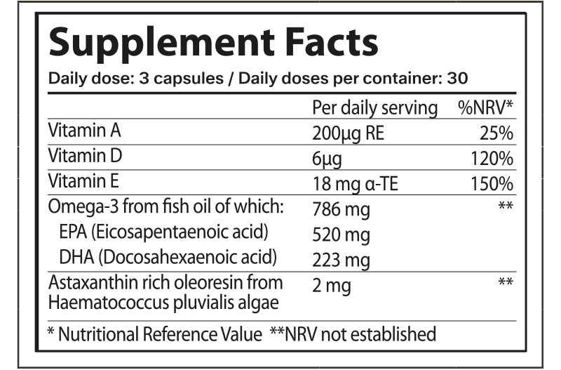
Amare Sunset™
Nutritional Information
13
13
13
Copyright © 2026 Amare Global. All rights reserved.

Slide 14
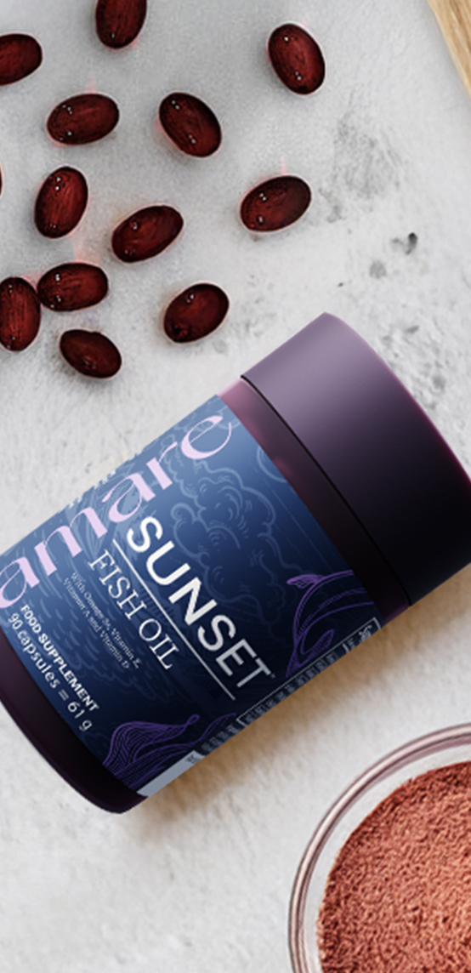
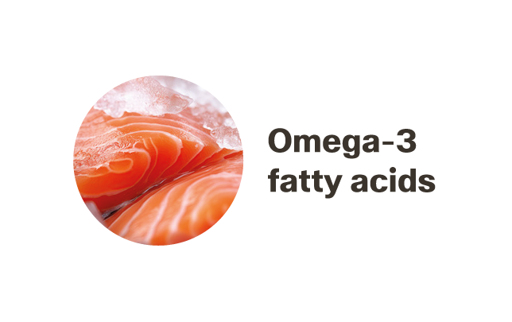
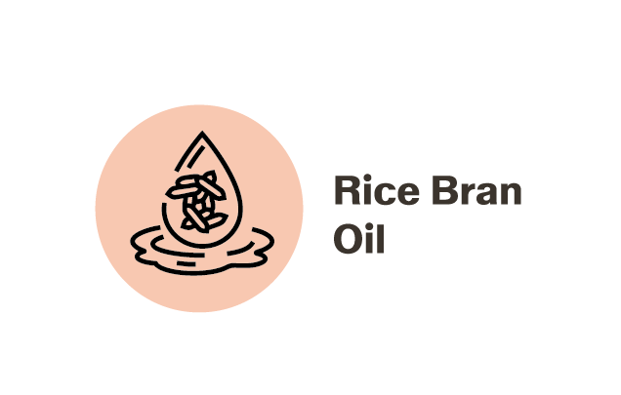
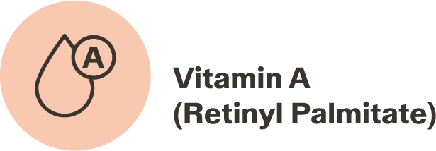
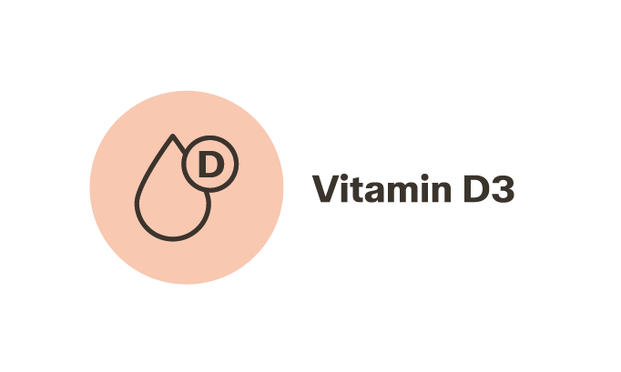
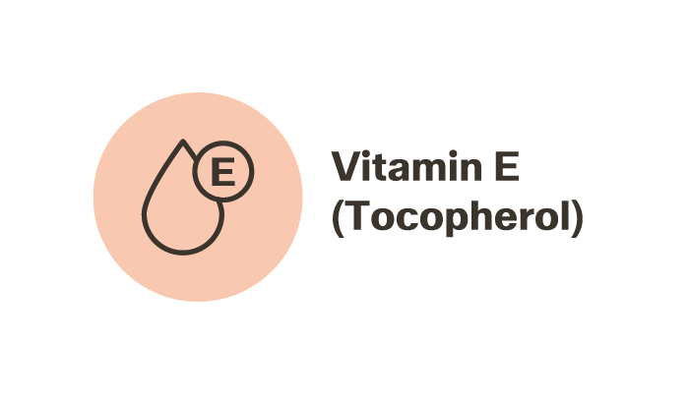
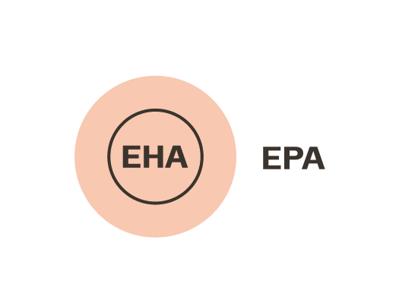
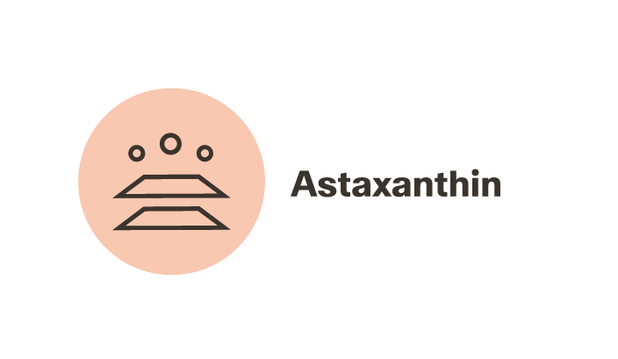
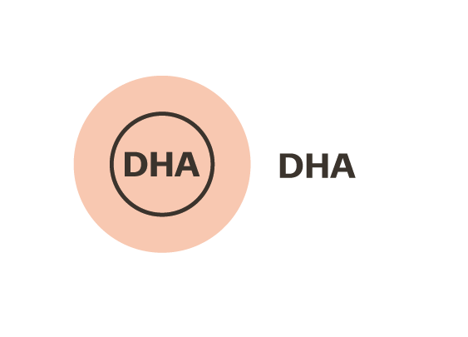
Amare Sunset™
Ingredients
Fish oil (Salmon and other fish), Capsule shell (Fish gelatin), Rice Bran Oil, Vitamin E (D-alpha tocopherol), Humectant (Glycerol), Astaxanthin , Vitamin A (Retinyil Palmitate), Vitamin D3 (Cholecalciferol).
*For allergens, see ingredients in bold.
14
14
14
Copyright © 2026 Amare Global. All rights reserved.

Slide 15
You can reach out product brochure in your official language: Sunset EU Product Brochure
For More Please Check Out
www.amare.com

Slide 16


