Slide 1
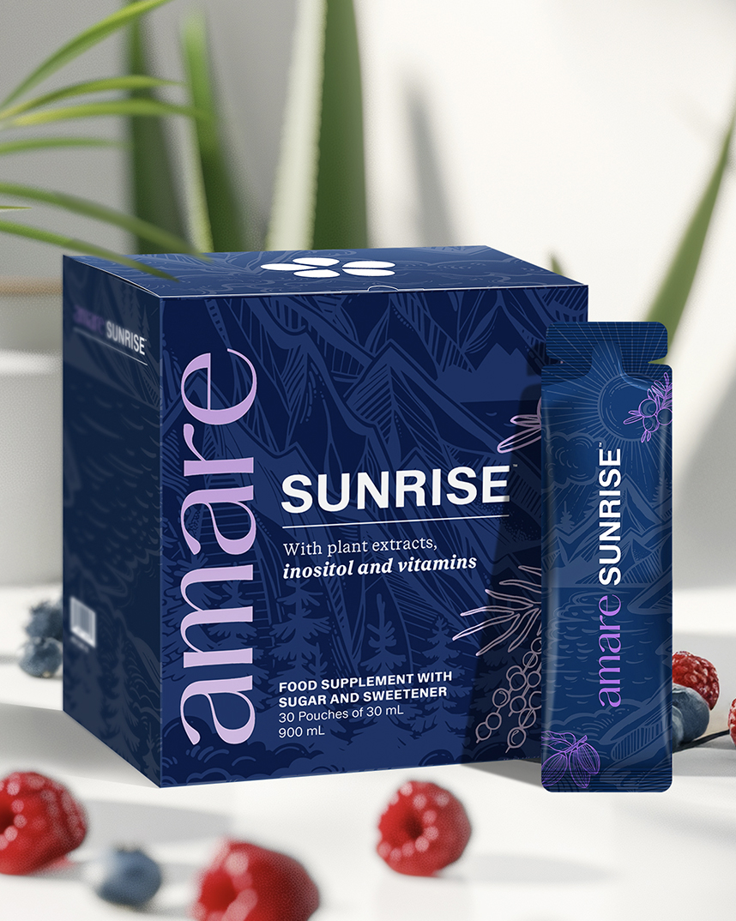


Sunrise™
1
Copyright © 2025 Amare Global. All rights reserved.

Slide 2
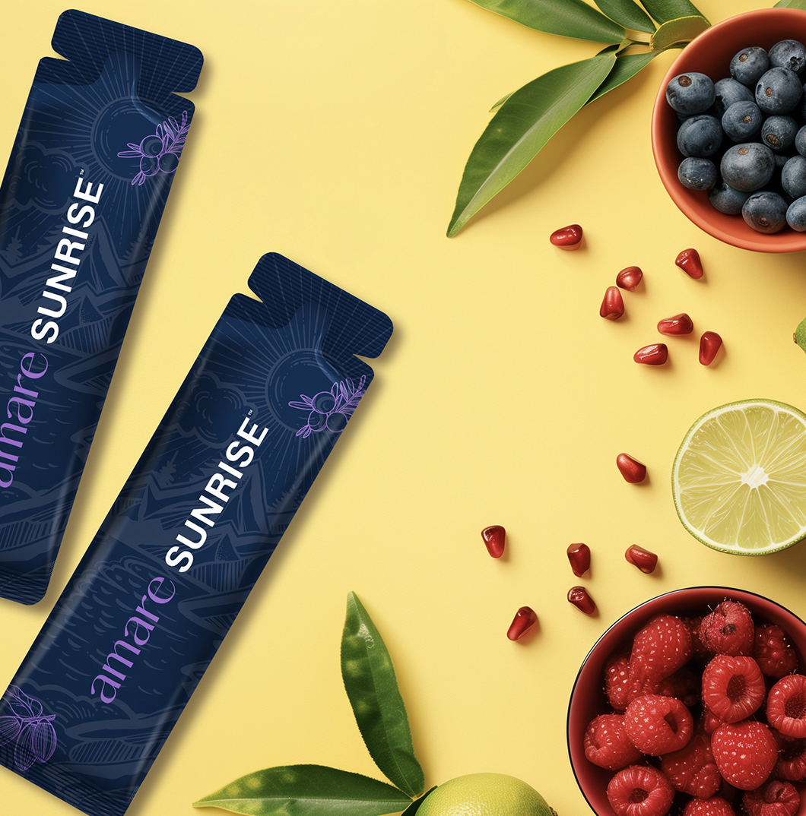
Amare Sunrise™
What It Is?
22 Benefical Foods & 9 Vitamins
Amare Sunrise™ is the perfect way to kickstart your day and give your body the nutrients it needs to thrive.
This product offers a balanced combination of different plant-based ingredients to help complement your daily diet including bilberry, blueberry, canadian blueberry, cranberry, lingonberry, acai, pomegranate, aronia, mangosteen, grape skin extract and green botanicals such as spinach, kale, and broccoli. These carefully selected ingredients are formulated to contribute to a balanced lifestyle and a varied diet.
*DISCLAIMER: Amare products are not intended to diagnose, treat, cure, or prevent any disease or medical condition. Please store your Amare products out of reach of young children. For adults only. The stated health claims are valid provided that the vitamins and minerals contained in the food supplement are present in amounts as defined by applicable regulations. The information provided here is derived from scientific studies carried out on specific ingredients found in Amare products. These studies have not been performed directly on Amare products themselves. Thus, the findings of these studies should not be interpreted as direct evidence of the effects or benefits of Amare products.
2
Copyright © 2025 Amare Global. All rights reserved.

Slide 3
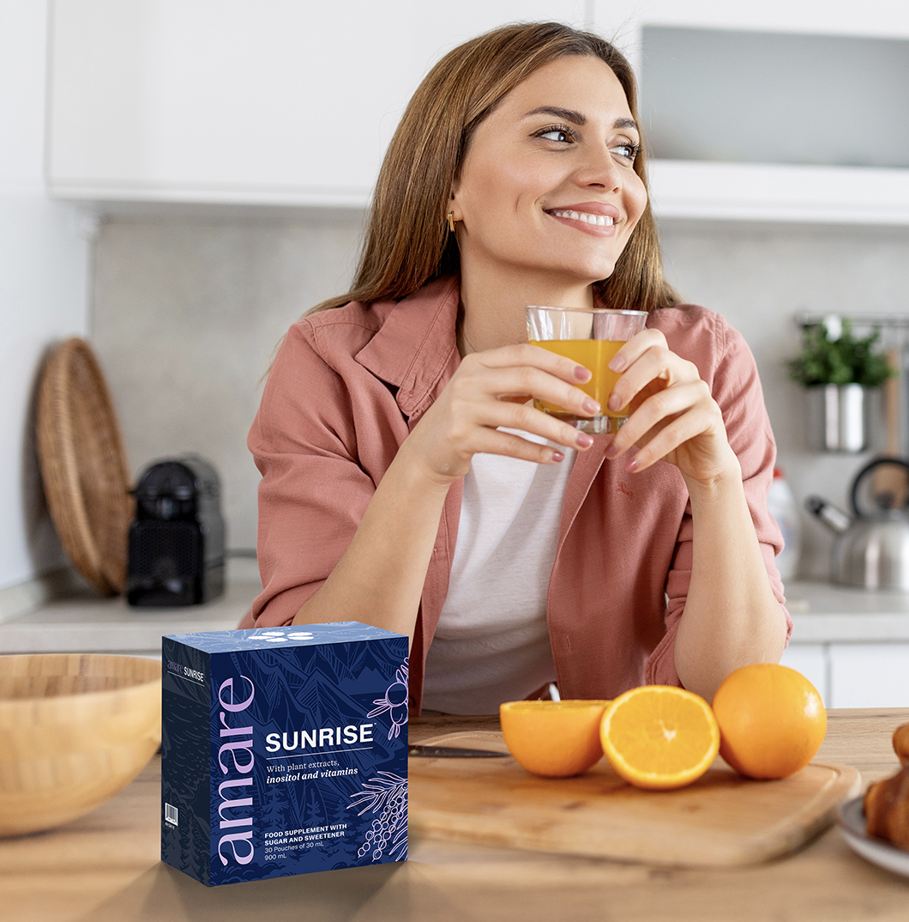

Amare Sunrise™
Why You’ll Love It?
Nature provides plants with a variety of natural compounds that help them adapt to environmental stress. Amare Sunrise™ contains plant pigments as well as Vitamin C and Riboflavin (Vitamin B2), which contribute to the protection of cells from oxidative stress. Amare Sunrise™ features a blend of different berries – including bilberry, blueberry, Canadian blueberry, red raspberry, aronia, lingonberry, cranberry, and acai berry. These carefully selected ingredients are included to complement a varied and balanced diet as part of a healthy lifestyle.
*DISCLAIMER: Amare products are not intended to diagnose, treat, cure, or prevent any disease or medical condition. Please store your Amare products out of reach of young children. For adults only. The stated health claims are valid provided that the vitamins and minerals contained in the food supplement are present in amounts as defined by applicable regulations. The information provided here is derived from scientific studies carried out on specific ingredients found in Amare products. These studies have not been performed directly on Amare products themselves. Thus, the findings of these studies should not be interpreted as direct evidence of the effects or benefits of Amare products.
3
3
3
3
Copyright © 2025 Amare Global. All rights reserved.

Slide 4
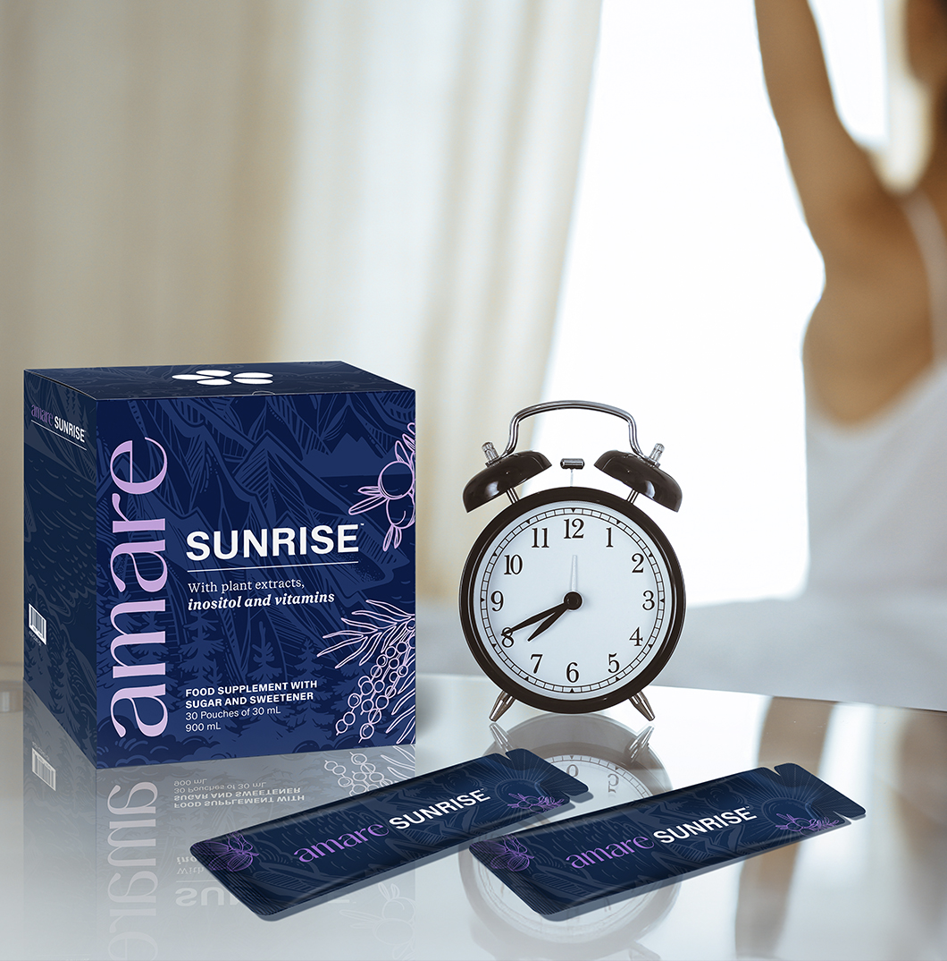
Amare Sunrise™
How To Use?
Start your day with 1 (30 ml) of Pouch Amare Sunrise™. Make it your morning routine, you will love it.
Caution: Food supplements must not be used as a substitute for a varied and balanced diet and a healthy lifestyle. If you are pregnant, breastfeeding, taking any medications or under medical supervision, please consult a doctor or healthcare professional before use. Do not exceed the recommended daily dose. Keep out of reach of children. For adults only.
*DISCLAIMER: Amare products are not intended to diagnose, treat, cure, or prevent any disease or medical condition. Please store your Amare products out of reach of young children. For adults only. The stated health claims are valid provided that the vitamins and minerals contained in the food supplement are present in amounts as defined by applicable regulations. The information provided here is derived from scientific studies carried out on specific ingredients found in Amare products. These studies have not been performed directly on Amare products themselves. Thus, the findings of these studies should not be interpreted as direct evidence of the effects or benefits of Amare products.
4
Copyright © 2025 Amare Global. All rights reserved.

Slide 5
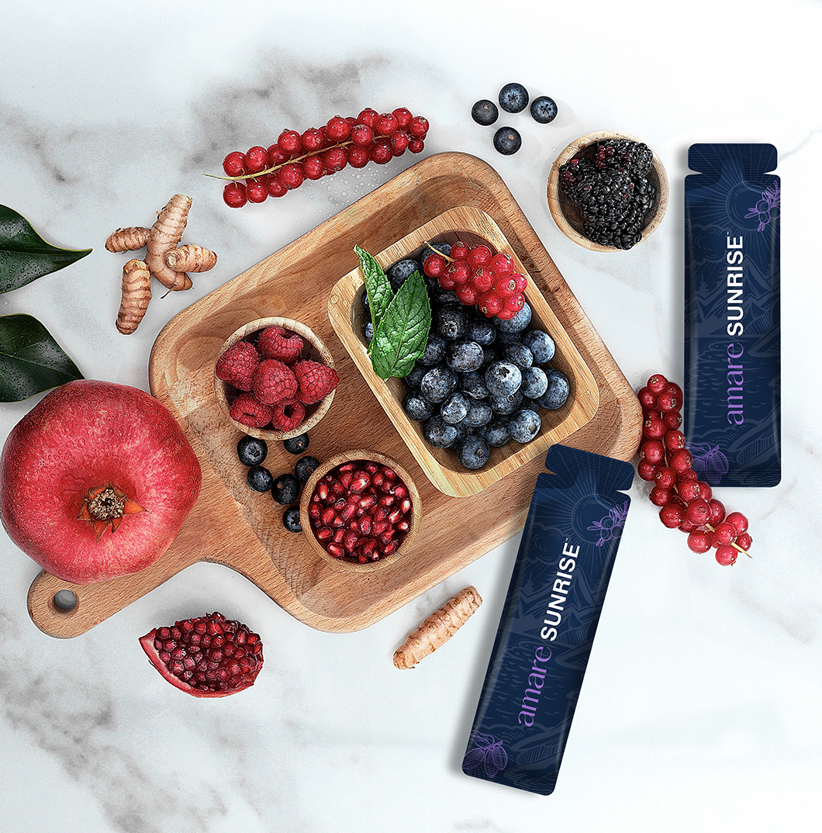
Amare Sunrise™
The SCIENCE of
Amare Sunrise™
Sunrise combines 22 carefully selected superfoods, including berries such as bilberry, blueberry, Canadian blueberry, red raspberry, aronia, lingonberry, cranberry, and acai berry – each naturally containing different nutrients. The result is a delicious blend that provides 9 essential vitamins in a single serving, designed to complement a varied and balanced diet as part of a healthy lifestyle.
*DISCLAIMER: Amare products are not intended to diagnose, treat, cure, or prevent any disease or medical condition. Please store your Amare products out of reach of young children. For adults only. The stated health claims are valid provided that the vitamins and minerals contained in the food supplement are present in amounts as defined by applicable regulations. The information provided here is derived from scientific studies carried out on specific ingredients found in Amare products. These studies have not been performed directly on Amare products themselves. Thus, the findings of these studies should not be interpreted as direct evidence of the effects or benefits of Amare products.
5
Copyright © 2025 Amare Global. All rights reserved.

Slide 6
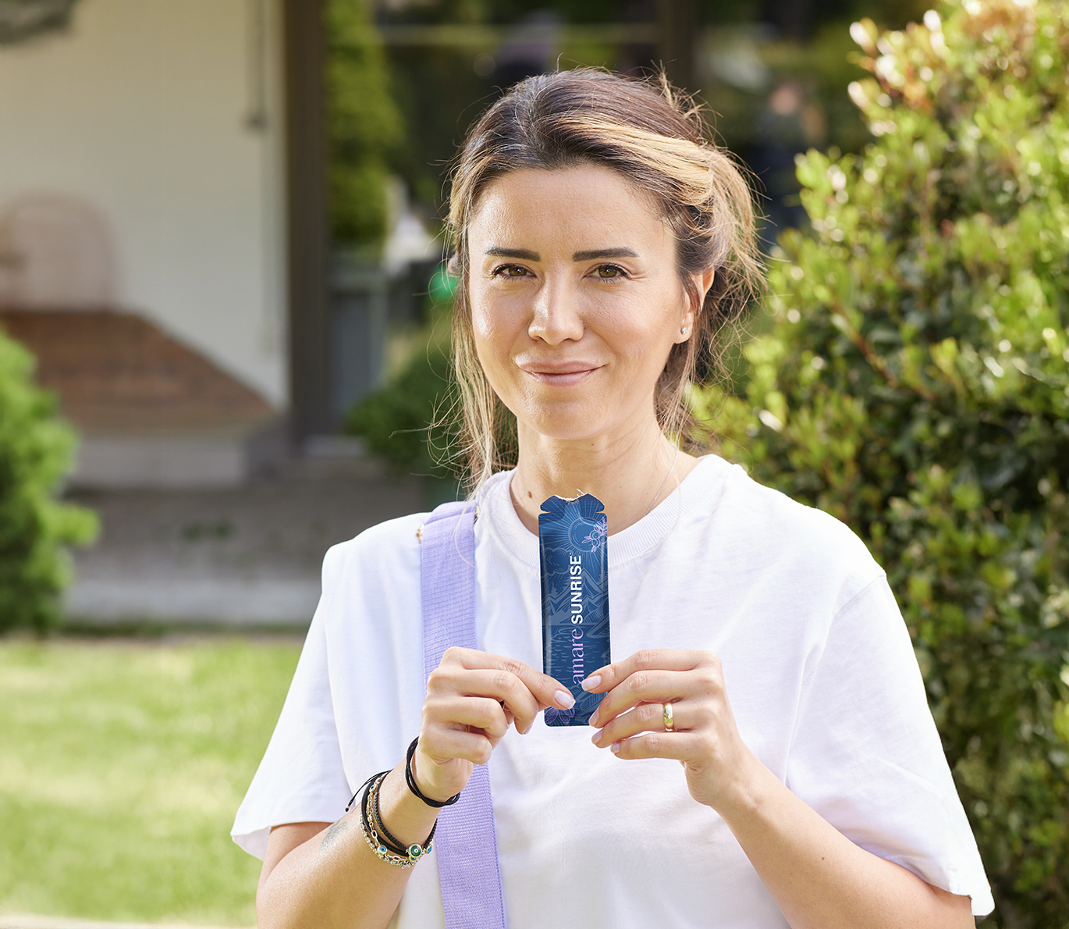
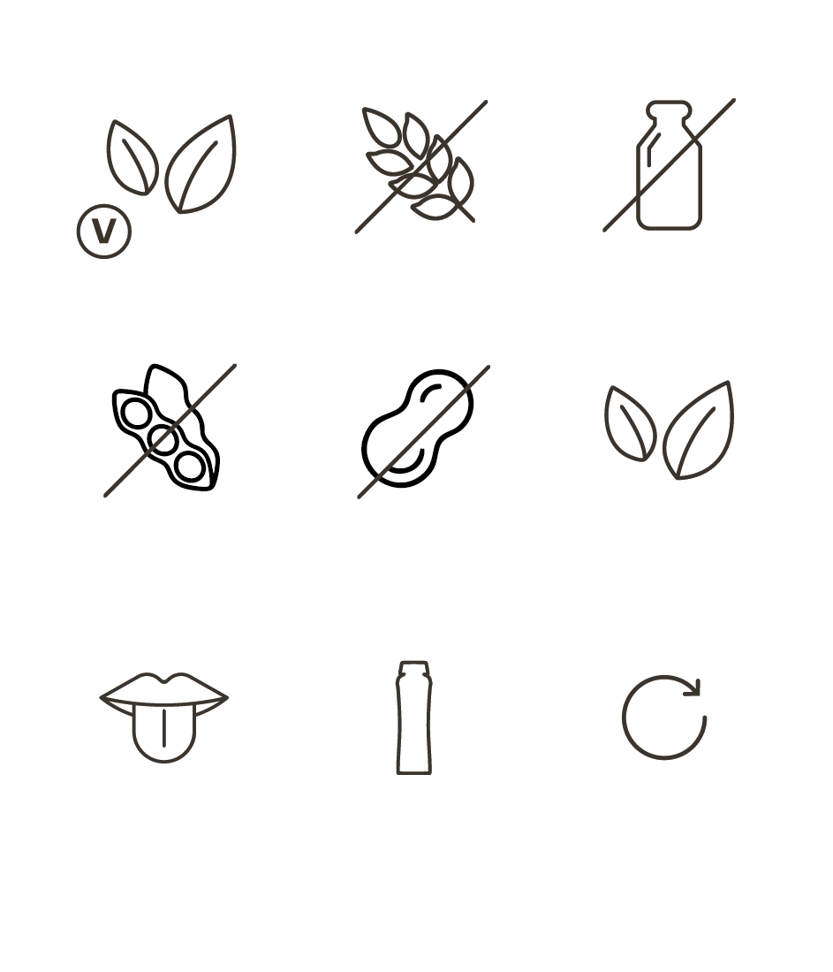
Amare Sunrise™
Key Features

Slide 7

Amare Sunrise™
Vitamins
Vitamins
Vitamin C
(L-ascorbic Asid)
Vitamin B6
(Pyridoxine hydrochloride)
Vitamin B2
(Riboflavin)
Folic acid
(Pteroylmonoglutamic acid – Vitamin B9)
Biotin
(D-biotin - Vitamin B7/H)
Vitamin B12
(Cyanocobalamin)
Niacinamide
D-calcium pantothenate
Thiamin HCl
*DISCLAIMER: Amare products are not intended to diagnose, treat, cure, or prevent any disease or medical condition. Please store your Amare products out of reach of young children. For adults only. The stated health claims are valid provided that the vitamins and minerals contained in the food supplement are present in amounts as defined by applicable regulations. The information provided here is derived from scientific studies carried out on specific ingredients found in Amare products. These studies have not been performed directly on Amare products themselves. Thus, the findings of these studies should not be interpreted as direct evidence of the effects or benefits of Amare products.
7
Copyright © 2025 Amare Global. All rights reserved.

Slide 8


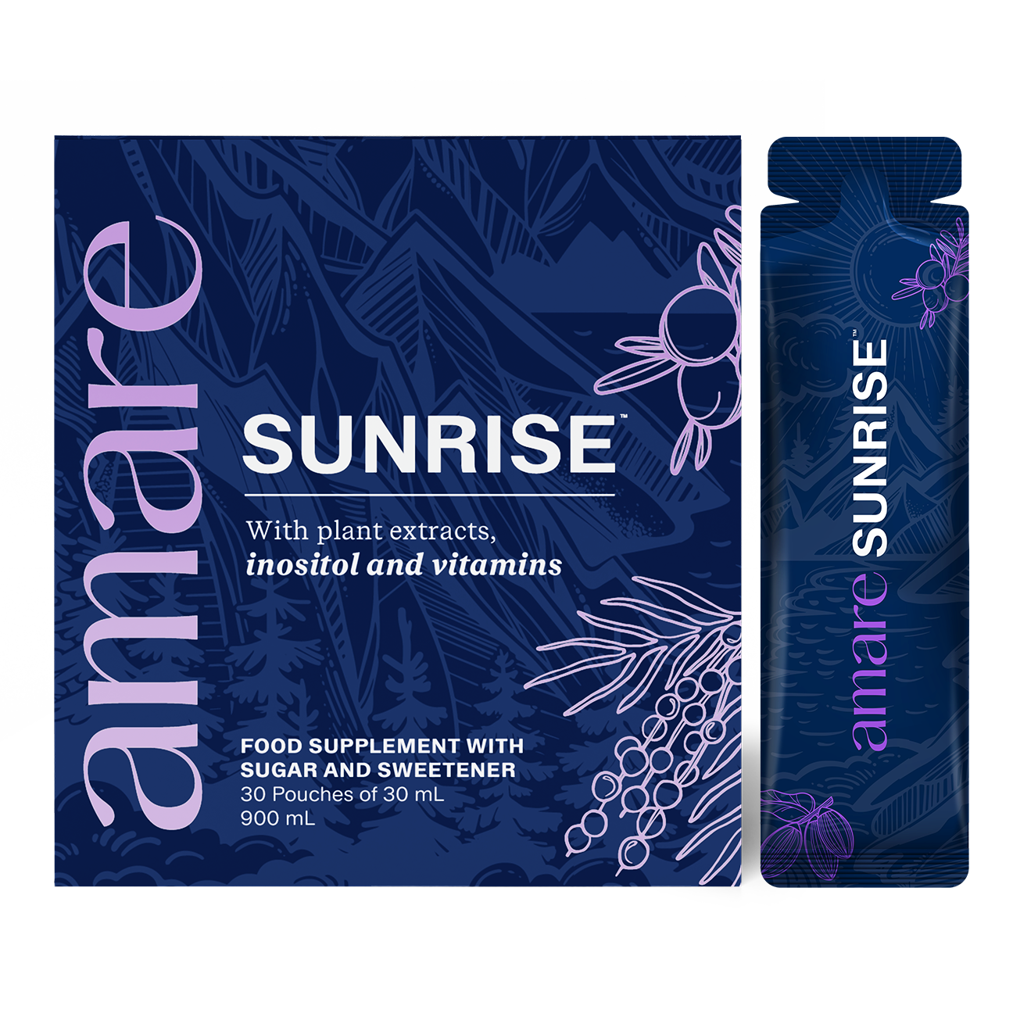


Amare Sunrise™
Heart
How It Works - Key Benefits
Vitamin B1 contributes to the normal function of the heart.
Vision
Vitamin B2 contributes to the maintenance of normal vision.
Hair
Biotin contributes to the maintenance of normal hair.
*All of these claims are approved under EU Commission Regulation (EU) No 432/2012 and may be used only if the vitamin is present in sufficient quantities (≥15% of NRV per daily dose).
*DISCLAIMER: Amare products are not intended to diagnose, treat, cure, or prevent any disease or medical condition. Please store your Amare products out of reach of young children. For adults only. The stated health claims are valid provided that the vitamins and minerals contained in the food supplement are present in amounts as defined by applicable regulations. The information provided here is derived from scientific studies carried out on specific ingredients found in Amare products. These studies have not been performed directly on Amare products themselves. Thus, the findings of these studies should not be interpreted as direct evidence of the effects or benefits of Amare products.
Bones
Vitamin C contributes to normal collagen formation for the normal function of bones.
8
Copyright © 2025 Amare Global. All rights reserved.

Slide 9



Amare Sunrise™
Blood
How It Works - Key Benefits
Vitamin C contributes to normal collagen formation for the normal function of blood vessels.
Vitamin B2 contributes to the maintenance of normal red blood cells.
Folic acid contributes to normal amino acid synthesis.
Folic acid contributes to normal blood formation.
Vitamin B12 contributes to normal red blood cell formation.
Teeth
Vitamin C contributes to normal collagen formation for the normal function of teeth.
Cells
*All of these claims are approved under EU Commission Regulation (EU) No 432/2012 and may be used only if the vitamin is present in sufficient quantities (≥15% of NRV per daily dose).
Vitamin C contributes to the protection of cells from oxidative stress.
Vitamin B2 contributes to the protection of cells from oxidative stress.
Biotin contributes to the maintenance of normal mucous membranes.
*DISCLAIMER: Amare products are not intended to diagnose, treat, cure, or prevent any disease or medical condition. Please store your Amare products out of reach of young children. For adults only. The stated health claims are valid provided that the vitamins and minerals contained in the food supplement are present in amounts as defined by applicable regulations. The information provided here is derived from scientific studies carried out on specific ingredients found in Amare products. These studies have not been performed directly on Amare products themselves. Thus, the findings of these studies should not be interpreted as direct evidence of the effects or benefits of Amare products.
9
Copyright © 2025 Amare Global. All rights reserved.

Slide 10


Amare Sunrise™
Metabolism
How It Works - Key Benefits
Vitamin B3 contributes to normal energy-yielding metabolism.
Vitamin B5 contributes to normal energy-yielding metabolism.
Vitamin B6 contributes to normal energy-yielding metabolism.
Vitamin B6 contributes to normal protein and glycogen metabolism.
Vitamin B6 contributes to the regulation of hormonal activity.
Vitamin B1 contributes to normal energy-yielding metabolism.
Vitamin B2 contributes to normal energy-yielding metabolism.
Biotin contributes to normal energy-yielding metabolism.
Biotin contributes to normal macronutrient metabolism.
Vitamin B12 contributes to normal energy-yielding metabolism.
Vitamin B12 contributes to normal homocysteine metabolism.
Nervous System
Vitamin B3 contributes to the normal functioning of the nervous system.
Vitamin B1 contributes to the normal functioning of the nervous system.
Vitamin B2 contributes to the normal functioning of the nervous system.
Vitamin B12 contributes to the normal functioning of the nervous system.
*All of these claims are approved under EU Commission Regulation (EU) No 432/2012 and may be used only if the vitamin is present in sufficient quantities (≥15% of NRV per daily dose).
*DISCLAIMER: Amare products are not intended to diagnose, treat, cure, or prevent any disease or medical condition. Please store your Amare products out of reach of young children. For adults only. The stated health claims are valid provided that the vitamins and minerals contained in the food supplement are present in amounts as defined by applicable regulations. The information provided here is derived from scientific studies carried out on specific ingredients found in Amare products. These studies have not been performed directly on Amare products themselves. Thus, the findings of these studies should not be interpreted as direct evidence of the effects or benefits of Amare products.
10
Copyright © 2025 Amare Global. All rights reserved.

Slide 11


Amare Sunrise™
Skin
How It Works - Key Benefits
Vitamin C contributes to normal collagen formation for the normal function of skin.
Vitamin B2 contributes to the maintenance of normal skin.
Folic acid contributes to normal maternal tissue growth during pregnancy.
Biotin contributes to the maintenance of normal skin.
Brain Function
Vitamin B5 contributes to normal mental performance.
Vitamin B6 contributes to normal psychological function.
Vitamin B1 contributes to normal psychological function.
Folic acid contributes to normal psychological function.
Biotin contributes to normal psychological function.
Vitamin B12 contributes to normal psychological function.
*All of these claims are approved under EU Commission Regulation (EU) No 432/2012 and may be used only if the vitamin is present in sufficient quantities (≥15% of NRV per daily dose).
*DISCLAIMER: Amare products are not intended to diagnose, treat, cure, or prevent any disease or medical condition. Please store your Amare products out of reach of young children. For adults only. The stated health claims are valid provided that the vitamins and minerals contained in the food supplement are present in amounts as defined by applicable regulations. The information provided here is derived from scientific studies carried out on specific ingredients found in Amare products. These studies have not been performed directly on Amare products themselves. Thus, the findings of these studies should not be interpreted as direct evidence of the effects or benefits of Amare products.
11
Copyright © 2025 Amare Global. All rights reserved.

Slide 12

Amare Sunrise™
Immune System
How It Works - Key Benefits
Vitamin C contributes to the normal function of the immune system.
Vitamin C contributes to the reduction of tiredness and fatigue.
Vitamin B6 contributes to the normal function of the immune system.
Vitamin B6 contributes to the reduction of tiredness and fatigue.
Vitamin B2 contributes to the reduction of tiredness and fatigue.
Folic acid contributes to the normal function of the immune system.
Folic acid contributes to the reduction of tiredness and fatigue.
Vitamin B12 contributes to the normal function of the immune system.
Vitamin B12 contributes to the reduction of tiredness and fatigue.
Niacin contributes to the reduction of tiredness and fatigue.
Pantothenic acid contributes to the reduction of tiredness and fatigue.
*All of these claims are approved under EU Commission Regulation (EU) No 432/2012 and may be used only if the vitamin is present in sufficient quantities (≥15% of NRV per daily dose).
*DISCLAIMER: Amare products are not intended to diagnose, treat, cure, or prevent any disease or medical condition. Please store your Amare products out of reach of young children. For adults only. The stated health claims are valid provided that the vitamins and minerals contained in the food supplement are present in amounts as defined by applicable regulations. The information provided here is derived from scientific studies carried out on specific ingredients found in Amare products. These studies have not been performed directly on Amare products themselves. Thus, the findings of these studies should not be interpreted as direct evidence of the effects or benefits of Amare products.
12
Copyright © 2025 Amare Global. All rights reserved.

Slide 13
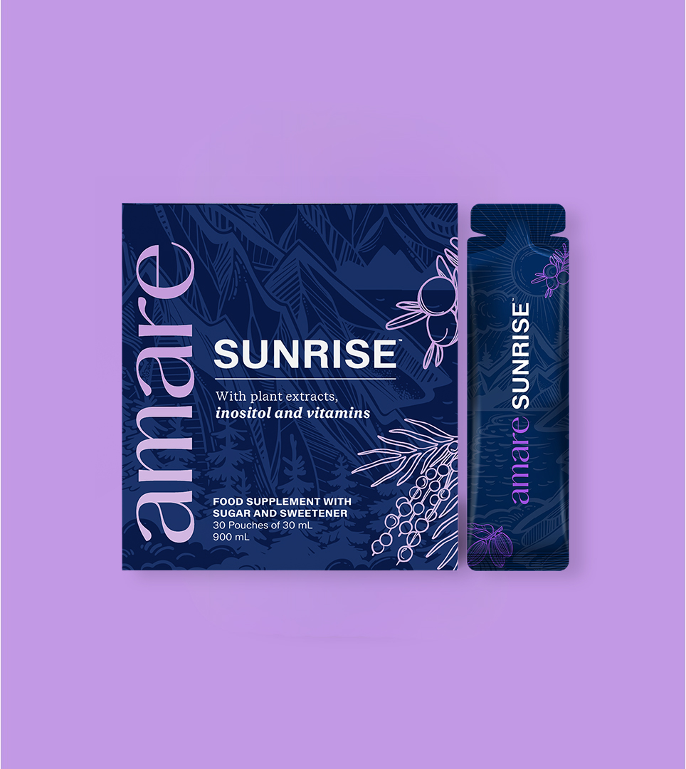
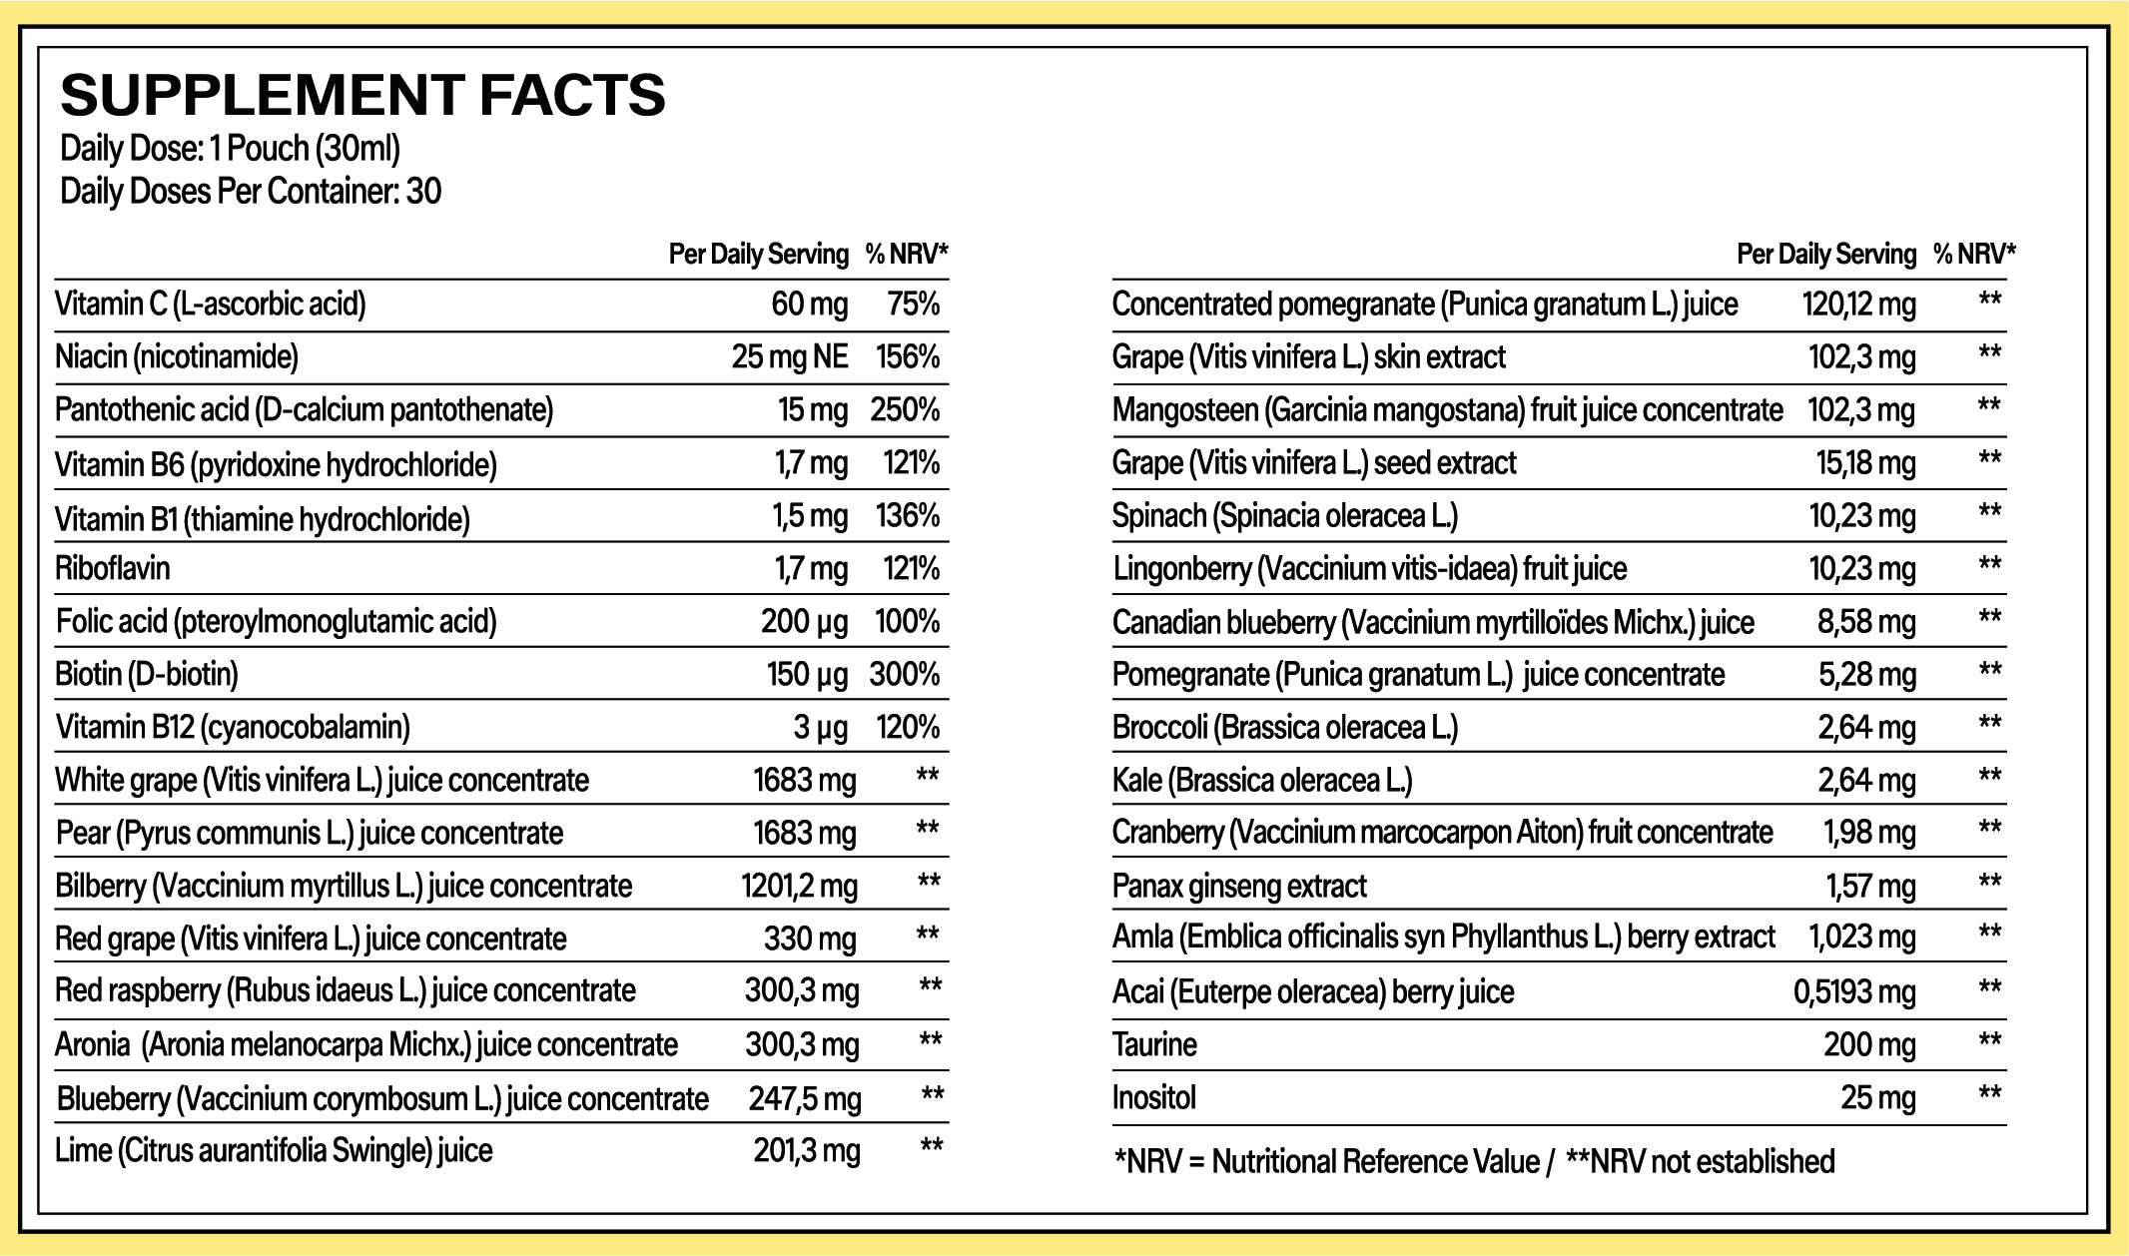
Amare Sunrise™
Nutritional Information
13
13
13
Copyright © 2025 Amare Global. All rights reserved.

Slide 14
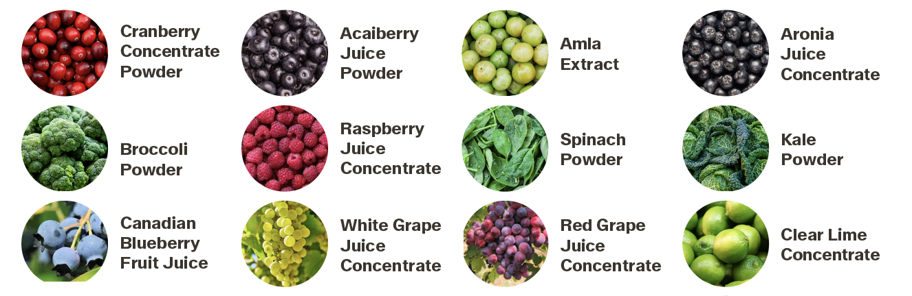
Amare Sunrise™
Ingredients
14
14
14
Copyright © 2025 Amare Global. All rights reserved.

Slide 15
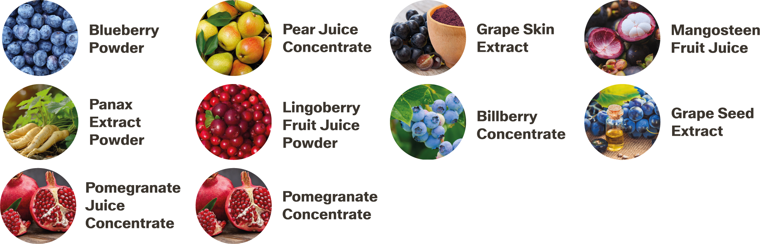
Amare Sunrise™
Ingredients
15
15
15
Copyright © 2025 Amare Global. All rights reserved.

Slide 16
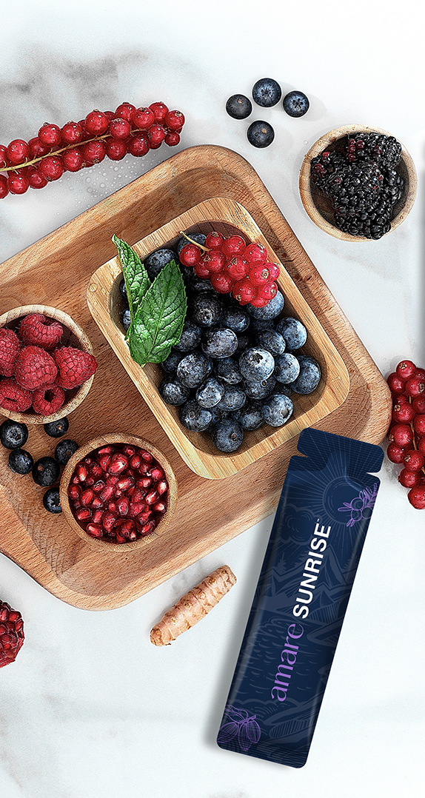
Amare Sunrise™
Ingredients
Water, fructose corn syrup, white grape (Vitis vinifera L.) juice concentrate, pear (Pyrus communis L.) juice concentrate, bilberry (Vaccinium myrtillus L.) juice concentrate, red grape (Vitis vinifera L.) juice concentrate, red raspberry (Rubus idaeus L.) juice concentrate, aronia (Aronia melanocarpa Michx.) juice concentrate, taurine, blueberry (High Bush) (Vaccinium corymbosum L.) juice concentrate, lime (Citrus aurantifolia Swingle) juice, colouring food (black carrot concentrate), thickener: dextrin, corn starch, acidity regulatory: malic acid, flavour, acidity regulatory: citric acid, concentrated pomegranate (Punica granatum L.) juice, grape (Vitis vinifera L.) skin extract, mangosteen (Garcinia mangostana) fruit juice concentrate, vitamin C (L-ascorbic acid), thickener: xanthan gum, thickener: dextrin, niacin (nicotinamide), inositol, pantothenic acid (D-pantothenate, calcium), anti-caking agent: tricalcium phosphate, grape (Vitis vinifera L.) seed extract, sweetener: steviol glycoside from Stevia, spinach (Spinacia oleracea L.), lingonberry (Vaccinium vitis-idaea) fruit juice, Canadian blueberry (Vaccinium myrtilloids Michx.) juice, pomegranate (Punica granatum L.) juice concentrate, broccoli (Brassica oleracea L.), kale (Brassica oleracea L.), vitamin B6 (pyridoxine hydrochloride), vitamin B1 (thiamine hydrochloride), riboflavin, cranberry (Vaccinium macrocarpon Aiton) fruit concentrate, panax ginseng extract, thickener: gum acacia, amla (Emblica officinalis syn Phyllanthus L.) berry extract, acai (Euterpe oleracea) berry juice, anti-caking agent: dicalcium phosphate, folic acid (pteroylmonoglutamic acid), biotin (D-biotin), vitamin B12 (cyanocobalamin).
16
16
16
Copyright © 2025 Amare Global. All rights reserved.

Slide 17
You can reach out product brochure in your official language: Sunrise EU Product Brochure
For More Please Check Out
www.amare.com

Slide 18


